Slide 1
Aortic Dissection
Dr. Jamal Dabbas
Interventional cardiologist & internist

Slide 2
Summary
An aortic dissection is a tear in the inner layer of the aorta which leads to a progressively growing hematoma between in the intima-media space. Hypertensive males between the 4th and 6th decade have the highest incidence of aortic dissection.

Slide 3
Patients complain of a sudden onset and severe pain radiating into the thorax, back, or abdomen. Initial chest x-ray shows a widened mediastinum.

Slide 4
The diagnosis is confirmed with a contrast-enhanced CT in stable patients and transesophageal echocardiography in unstable patients. Treatment options range from conservative measures (e.g., blood pressure optimization) to surgery (aortic prosthesis), depending on the localization and severity of the dissection. Complete occlusion of branching vessels and aortic rupture are common complications. Even with treatment, mortality rates associated with aortic dissection are high.

Slide 5
Epidemiology
Incidence: 40–80 years (Peak incidence: 60-80 years; in Marfan syndrome at the age of 30–50)
Sex: ♂ > ♀ (3:1)
Localization
  Ascending aorta: ∼ 65% of cases
  Descending aorta, distal to the left subclavian artery: 20% of cases
  Aortic arch: 10% of cases
  Abdominal aorta: 5% of cases

Slide 6
Etiology
Acquired
  Hypertension (most common)
    Approx. 70% of patients with aortic dissection have elevated blood pressure. This elevated pressure leads to propagation of the dissection and increases the risk of rupture.
    Exception: in patients < 40 years, less than 40% due to hypertension

Slide 7
  Trauma (e.g., deceleration injury in a motor vehicle accident, iatrogenic injury and during valve replacements or graft surgery)
  Vasculitis with aortic involvement (e.g., syphilis)
  Use of amphetamines and cocaine
  Third-trimester pregnancy (or early postpartum period)
  Atherosclerosis

Slide 8
Congenital
  Connective tissue disease (Marfan syndrome, Ehlers-Danlos syndrome)
  Bicuspid aortic valve
  Coarctation of the aorta

Slide 9
Classification
Stanford classification
Type A (proximal): ascending aorta dissection, including retrograde extension from the descending aorta (independent of the site of origin and propagation)
Type B (distal): descending aorta dissection, originating distal to the left subclavian artery

Slide 10

Stanford A = Affects ascending aorta; Stanford B = Begins beyond brachiocephalic vessels.

Slide 11
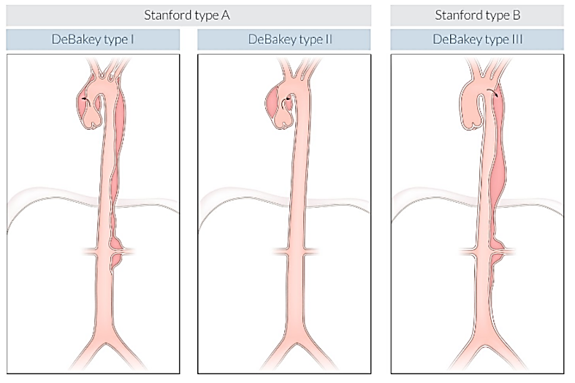
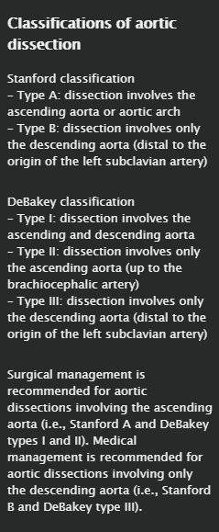

Slide 12
Pathophysiology
Anatomic site of origin
  Above (2.2 cm) the aortic root
  Aortic arch
  Distal to left subclavian artery

Slide 13
Transverse tear in the aortic intima (“entry”) → blood enters the media of the aorta and forms a false lumen in the intima-media space → hematoma forms and propagates longitudinally downwards
  → Rising pressure within the aortic wall → rupture
  → Occlusion of every single branching vessel (e.g., coronary arteries, arteries supplying the brain, renal arteries, arteries supplying the lower limbs) → ischemia in the affected areas (see “Complications” below)
  → A second intimal tear may result in a “reentry” into the primary aortic lumen.

Slide 14
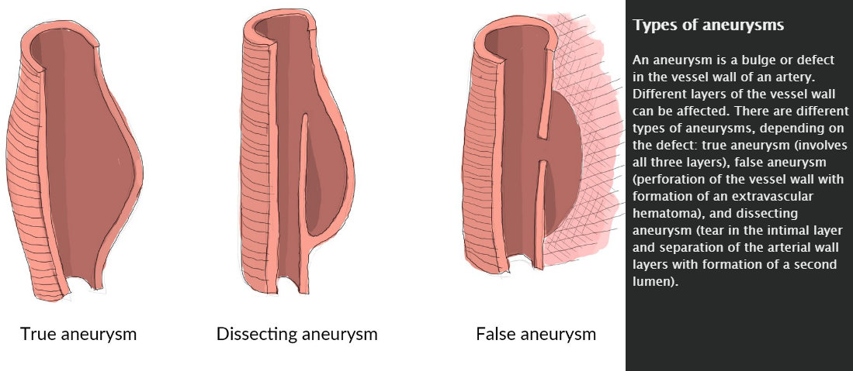

Slide 15
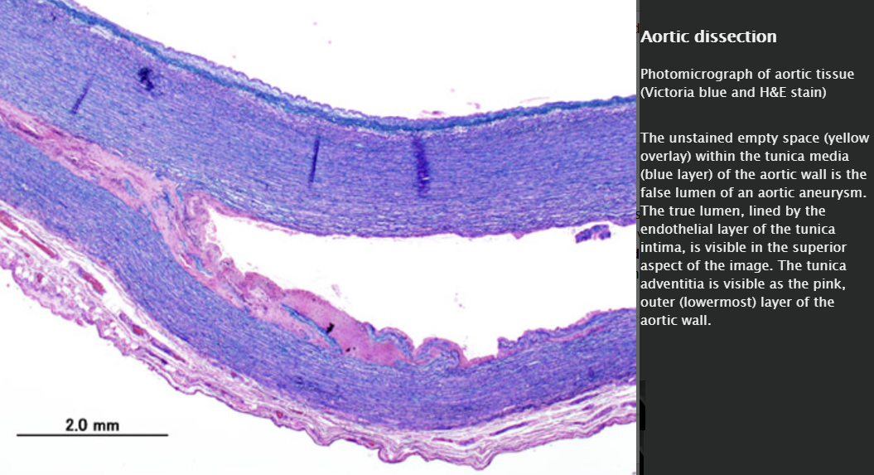

Slide 16
Clinical features
Sudden and severe tearing/ripping pain
  Location
    Anterior chest (ascending) or back (descending)
    Interscapular or retrosternal pain
    Neck and jaw
    Abdomen or periumbilical, colicky pain
  Character: migrates as the dissected wall propagates caudally

Slide 17
↑ BP (if the patient is hypotensive, consider shock from blood loss or a cardiac tamponade)
Asymmetrical blood pressure and pulse readings between limbs
Syncope, diaphoresis, confusion or agitation
A heart murmur (an aortic regurgitation in a proximal dissection)

Slide 18
Diagnostics
Initial imaging: Chest x-ray (AP view) showing a widened mediastinum (> 8 cm)

Slide 19
Definitive diagnostic tests (determine the type of lumen, location, and extent of the dissecting membrane)
  In stable patients → Contrast-enhanced CT angiography (gold standard) High sensitivity and specificity.
  In unstable patients, renal insufficiency, contrast allergy → Transesophageal echocardiography (TEE)
  If contrast-enhanced CT is contraindicated in stable patients → Magnetic resonance angiography (MRA)

Slide 20
ECG: in all patients, although normal or signs of left ventricular hypertrophy

Slide 21
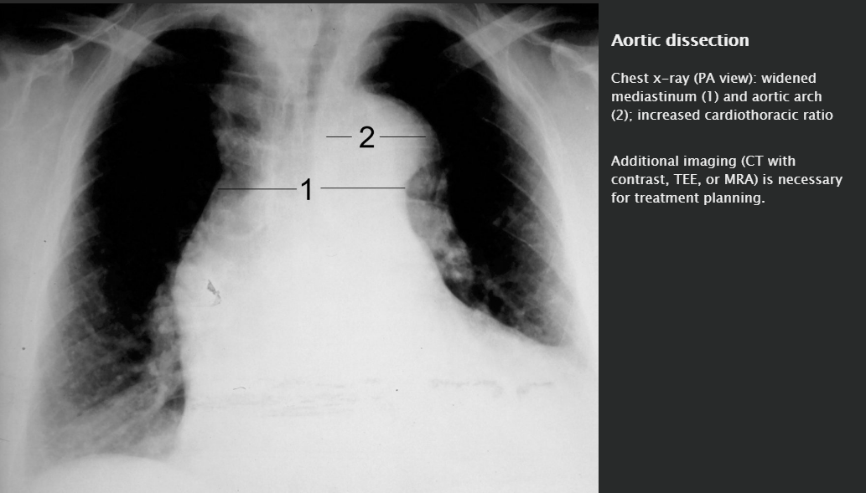

Slide 22
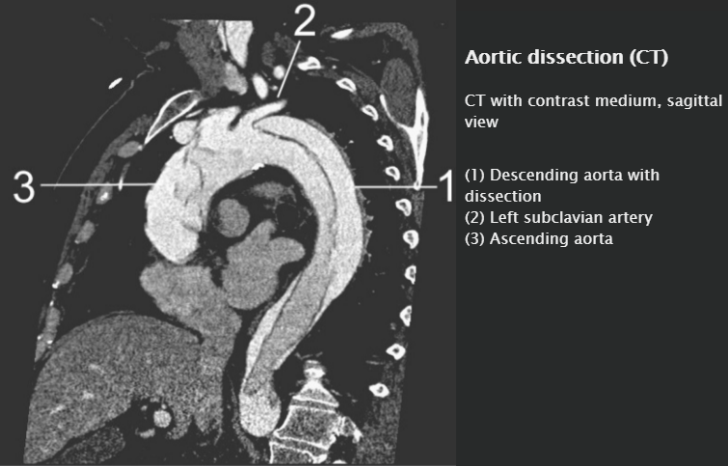

Slide 23
Treatment
Stanford A dissections (involvement of the ascending aorta) require immediate surgery, while Stanford B dissections are generally treated conservatively unless complications (e.g., rupture or occlusion) occur.

Slide 24
Conservative treatment
Sedation and analgesia (e.g., morphine)
Adequate resuscitation
Control hypertension
  Target value of the systolic blood pressure is ∼ 90–120 mm Hg
  IV labetalol, esmolol, or propanolol (best initial )
  Followed by IV sodium nitroprusside (vasodilator)

Slide 25
Surgery
Open surgery with a polyester graft implantation
Possibly, endovascular treatment: aortic stent implantation (only in type B dissections and if the operative risk is too high)

Slide 26

Avoid thrombolytic therapy in patients with suspected aortic dissection!

Slide 27
Complications
Aortic rupture and acute blood loss: acute back and flank pain (tearing pain), symptoms of shock → indication for emergency surgery

Slide 28
Complications of Stanford type A dissections
  Myocardial infarction (coronary artery occlusion)
  Aortic regurgitation (extension of the dissection into the aortic valve): new diastolic heart murmur and (exertional) dyspnea
  Cardiac tamponade combined with cardiogenic shock
  Pericarditis (slow extension of the dissection into the pericardium)
  Stroke (extension of the dissection into the carotids)

Slide 29
Complications of both Stanford type A and B dissections
  Bleeding into the thorax, mediastinum, and abdomen
  Arterial occlusion followed by ischemia of the:
    Coeliac trunk, superior/inferior mesenteric artery → acute abdomen, ischemic colitis
    Renal arteries → acute renal failure (oliguria, anuria)
    Spinal arteries → weakness of lower extremities or acute paraplegia
    Complete occlusion of the distal aorta → Leriche syndrome (aortoiliac occlusive disease)

Slide 30
Prognosis
Generally, the 30-day mortality is high

Slide 31
Prevention
Blood pressure control
Smoking cessation
Screening and repair of rapidly expanding aneurysms (also see “Therapy” and “Prevention” sections in aortic aneurysms)

Slide 32
Peripheral arterial disease
(PAD)

Slide 33
Summary
Peripheral arterial disease (PAD) is characterized by narrowing and, in final stages, occlusion of the peripheral arteries due to atherosclerotic plaques. Smoking is the most important risk factor for developing PAD.

Slide 34
PAD is often a silent disease, but patients may present with features of arterial insufficiency (intermittent claudication, reduced temperature and pulse rate in affected limb, skin discoloration, and trophic changes). On occasion, critical limb ischemia is the only presenting complaint. Segmental blood pressures and pulse volume recordings, particularly the ankle-brachial index (ABI), may support the diagnosis.

Slide 35
Further imaging may confirm and assess the location and severity of arterial stenosis or occlusion. Treatment focuses on smoking cessation, graduated exercise, avoiding extremely cold temperatures, and modifying other cardiovascular risk factors. If conservative treatment fails, interventional and surgical management is recommended for low-risk patients with potential long-term success.

Slide 36
Epidemiology
Prevalence:
  Prevalence increases with age, starting from the age of 40
Peak incidence: 60–80 years of age
Sex: ♂ = ♀

Slide 37
Etiology
Insufficient tissue perfusion due to atherosclerosis in the aorta and peripheral arteries
Often coexists with coronary artery disease (CAD), stroke, atrial fibrillation, and renal disease
See risk factors for atherosclerosis

Slide 38

PAD usually coexists with coronary artery disease. Smoking is the most important risk factor for PAD!

Slide 39
Classification
Fontaine Classification of PAD
Stage I | Asymptomatic PAD
Stage II | Pain on exertion IIa: claudication at a walking distance > 200 m IIb: claudication walking distance < 200 m
Stage III | Ischemic pain at rest
Stage IV | Necrosis/gangrene/ulcers IVa: dry necrosis, trophic disorders IVb: infection of necrotic tissue, humid gangrene

Slide 40
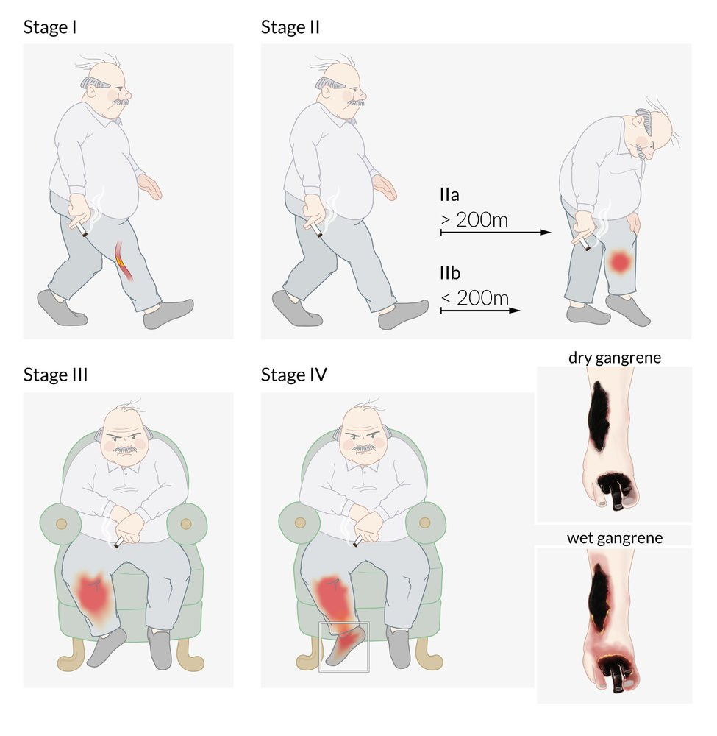

Slide 41
Clinical features
Characteristic features | Description
Silent disease | Up to 20–50% of patients with PAD are asymptomatic!
Intermittent claudication (10–35% of patients) | Pain, cramps, or paresthesia distal to arterial occlusion Femoropopliteal disease (most common) → calf claudication Aortoiliac disease (Leriche's syndrome) Level of the aortic bifurcation or bilateral occlusion of the iliac arteries Triad of bilateral buttock, hip, or thigh claudication; erectile dysfunction; and absent/diminished femoral pulses Tibiofibular disease→ foot claudication Worsens upon exertion , completely relieved by rest or lowering affected limbs Reproducible when the patient is asked to walk the same distance as when he/she was symptomatic

Slide 42
Characteristic features | Description
Absent or diminished pulses | Brachial artery Radial artery Femoral artery Popliteal artery Posterior tibial artery Dorsalis pedis artery

Slide 43
Characteristic features | Description
Trophic changes | ↓ Skin temperature ↓ Perspiration ↓ Hair on legs Brittle nails, ↓ nail growth Atrophied muscles Dry atrophic, shiny skin and/or bluish skin discoloration Skin pallor when limb is elevated and reactive hyperemia of dependency → Buerger test for examination Livedo reticularis (advanced disease) Gangrene, ulcers, necrosis (end-stage disease): also “Arterial ulcer”

Slide 44
Characteristic features | Description
Rest pain | Typically in distal metatarsals Worse at night Improved when hanging feet over bed or standing

Slide 45
Characteristic features | Description
Critical limb ischemia | The presence of any one of the following: Resting pain Ulcer Tissue loss (gangrene) Indicative of limb-threatening arterial occlusion

Slide 46
A bruit, suggestive of arterial stenosis, may be heard in > 60–70% of cases with PAD!

Slide 47
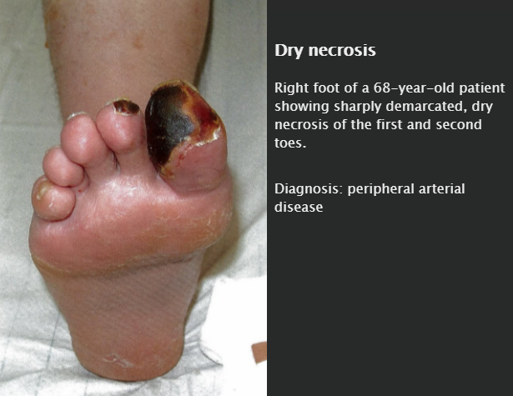

Slide 48
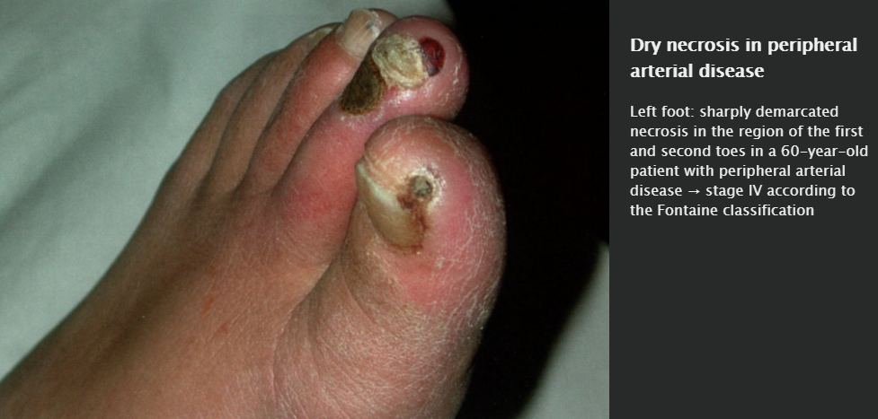

Slide 49
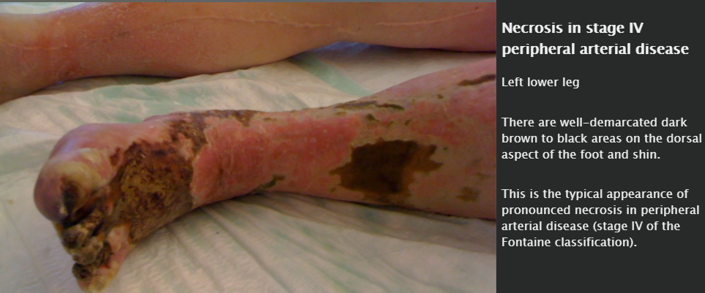

Slide 50
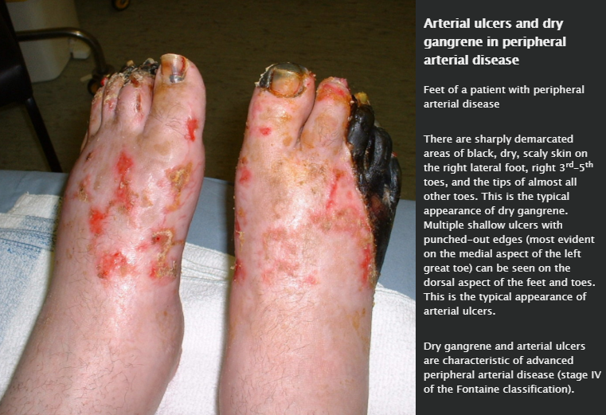

Slide 51
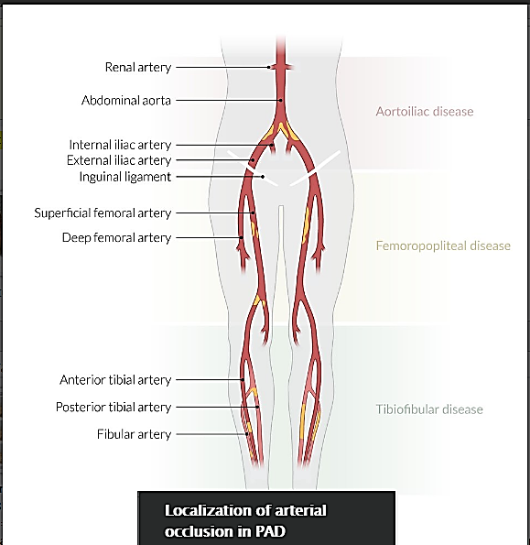

Slide 52
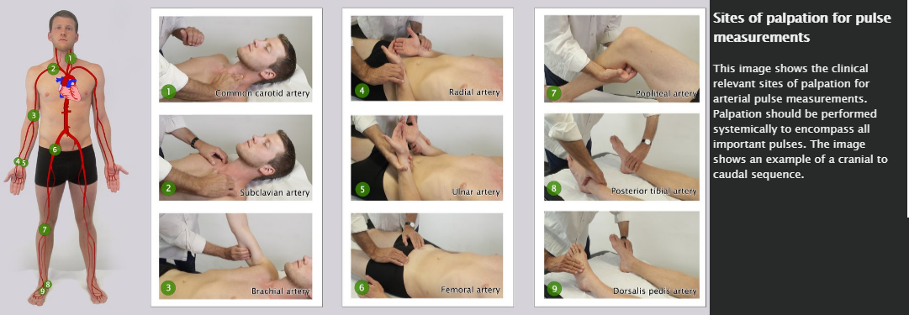
Ankle-brachial index (ABI)

Slide 53
ABI is the ratio of systolic ankle blood pressure (BP) to systolic brachial BP
Normally, ankle BP and brachial BP are equal (ABI = 1), or ankle BP is only slightly higher because of gravity (ABI ≥ 0.9)

Slide 54
Imaging
While vascular imaging is not necessarily required for diagnosis, it is useful to determine the site and severity of arterial stenosis or occlusion (especially preoperatively and postoperatively)
Color-coded duplex ultrasonography
Digital subtraction angiography (DSA): gold standard
CT angiography
MR angiography

Slide 55
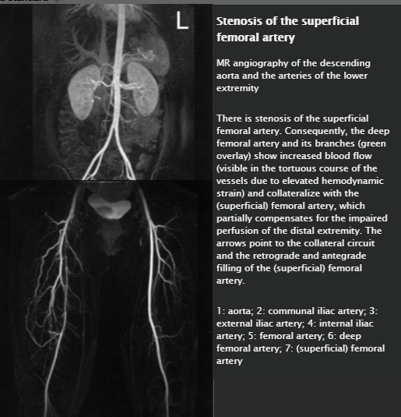

Slide 56
Differential diagnoses
Differential diagnosis of claudication
 |  |  | Patient characteristics | Clinical Features
Causes of arterial occlusion | Vasculitides | Takayasu's disease | Asian females 15–45 years | Fever, malaise, arthralgia Syncope, angina pectoris Impaired vision
 |  | Obliterating thromboangiitis | 20–40 years | Migratory thrombophlebitis Intermittent claudication, often limited to feet, calves and/or hands Raynaud's syndrome

Slide 57
Differential diagnosis of claudication
 |  | Patient characteristics | Clinical Features
Causes of arterial occlusion | (Lower-extremity) Fibromuscular dysplasia | Middle-aged women | Gradual onset of symptoms Rarely affects the extremities, leading to intermittent claudication, critical limb ischemia, and blue toe syndrome
 | Atherosclerosis | Similar risk factors as PAD | Chronic lower limb ischemia may manifest like PAD Acute limb ischemia → 6 Ps Blue toe syndrome: small vessel occlusion caused by embolus

Slide 58
Differential diagnosis of claudication
 |  | Patient characteristics | Clinical Features
Causes of arterial occlusion | Arterial embolism | Young patients without atherosclerotic risk factors | Sudden onset of symptoms 6 Ps

Slide 59
Differential diagnosis of claudication
 |  | Patient characteristics | Clinical Features
Mimics of arterial occlusion | Deep vein thrombosis | > 60 years old History of immobilization, obesity, hereditary thrombophilia or malignancy | Swelling Warmth Erythema Progressive tenderness Dull pain: worsened by walking, improved by resting
 | Spinal stenosis | Middle-aged to older patients | Bilateral neurogenic claudication
 | Diabetic neuropathy | Middle-aged to older patients High BMI | Progressive symmetrical loss of or abnormal sensation in the distal lower extremities (glove and stocking sensation) Normal ABI Neuopathic diabetic foot: warm, dry skin, palpable foot pulses

Slide 60
Treatment
Conservative
Smoking cessation!
Supervised graded exercise therapy
Foot care (especially in diabetic patients)
Avoid cold temperatures

Slide 61
Medical therapy
Modify cardiovascular risk factors: see therapy of atherosclerotic disease
  Antiplatelet therapy reduces morbidity and mortality
    Aspirin: irreversible cyclooxygenase inhibition → decreased thromboxane A2 synthesis → decreased platelet aggregation
    ADP receptor inhibitors
      Clopidogrel: inhibition of the P2Y₁₂ ADP receptor → decreased platelet activation and platelet-fibrin crosslinking
      Ticagrelor: reversible inhibition of the P2Y₁₂ ADP receptor (otherwise identical downstream effects as clopidogrel)
  Lipid-lowering agent (usually statins)
  Antihypertensive treatment
  Hyperglycemia control

Slide 62
PDE inhibitors
  Cilostazol: two beneficial mechanisms
    Phosphodiesterase 3 (PDE3) inhibition → increased cAMP → increased activity of protein kinase A → reduced platelet aggregation
    Myosin light chain kinase inhibiton → vascular smooth muscle relaxation → arterial vasodilation

Slide 63
Revascularization
Indications
  Critical limb ischemia
  Failure of conservative and pharmacologic treatment
  Inability to perform normal work or activities because of claudication

Slide 64
Minimally invasive interventional radiology: percutaneous transluminal angioplasty (PTA) with or without stenting
Surgical procedures
  Operative vascular reconstruction (bypass surgery): an autologous vein (e.g., great saphenous vein) is used to bypass the stenosis
  Endarterectomy

Slide 65
Amputation
Last resort in the event of gangrene

Slide 66
Complications
Arterial ulcer
  Definition: skin defect due to impaired blood flow to the lower extremities
  Etiology: most often seen in peripheral arterial disease
  Clinical features
    Punched-out ulcer with well-defined borders
    Usually involves the foot, particularly pressure points (e.g., lateral malleolus, tips of the toes)
    Often severe pain
  Differential diagnosis: venous ulcer

Slide 67
Infection of ulcers; sepsis
Acute limb ischemia

Slide 68
Prognosis
Intermittent claudication → good prognosis
Rest pain and/or ischemic ulcers → poor prognosis
Increased cardiovascular mortality → high risk for secondary MI or stroke

Slide 69
A low ABI in PAD is also predictive of an increased risk of all-cause and cardiovascular mortality!

Slide 70
Prevention
Primary and secondary prevention of atherosclerosis

