Slide 1

Beta Blockers
from Formulation to Clinical
仅供医疗专业人士参考

Slide 2
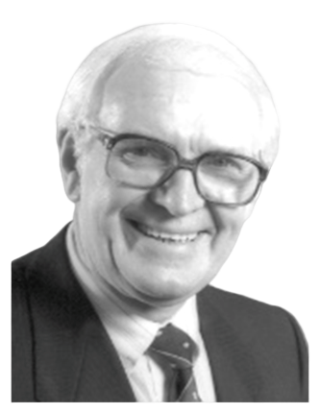
Sir James was awarded the Nobel Prize for Medicine for his achievements in β-blockers in 1988.
Scottish pharmacologist, the founder of modern pharmacology
James Black finally synthesized a beta-blocker to treat angina pectoris by blocking sympathetic nerve to reduce myocardial oxygen demand.
1950
Started research on angina pectoris due to his father’s death of heart disease
1956
Based on Ahlquist's hypothesis of adrenergic receptors, the protocol was determined.
1958
Study of β-blockers was started in ICI (a British Company, the predecessor of AstraZeneca).
James W. Black
(1924-2010)
1962
Propranolol, the first clinically effective β-blocker, was synthesized for angina pectoris by blocking sympathetic nerve to reduce myocardial oxygen demand
Scottish pharmacologist, the founder of modern pharmacology
1988
Won the Nobel Prize in medicine in 1988 for his achievements in β-blockers
Won the Nobel Prize for Physiology/Medicine in 1988
https://www.nobelprize.org/prizes/medicine/1988/summary/.

Slide 3

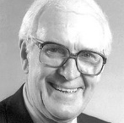

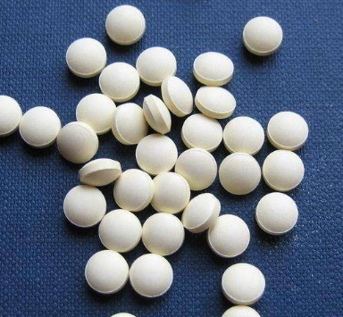
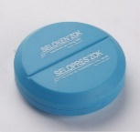

The development of β-blockers and metoprolol.
1964
1975
1988
Sir James W. Black invented the first β-blocker approved for use in clinics, propranolol
Metoprolol conventional tablets approved for marketing
Sir James W. Black gained Nobel prize
1969
1986
now
Metoprolol developed successfully
Betaloc ZOK approved for marketing
Betaloc ZOK is the only β-blocker approved in 7 indications¹
Zero Order Kinetic
Metoprolol Succinate certificate of pharmaceutical product
Notes:
Photo from the Nobel Foundation archive. https://www.nobelprize.org/prizes/medicine/1988/black/lecture/
BB is indicated for the control of a range of conditions including hypertension, angina pectoris, disturbances of cardiac rhythm, maintenance treatment after myocardial infarction and functional heart disorders with palpitations. It is available in European markets under brand names including Seloken, Seloken ZOK (extended release), Selo-Sok and Betaloc ZOK. Logimax is the fixed-dose combination of metoprolol succinate with felodipine. It is indicated for the control of hypertension.

Slide 4
Indications
AF – often first line in acute AF. Bisoprolol, atenolol or metoprolol may be used orally, or if IV is required, metoprolol (NB much smaller doses than orally!) or the short acting esmolol are useful
Heart Failure – using beta blockers in heart failure due to systolic dysfunction reduces mortality and hospital admission. Carvedilol, metoprolol and bisoprolol are recommended. However, initiation of therapy should be cautious, and is usually started in patients after an acute episode, when signs of fluid retention have resolved, but before discharge from hospital.
When used in conjunction with an ACE-inhibitor, beneficial effects are increased. ACE-inhibitor therapy should be started first.

Slide 5
Angina – highly effective at reducing symptoms but there is no evidence to suggest they reduce mortality or improve outcomes. All patients with stable angina should be on long-term beta blocker therapy, and cardioselective agents – such as atenolol or metoprolol are recommended
MI – secondary prevention – all patients with an MI (including ST elevation and non-ST elevation) should be started on a beta blocker to reduce the risk of short term complications and improve long-term survival.

Slide 6
Hypertension – most guideline now only suggest to use if other methods have been unsuccessful, and to use in conjunction with other agents
Migraine – propranolol is often used as a regular medication and reduces the frequency of attacks.

Slide 7
Adverse Effects
Bradycardia
Bronchospasm
Cold extremities
Alternation of glucose and lipid metabolism due to effects on the liver
Heartblock

Slide 8
Contraindications
Bradycardia
Peripheral vascular disease – use with caution – can cause peripheral vasospasm. Should also be avoided in Raynaud’s phenomenon for the same reason
Poorly controlled asthma – can cause bronchospasm. Consider the use of beta1-selective beta-blockers in anyone with asthma (e.g. metoprolol)
Pregnancy – avoid atenolol as can cause fetal growth retardation. Labetolol and oxprenolol are likely safe

Slide 9
Beta blockers are competitive inhibitors of beta-adrenergic receptors.
They are used mainly as anti-arrhythmic agents, but are also commonly used as secondary prevention in myocardial infarction, and as anti-hypertensives.
They are also used to treat glaucoma as they reduce aqueous humour secretion.

Slide 10



The extended-release formulations became a new focus for researchers.
The extended-release formulations can
Achieve continuous β blockade
Reduce adverse effects
Improve compliance

Slide 11

The potential advantages of producing extended-release preparations.¹
To achieve continuous and even beta-blockade
To reduce adverse effects associated with high peak plasma concentration.
once-daily dosing and thereby hopefully improve compliance.
Kendall MJ. Journal of Clinical Pharmacy and Therapeutics (1989) 14,159-1 79

Slide 12
Using one or two extended-release techniques cannot achieve the ideal slow-release effect such as Zero Order Kinetics.
Through the concept of first-order kinetics and zero-order kinetics to understand
the difference between sustained release and controlled release tablets
First-order kinetics¹
Zero-Order kinetics¹
1000
1000
MTC
MTC
800
800
600
600
Blood serum concentration(ng/L)
Blood serum concentration(ng/L)
400
Relatively rapid release after administration
400
200
200
MEC
MEC
0
0
0
50
100
150
200
0
50
100
150
200
Time(h)
Time(h)
Just release slowly
Release at a constant rate
the sustained release
the controlled release
Laracuente ML, et al. J Control Release. 2020 Nov 10;327:834-856.

Slide 13
The plasma profile is very well controlled under different conditions.
The release of Betaloc ZOK is not affected by normal physiological variations within the GI tract.¹
and concomitant intake of food
meal
pH
agitation
Under non-fasting conditions, the volunteers were given a standardized breakfast. The two plasma concentration profiles obtained were similar: the median Cmax/C24 ratios were 2.0 and 1.3 for non-fasting and fasting, respectively, and the relative systemic availability was (mean 105%), suggesting a slight but non-significant effect of food.¹
Effect of pH
Effect of agitation
% dissolution
% dissolution
100
100
80
pH 7.5
80
pH 6.8
60
50 rpm
60
pH 5.0
100 rpm
40
pH 3.0
40
150 rpm
20
pH 1.2
20
0
0
0
5
10
15
20
0
5
10
15
20
hours
hours
Note
Metoprolol tartrate should be taken on an empty stomach. Concomitant intake of food increases the bioavailability of metoprolol by 30% - 40%²
The bioavailability of metoprolol succinate is not affected by food³
Sandberg A, et al. Eur J Clin Pharmacol. 1988; 33(suppl): S3-S7.
Metoprolol Tartrate Package Insert
Metoprolol Succinate Package Insert

Slide 14
Metoprolol has a high degree of β1-receptor selectivity.
Binding affinities from competition experiments for agonists and antagonists at human β-adrenergic receptor subtypes. 50 to 80PM ¹²⁵I-CYP were used as radioligand. Experiments were done in the presence of 100 µM GTP. K_{i}-values were calculated from IC₅₀-values using the Cheng-Prussow equation and represent geometric mean values of at least 3 different experiments done in triplicate.
Within the group
of β-blockers pindolol, carvedilol, and S-propranolol were found to be non-selective for β1- vs β2-adrenergic receptors.
while atenolol, bisoprolol and metoprolol were up to 63-fold selective for β1- vs β2- adrenergic receptors.¹
Compound
β₁ -adrenergic receptor
β₂-adrenergic receptor
K_{i} (nM) 95% Confidence limit
K_{i} (nM) 95% Confidence limit
Norepinephrine
Epinephrine
Isoproterenol
Fenoterol
Salbutamol
Salmeterol
Formoterol
Terbutaline
BRL-37344
Alprenolol
Pindolol
Carvedilol
Atenolol
Bisoprolol
Metoprolol
S-Propranolol
CGP-20712
SR 59230A
CGP-12177
ICI-118551
Broxaterol
3,570
3,970
224
13,600
2,440
1,600
1,710
31,300
37,900
5.8
2.6
1.7
388
22.4
47.0
1.8
4.7
16.4
4.5
49.5
1,310
2,440-5,210
2,840-5,530
145-343
11,100-16,700
1,770-3,380
1,110-2,290
1,430-2,060
19,000-51,600
34,100-41,800
4.5-7.5
1.3-5.2
1.3-2.2
298-504
18.1-27.7
27.3-81.0
1.2-2.8
4.0-5.5
14.0-19.2
3.3-6.1
40.0-61.4
930-1,860
26,400
735
458
719
2,170
24.6
2,570
15,400
9,170
1.2
4.8
1.1
8,140
1,150
2,960
0.8
4,040
61.9
4.3
0.7
1,290
23,400-29,900
510-1,050
377-556
565-915
1,600-2,950
15.9-37.8
1,590-4,160
11,900-20,000
7,520-11,200
0.8-1.8
3.8-6.1
0.8-1.6
5,970-11,100
1,100-1,190
2,090-4,190
0.6-1.0
2,790-5,860
30.2-127
2.3-8.1
0.4-1.1
916-1,810
Metoprolol 63:1
Propranolol 1:1.8
BBs = Beta blockers; GTP = guanosine triphosphate.
Hoffmann C, et al. Naunyn Schmiedebergs Arch Pharmacol. 2004;369:151-159.

Slide 15
Clinical Use of Betaloc ZOK

Slide 16
Why its crucial to find new strategies for optimizing heart rate control?
Heart
Rate
A total of 27,814 patients were enrolled and divided into 3 groups: low HR fluctuation [<25 beats per minute (bpm)], control (25–34 bpm), and high HR fluctuation (≥35 bpm), based on the initial 24-hour HR fluctuation (calculated as the maximum HR minus minimum HR). Multivariate Cox regression and restricted cubic spline models were used.¹
Percentage of patients
This retrospective cohort study revealed that both high and low HR fluctuation correlated with increased mortality in critically ill ICU patients, providing new insights for optimizing HR control strategies.¹
Guo Q, et al. Heart rate fluctuation predicts mortality in critically ill patients in the intensive care unit: a retrospective cohort study. Ann Transl Med 2021;9(4):334.

Slide 17
Differential Effect of β-Blockers for Heart Rate Control in Coronary Artery Disease.¹
Heart
Rate
Mean resting heart rate in patients treated with each β-blocker.¹
73.5
P<0.01
72.8
70.8
Resting heart rate (bpm)
70.0
68.0
67.3
66.5
65.7
64.1
63.0
None
Carvedilol
Propranolol
Atenolol
Bisoprolol
Metoprolol
In an Observational, cross-sectional, and multicenter study with CAD patients recruited nationwide from 20 institutions. Antecedents, risk factors, and treatments were collected. Controlled RHR was considered at<70 bpm.
The study included 2897 patients treated with a BB (56.5%). The mean RHR was 69.6 bpm (12.6). A significantly lower RHR was observed in patients treated with a BB compared to the rest (67.2 vs 73.0 bpm; P < 0.01). No differences were observed in mean doses of each agent according to RHR control, except for verapamil. BB treatment was independently associated with RHR control (odds ratio [OR]: 2.42, 95% CI: 2.05–2.87; P < 0.01), and no association was found for nondihydropyridine CCBs (OR: 0.99, 95% CI: 0.96–1.02; P = 0.38). Bisoprolol (OR: 1.56, 95% CI: 1.38–1.78;P < 0.01), atenolol (OR: 2.01, 95% CI: 1.57–3.49; P < 0.01), and metoprolol (OR: 1.29, 95% CI: 1.04–1618;P = 0.04) were independently associated with RHR control.
Cordero A, Bertomeu-González V, Mazón P, et al. Differential effect of β-blockers for heart rate control in coronary artery disease. Clinical Cardiology. 2011;34(12):748-754.

Slide 18
Metoprolol succinate was superior to bisoprolol in controlling resting heart rate in HF patients even when the dosage was insufficient.
Heart
Rate
Proportion of patients
reaching the beta‐blocker target dose.¹
at baseline (blue) vs. the end of follow‐up (red).
The proportion of patients whose
resting heart rate ≥ 70 b.p.m.¹
at baseline (blue) vs the end of follow‐up (red).
Beta‐blocker dose and resting HR of consecutive ambulatory patients with a diagnosis of HFrEF (ejection fraction ≤ 35%) in sinus rhythm were reviewed at the first outpatient contact in the Cleveland Clinic Health System from the year 2000 to 2015.
Varian KD, et al. ESC Heart Fail. 2020 Oct;7(5):3049-3058.

Slide 19
Arrhythmia
Effect of Betaloc ZOK on remodeling of the heart and cardiac rhythm disturbances after myocardial infarction in patients with chronic heart failure.¹
After 6 Months
Metoprolol succinate was given to 60 patients with class I-III heart failure and ejection fraction <45% after myocardial infarction. Forty-seven patients (mean age 59.3+/-9.8 years) completed 6 months of therapy. Dynamics of ventricular arrhythmias were assessed by Holter ECG monitoring, registration of parameters of high-resolution ECG and heart rate variability. and echocardiography. Functional class of heart failure decreased in 93%, that of angina - in 55% of patients. An antiarrhythmic effect was achieved in 72% of patients. This was associated with the diminishment of left ventricular volumes and increased ejection fraction, shortening of TotQRSF, and improvement of autonomic regulation of cardiac action. No dynamics of myocardial contractility and electrophysiological remodelling occurred in patients without an antiarrhythmic effect
93%
55%
Reduction in Functional class of Heart Failure
Achievement of Antiarrhythmic Effect
Reduction in Functional class of Angina
Ventricular Volumes
Ejection
Fraction
Syrkin AL et al, Kardiologiia. 2003;43(6):48-53. https://pubmed.ncbi.nlm.nih.gov/12891311/

Slide 20
Long-term use of metoprolol reduced the risk of sudden death in MI patients by up to 40% within three years.
Myocardial Infarction
Study¹ | Number of patients | Follow-up time
Gothenburg Metoprolol Trial | 1395 | 3 months
Amsterdam Metoprolol Trial | 301 | 3 years
Stockholm Metoprolol Trial | 583 | 1 year
Belfast Metoprolol Trial | 800 | 1 year
Lopressor Intervention Trial | 2395 | 1 year
In order to get a clearer picture of the value of metoprolol treatment for secondary prophylaxis after acute myocardial infarction, individual patient data from the five different trials utilizing metoprolol as the study drug have been pooled. In the overall test, There was a significant reduction (19%) in the rate of mortality.
The reduction was observed both in men (16%) and
women (23%). In accordance with the previous findings, the reduction in total mortality was mainly due to reduced sudden cardiac deaths. Interestingly, the beneficial effect of metoprolol was not influenced by risk factors such as age, sex and smoking habits, i.e., the treatment effect was seen both in high and low-risk patients.¹
The total number of patients was 5,474 enrolled in all five studies.
Metoprolol with a dose of 200 mg was used.¹
Olsson G, et. al. Eur Heart J. 1992, Jan 13(1) 28-32.

Slide 21
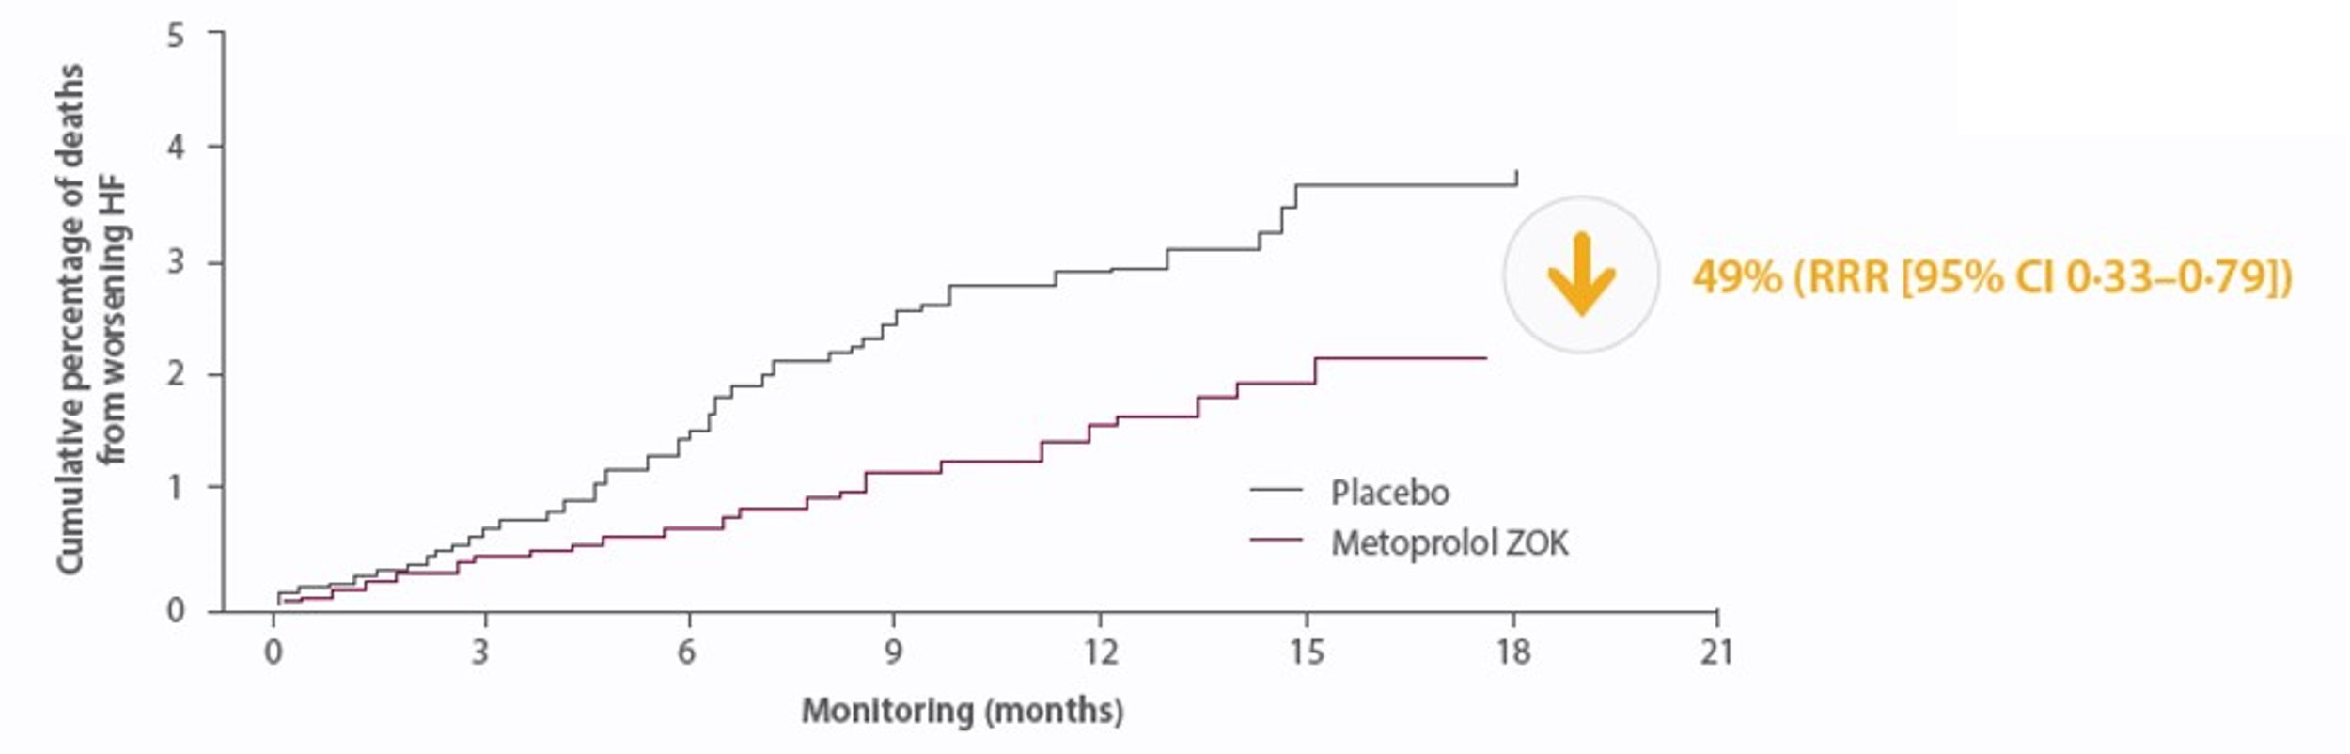
Betaloc ZOK reduces the relative risk of mortality by 49% in HF.
Heart Failure
once daily Betaloc ZOK added to standard therapy improved survival and lowered the risk of sudden death and death from worsening heart failure in patients with mild to severe chronic heart failure secondary to left-ventricular systolic dysfunction of ischemic or non-ischemic cause.¹
5
beginning with 12.5 or 25mg, qd
4
49%
(RRR[95%CI 0.33-0.79])
3
Cumulative percent age of deaths
from worsening HF
2
1
Placebo
Metoprolol CR/XL
0
0
3
6
9
12
15
18
21
Monitoring(months)
CI = confidence interval; MERIT-HF = Metoprolol CR/XL Randomized Trial in Heart Failure; RRR = relative risk reduction.
*The study was preceded by a single-blind, 2-week placebo run-in period, where 3991 patients were enrolled with chronic HF in New York Heart Association (NYHA) functional class II-IV and with an ejection fraction of 0.40 or less, stabilized with optimum standard therapy, in a double-blind, randomized controlled study, with a primary endpoint of all-cause mortality, analyzed by intention-to-treat.
MERIT-HF Study Group. Lancet. 1999;353(9169):2001-2007.

Slide 22
Betaloc ZOK reduces hospitalization in patients with HF.
Heart Failure
In patients with symptomatic heart failure, Betaloc ZOK improved survival and reduced the need for hospitalizations due to worsening heart failure.¹
13%
20%
32%
The mean daily dose of metoprolol CR/XL at the end of the study was 159 mg once daily.
Hjalmarson A, et al. JAMA. 2000 Mar 8;283(10)1295-302.

Slide 23
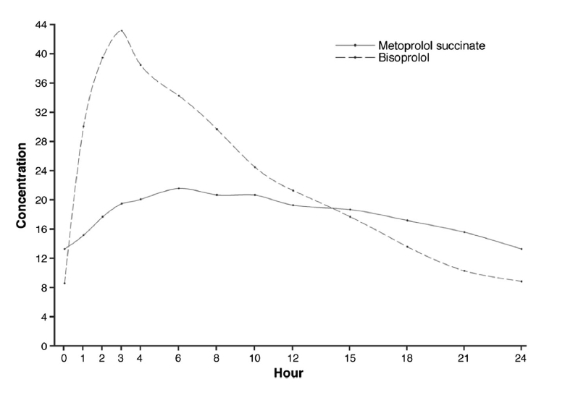
In Silico Comparison Between Metoprolol Succinate and Bisoprolol on 24-Hour Systolic Blood Pressures.
Hypertension
Plasma concentrations at
Steady-state over the 24-h dose
interval: bisoprolol and
metoprolol succinate
*
*
*
Bisoprolol and metoprolol succinate provide comparable overall blood pressure-lowering activity.
However, there are differences between the two drugs in the diurnal pattern of their antihypertensive effects, with metoprolol succinate providing greater efficacy toward the end of the 24-h day.¹
In Silico Comparison Between Metoprolol Succinate and Bisoprolol on 24-Hour Systolic Blood Pressures

Slide 24
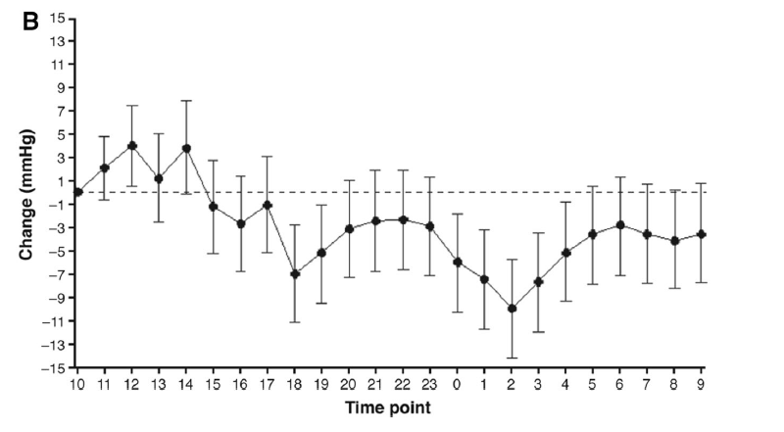
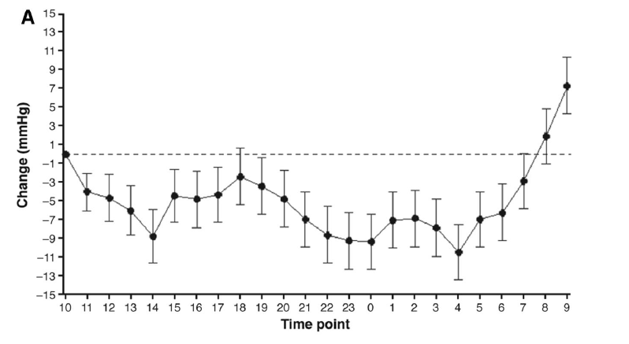
In Silico Comparison Between Metoprolol Succinate and Bisoprolol on 24-Hour Systolic Blood Pressures.
Hypertension
Estimates (±95 % confidence intervals) of changes in systolic blood pressure (BP, SYS) values. A. Bisoprolol, B. Metoprolol
*
*
*
The pharmacokinetics of metoprolol CR/ZOK are dominated by a protracted uptake period extending over [10 h and (in comparison with bisoprolol) rapid elimination, with the net result of a more flat plasma concentration curve and a less varying effect profile.
Thus, when compared with bisoprolol, metoprolol CR/ZOK is likely to have a temporally less varying blood pressure-lowering effect over the 24-h day¹
In Silico Comparison Between Metoprolol Succinate and Bisoprolol on 24-Hour Systolic Blood Pressures

Slide 25
Betaloc ZOK resulted in a continuously steady lowering of BP at 24h after administration (VS bisoprolol).
Hypertension
Superior to bisoprolol in BP reduction 24h after administration
4 weeks¹
8 weeks¹
Change from Baseline in Resting BP (mmHg)
Systolic BP
Diastolic BP
Systolic BP
Diastolic BP
*
*
5.8
6.7
*
*
3.8
4.2
Betaloc ZOK 100mg, qd
Bisoprolol 10mg, qd
* Compared with Bisoprolol, P<0.01
Kronig B. Verh Dtsch Ges Herz Kreislaufforsch. 1990;22:224-229.

Slide 26
Betaloc ZOK 100mg reduced the number of angina pectoris per week by 84% in patients with stable angina.
Angina
*P＜0.001 vs. baseline¹
*P＜0.005 vs. baseline¹
78%
84%
*
*
Fifty-two patients with a history of stable exercise-induced angina pectoris and at least six episodes of significant ST-segment depression during 24-h ambulatory electrocardiographic monitoring after 9 days of placebo were included in the study. The patients first completed a 9-day placebo run-in phase with additional administration of a long-acting nitrate during the first 7 days. They then received in a randomized sequence metoprolol CR/XL and amlodipine each for 4 weeks. During placebo treatment and at the end of each phase of active treatment, the patient’s clinical progress was assessed, and a 24-h ECG monitor was performed.
Klein G, et al. J Clin Pharm Ther. 1997 Oct-Dec;22(5-6):371-8

Slide 27
Metoprolol significantly improved the ischemic burden of patients with chronic stable angina compared with CCB.
Angina
There was a 76% reduction in the duration of the total ischemic burden by metoprolol as compared to 43% by diltiazem (P<0.01).¹
There was a 40% reduction in the frequency of total ischemic burden by metoprolol as compared to 24% by diltiazem (P<0.02).¹
Mean reduction in duration of total ischemic burden
Mean reduction in the frequency of total ischemic burden
76%
400
P<0.01
10
40%
P<0.02
24%
43%
300
8
364
8.2
6
8.0
Mean duration in minutes
295
Mean Episodes/48 hour
200
4
6.1
4.9
100
169
2
88
0
Metoprolol
Diltiazem
0
Metoprolol
Diltiazem
Control
After therapy
Control
After therapy
Ahuja RC, et al. Int J Cardiol. 1993;41:191-199.

Slide 28
Safety profile of Betaloc ZOK

Slide 29
Is the safety profile of Betaloc ZOK favorable?
In the MERIT-HF study,
the overall incidence of AEs was lower in the Betaloc ZOK group than in the placebo group¹
Incidence of AEs (%)
MERIT-HF study was a double-blind, randomized, controlled study. 3991 patients with CHF in 13 European countries and the United States enrolled on this study. The initial dose of metoprolol CR/XL was 12.5/25 mg once per day, and the target dosage was 200 mg once per day. The mean follow-up was 1 year.
Hjalmarsson Å et al, JAMA 2000;283:1295-302.

Slide 30
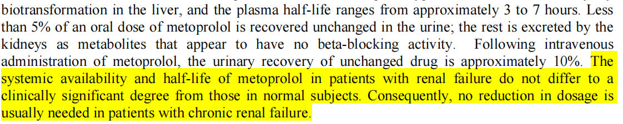
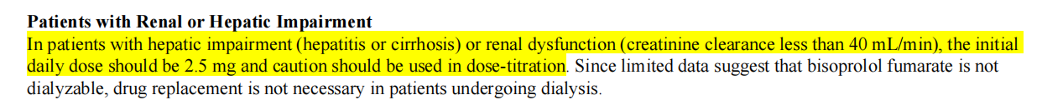
Patients with chronic renal failure usually do not need to reduce the dosage of metoprolol.
The Food and Drug Administration (FDA)
METOPROLOL SUCCINATE EXTENDED-RELEASE TABLETS¹
ZEBETA (BISOPROLOL FUMARATE) TABLETS - bisoprolol fumarate tablet²
The systemic availability and half-life of metoprolol in patients with renal failure do not differ to a clinically significant degree from those in normal subjects. Consequently, no reduction in dosage is usually needed in patients with chronic renal failure¹； while the initial daily dosage of bisoprolol fumarate should be 2.5 mg for the patients with hepatic insufficiency (hepatitis or cirrhosis) or renal insufficiency (creatinine clearance below 40 mL/min) and should be used with caution Dose titration².
https://www.accessdata.fda.gov/drugsatfda_docs/label/2006/019962s032lbl.pdf
https://www.accessdata.fda.gov/drugsatfda_docs/label/2007/019982s014lbl.pdf

Slide 31
Metoprolol had no effect on glucose and lipid metabolism.
The risk of new-onset diabetes reported in MERIT-HF was even lower than in the placebo group.¹
β1-blockers had no effect on serum lipids.²
Lipids change | β-blocker | selective
Total Cholesterol | NC | NC
LDL Cholesterol | NC | NC
Triglyceride | +0.35 | -0.06
HDL Cholesterol | -0.10 | NS
The risk of new-onset diabetes(%)
NC = no significant change (as per the study)
Deedwania PC, et al. Am Heart J. 2005;149(1):159-167.
Kasiske BL, et al. Ann Intern Med.1995;122(2):133-41.

Slide 32
Metoprolol, a β1 - selective blocker, can be used safely at the maximum dose in CAD patients with COPD.¹
Fifty patients (aged 57.3 +/-10.1 years) were enrolled in this study; 27 patients received metoprolol CR/XL(controlled release), and 23 received metoprolol (conventional) and titrated up to the maximum tolerated dose. The clinical controls were done during the first week and then in the first and third months.
There was no significant decrease in forced expiratory volume in 1 s (FEV1) in either group (basal vs last FEV1: 54.5% 13.4% vs 54.3% 13% in the metoprolol CR/XL group and 49.6% 14.5% vs 53.2% 12.8% in the metoprolol group). No adverse event was experienced.
Metoprolol, a β1-selective blocker, can be used safely at the maximum dose in CAD patients and non-asthmatic patients with COPD.
Camsari A, et al. Heart Vessels. 2003 Sep;18(4):188-92.

Slide 33
Betaloc ZOK is the only β-blocker approved with 7 indications.
 | Hypertension | Angina | Post MI | CHF | Arrhythmias | Heart Disorder with palpitation | Migraine Prophylactic
Metoprolol Succinate¹ | √ | √ | √ | √ | √ | √ | √
Bisoprolol² | √ | √ | × | √ | × | × | ×
Nebivolol³ | √ | × | × | √ | × | × | ×
Carvedilol⁴ | √ | √ | × | √ | × | × | ×
Metoprolol Succinate certificate of pharmaceutical product
Bisoprolol Certificate of pharmaceutical product
Nebivelol Certificate of pharmaceutical Product
Carvedilol certificate of pharmaceutical Product

Slide 34
Equivalent Doses Between Betaloc ZOK® and Bisoprolol in Patients With Hypertension and in patients with HF in Clinical Practice.
Equivalent Doses Between Betaloc ZOK® and Bisoprolol and in patients with HF in Clinical Practice.¹
Equivalent Doses Between Betaloc ZOK® and Bisoprolol in Patients With Hypertension.²
Bisoprolol Dose
Equivalent
Betaloc ZOK® Dose
Bisoprolol Dose
Betaloc ZOK® Dose
2.5 mg OD
Initiate
Betaloc ZOK®
24h after discontinuation of bisoprolol
50 mg OD
1.25 mg OD
25 mg OD
5 mg OD
100 mg* OD
2.5 mg OD
50 mg OD
5 mg OD
100 mg* OD
10 mg OD
150-200 mg OD
10 mg OD
150-200 mg OD
Switch between bisoprolol and Betaloc ZOK® at a daily dose conversion ratio of 1:20
Albert NM. Crit Care Nurse. 2007;27:62-72.
Begic E, et al. CMBEBIH. 2017;62:660-665.

