Slide 1
CPR, general principles
Dr. Jamal Dabbas
Interventional cardiologist & internist

Slide 2
1-If the patient isn’t breathing, is unconscious & has no pulse CPR should be applied immediately. Always remember, proper CPR begins with chest compressions.

Slide 3
2-It's important to note: that death is most likely to occur after 10 minutes of loss of oxygen to the brain.
From 6 to 10 minutes brain damage is expected.
From 4 to 6 minutes brain damage is very possible.
And from 0 to 4 minutes brain damage is virtually non-existent.

Slide 4
3-Chest compressions combined with breathing into the patient will carry the now oxygenated blood throughout the body and into the brain. CPR acts like an artificial heart moving the blood rich in oxygen to the brain.

Slide 5
4-Untrained rescuers should provide Compression-only CPR since it's easy for an operator (dispatcher) to provide and guide instructions over the telephone.

Slide 6
5-Check the patient and see if he/she is conscious or not.
Do not check for a pulse because time is of the essence and finding a pulse can take too long.
Call out to the patient asking, “Are you okay?” Repeat if necessary, and if the patient doesn't respond, immediately call 911 For no more than 10 seconds, check for life: listen for any sounds, put your cheek next to the patient’s mouth to feel any breaths & check for clear Airway, while you place the person on their back on a hard surface. Open the patients airway with a head-tilt, chin-lift technique.

Slide 7
If patient is unresponsive and is not breathing or has abnormal breathing (ie. Agonal breathing) and no definitive pulse was, immediately begin chest compressions of at least 2 inches in depth (≥ 1/3 the anterior-posterior depth of the chest in children or infants) at a rate of 100-120 compressions per minute.

Slide 8
After performing 30 compressions administer two (2) rescue breaths via mouth to mouth, mouth to mask or through stoma as appropriate. For children and infants, if there are two rescuers performing CPR, the ratio of compressions to ventilations changes to 15:2.
After the two rescue breaths have been administered immediately resume chest compressions.

Slide 9
Repeat the cycle of 30 chest compressions and two rescue breaths and use the AED/Defibrillator as soon as it is available. Continue CPR until properly relieved by rescue personnel.

Slide 10
6-It's important to note: that the AHA guidelines recommend in-confident performers should, at least, perform chest compressions upon the patient, since studies show chest compressions can be as effective as the combination of CPR.

Slide 11
7-A is for Airway during first assessment of need for CPR. Clear the Airway
Check for any obstructions, such as the tongue, foreign objects, vomit, swelling, or food blocking the patient’s throat or windpipe (finger-swipe, if necessary).

Slide 12
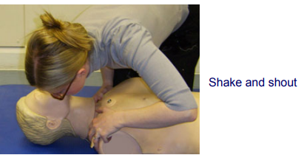
Check for any Response

Slide 13
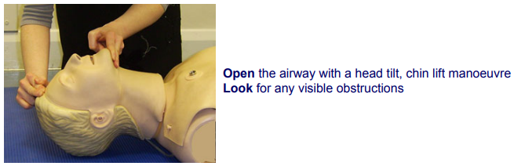

Slide 14
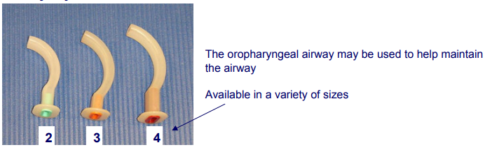

Slide 15
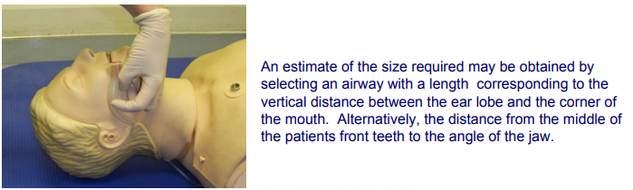

Slide 16
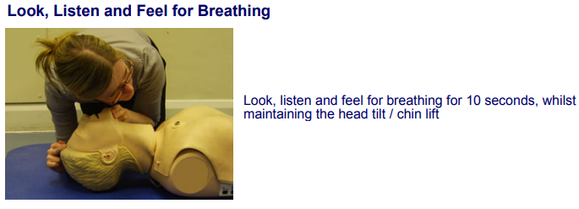

Slide 17
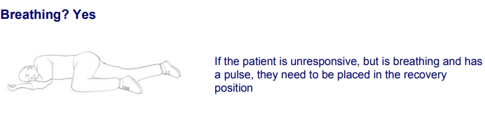

Slide 18
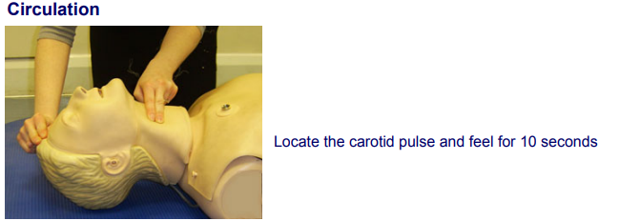

Slide 19
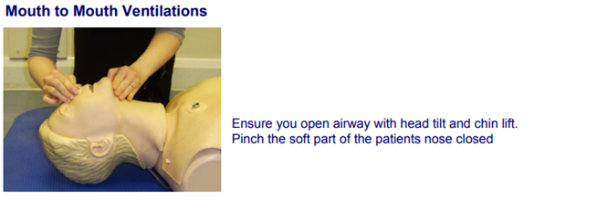

Slide 20
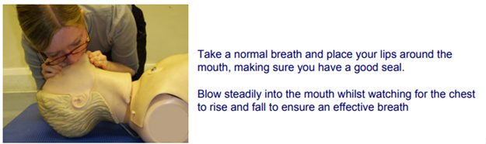

Slide 21
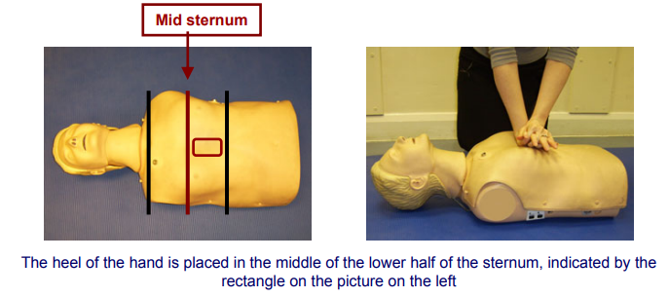
Not Breathing, No Pulse?
Commence CPR at a ratio of: 30 chest compressions : 2 ventilations
Chest Compressions

Slide 22
Make sure the patient is on a solid surface (on the backside). Open the patient’s airway by tilting the head back ,while gently lifting the chin with your other hand. Then if no breathing ,go to B , B is for Breathing. Mouth-to-Mouth Rescue Breathing: Perform mouth-to-mouth; however, it can also be performed mouth-to-nose, or mouth-to-mask while you pinch the patient’s nose shut.

Slide 23
8-When performing the breathing technique make sure to give two breaths for 1 second each.

Slide 24
How to perform chest compressions
Compressions for an Adult/Child
1. One hand over the other with your fingers interlocked (for very small adults and small children you may optionally only use one hand).

Slide 25
2. Place your joined hands palm down with the heel of your hand on the lower half of the patient's breastbone. For an average adult, this means that your middle finger should be somewhat in line with the patient's nipple. Be careful to avoid placing your hands too low as compressions performed too low can cause the xiphoid process break off, lacerate the liver, etc.

Slide 26
3. Place yourself so that you can compress straight down at a 90° angle to the patient's chest with your arms fully extended.

Slide 27
4. Compress to the correct depth at a rate of 100-120 compressions/minute, allowing for full chest recoil after each compression. Avoid leaning on the patient's chest as this will not allow for full chest recoil.

Slide 28
  For an adult: Push down at least 2 inches (5 cm) but no more than 2.4 inches (6 cm) for each compression.
  For a child: Push down at least 1/3 the anterior-posterior diameter of the chest for each compression. Do not exceed a depth of 2.4 inches (6 cm).

Slide 29
Follow proper protocol for the rate of compressions to ventilations. For adults and children with a single rescuer, this is generally 30:2. Two-rescuer CPR with a child uses a 15:2 compression to ventilation ratio.

Slide 30
When someone suffers sudden cardiac arrest, which comes first: using the AED or providing CPR?
If you witness the sudden cardiac arrest and there are people around, you want to first tell someone to call 9-1-1 and then tell someone to go get the AED.
Then, start performing CPR immediately and don’t stop until the person comes back with the AED. Use the AED as soon as it arrives!

Slide 31
(Although CPR is very important, when someone is in cardiac arrest, they ultimately need to be shocked by an Automated External Defibrillator) and then you provide CPR after the first shock when the AED tells you to.

