Slide 1
Cardiovascular Examination lecture
By : Dr. Jamal Dabbas
Interventional Cardiologist and internist

Slide 2
OBJECTIVES
JUGULAR VENOUS PULSE
UNDERSTAND/ HEAR S1 AND S2
S3 AND S4
HEAR SYSTOLE & DIASTOLE
DESCRIBE HEART MURMURS
HEAR 3 SYSTOLIC MURMURS

Slide 3
Sitting bolt upright, your dyspneic (short of breath) patient has visible jugular venous pulsations to the angle of his jaw, which is 12 cm above his sternal angle. What is his right atrial pressure? Why might he be short of breath?

Slide 4
History
Dyspnea
Chest pain
Palpitations
Syncope
Hemoptysis
Edema

Slide 5
General examination
Appearance. | Level of consciousness (altered mental status) Skin and mucous membrane (color changes, temperature, dehydration) Central cyanosis (see features of congenital heart defects and congestive heart failure) Pallor (e.g., anemia) Plethora (e.g., polycythemia) Xanthomas (e.g., dyslipidemia) Syndromic facies (e.g., in trisomy 21, trisomy 18; associated with congenital heart defects) Features of rheumatic fever: migrating polyarthritis, erythema marginatum, subcutaneous nodules Signs and symptoms of left-sided heart failure Signs and symptoms of right-sided heart failure

Slide 6
Hands | Perfusion (venous obstruction, conditions associated with a decreased cardiac output): Temperature Capillary refill time Cyanosis Palms: Osler nodes, Janeway lesions (see “Clinical features” of infective endocarditis) Nails: clubbing, splinter hemorrhages
Face | Malar flush (red cheeks, seen in patients with mitral stenosis) Swollen face
Eyes | Signs of dyslipidemia (xanthelasmas, arcus lipoides corneae) Signs of hypertensive retinopathy (ophthalmologic exam)

Slide 7
Mouth | Poor dental hygiene High arched palate (Marfan syndrome)
Neck | Carotid pulse Jugular venous pulse ( clinical assessment of central venous pressure)
Other | Lung bases: pulmonary edema Lower limbs Peripheral edema Signs of venous insufficiency (e.g., varicose veins) Signs of stroke

Slide 8
Central venous pressure
The jugular venous pulse (JVP) can be used to estimate the central venous pressure (CVP) and provides information about fluid status and cardiac function.

Slide 9
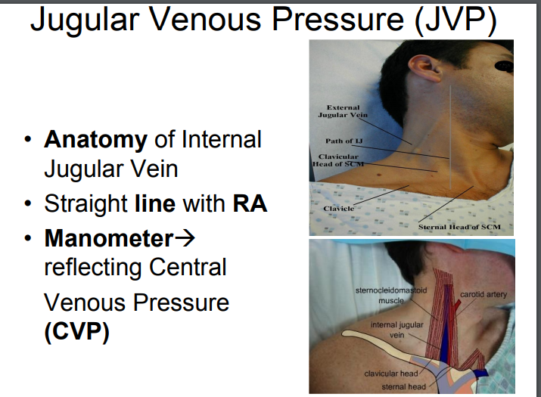

Slide 10
JUGULAR VENOUS PULSE
WHAT: VISIBLE PRESSURE CHANGES IN RIGHT ATRIUM
WHERE: UNDER STERNOCLEIDOMASTOID MUSCLE
WHY: DIAGNOSE HEART FAILURE, FLUID OVERLOAD, AV BLOCK

Slide 11
JUGULAR VENOUS PULSE
STERNAL ANGLE IS 5 CM ABOVE RIGHT ATRIUM
RIGHT ATRIAL PRESSURE = HEIGHT OF JVP ABOVE STERNAL ANGLE + 5
NORMAL RA PRESSURE: 5-10 CM H2O

Slide 12
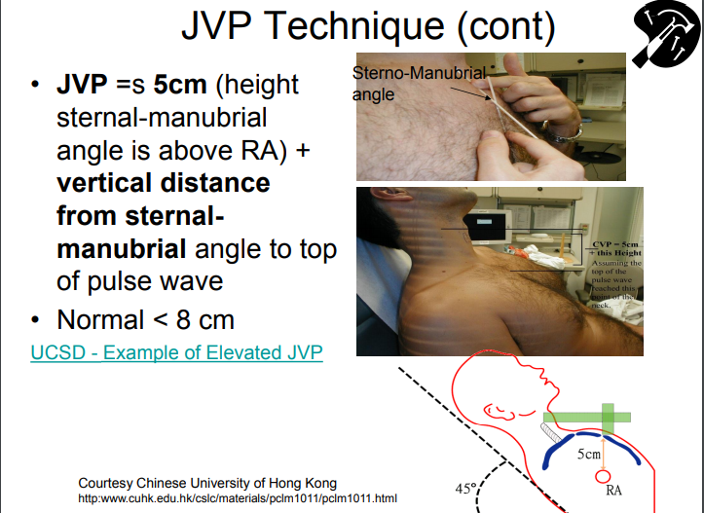

Slide 13
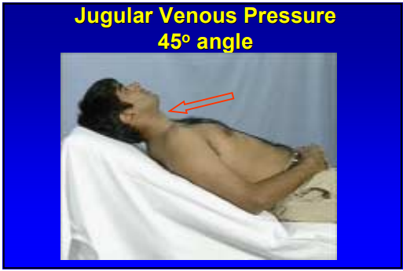

Slide 14
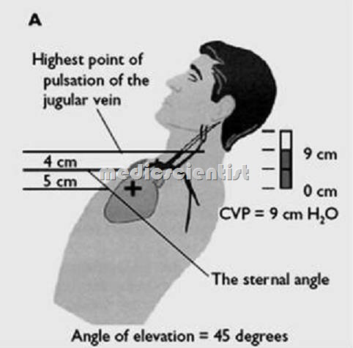

Slide 15
Approach
The patient should be in supine position, torso elevated to 45 degrees, and the head extended backward and turned to the left (the neck veins should not be visible and collapse in this position).
  Identify the venous pulsation of the internal jugular vein.
  Determine the height of the internal jugular venous filling pressure.
  The hepatojugular reflux may be tested if the JVP cannot be visualized properly.
Physiological JVP: waveform with the following components
  a wave → atrial contraction causes a peak in JVP; absent in atrial fibrillation
  c wave → RV contraction → closed tricuspid valve bulges into atrium → second peak in JVP
  x descent → atrial relaxation and ventricular contraction → inferior displacement of closed tricuspid valve → a drop in JVP; absent in tricuspid regurgitation

Slide 16
  v wave → increased right atrial pressure during filling period against the closed tricuspid valve; prominent in tricuspid insufficiency and right heart failure
  y descent → RA pressure decreases as blood is pumped into the right ventricle; prominent in tricuspic insufficiency, and constrictive pericarditis; absent in cardiac tamponade, and tricuspid stenosis
Evaluation of pathological JVP: > 4 cm is considered elevated.
  Signs of elevated jugular venous pressure
    Jugular venous distention
    Hepatojugular reflux
Conditions associated with elevated JVP: e.g., right heart failure, fluid overload, tricuspid valve dysfunction, SVC syndrome, pericardial effusion, tamponade, pulmonary hypertension

Slide 17
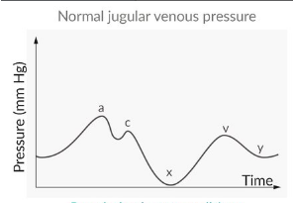

Slide 18
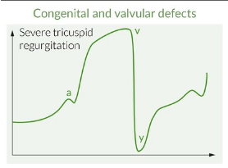

Slide 19
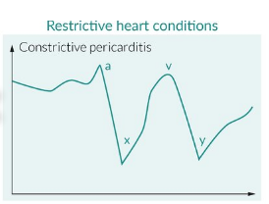

Slide 20
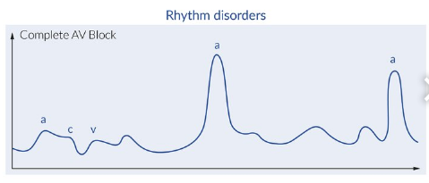

Slide 21
JUGULAR VENOUS PULSE
x
c
y
a
v

Slide 22
JUGULAR VENOUS PULSE
A: ATRIA CONTRACT
C: CLOSURE OF TRICUSPID VALVE
x: ATRIA BEGIN TO FILL
V: VOLUME OF ATRIA INCREASES
y: TRICUSPID VALVE OPENS, VENTRICLES FILL

Slide 23
WHICH POINT ON THE JUGULAR VENOUS PULSE OCCURS NEAR THE BEGINNING OF DIASTOLE?

Slide 24
ATRIOVENTRICULAR DISSOCIATION/ AV BLOCK
ATRIA AND VENTRICLES CONTRACT INDEPENDENTLY
ATRIA THUS CONTRACT AGAINST CLOSED AV VALVES
CANNON A WAVES

Slide 25
Blood pressure
Approach
The patient should be sitting for several minutes before measuring blood pressure.
Use correct cuff size.
The patient should be asked to rest his/her straight arm horizontally on a surface at heart level.
Record the pressure in both arms (and legs) and note any differences.
Determine the systolic and diastolic blood pressure value.
Repeat measurement.
Ambulatory blood pressure measurement (24 hours) may be helpful in establishing the average and peak blood pressure values during daily activities.

Slide 26
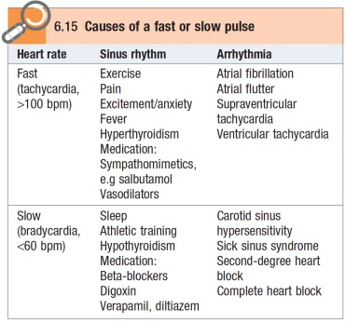
Pulses
A pulse wave is produced by ventricular contraction during systole.

Slide 27
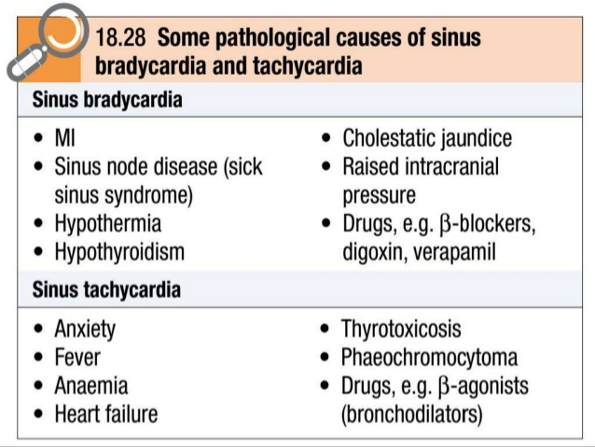

Slide 28
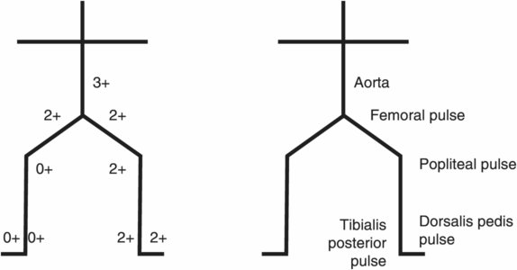

Slide 29
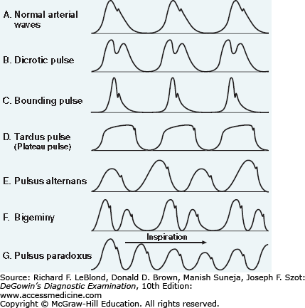

Slide 30
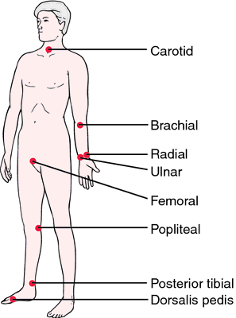

Slide 31
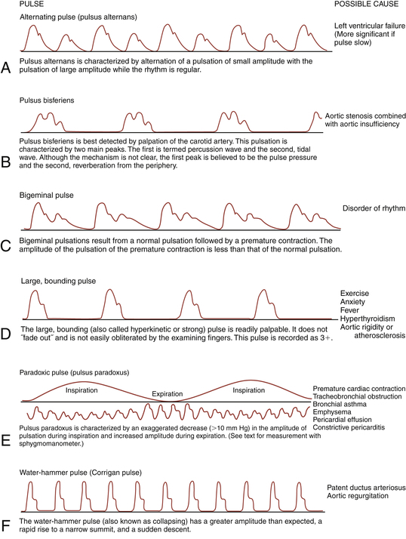

Slide 32
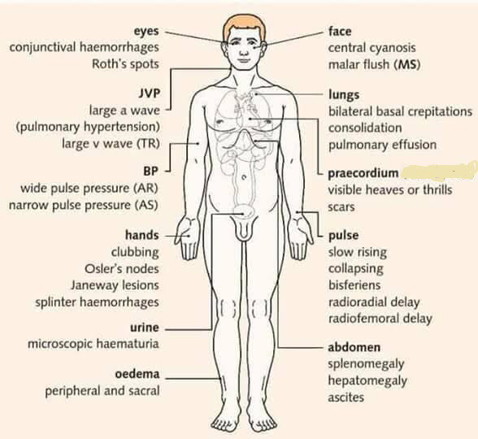

Slide 33
Approach
Three finger method: palpation with 2nd–4th fingertips
Palpation of the common carotid artery, radial artery, abdominal aorta, femoral artery, popliteal artery, tibialis posterior artery, and dorsalis pedis artery.
The pulse of the carotid artery should NEVER be palpated bilaterally and simultaneously!
  Risk of compression of vessels → cerebral hypoperfusion → syncope
  Risk of hyperstimulation of the carotid sinus reflex → bradycardia/low blood pressure → cerebral hypoperfusion → syncope
The thumb of the examiner should never be used to take the pulse as it has its own strong pulse, which might be mistaken for the patient's pulse!

Slide 34
POINT OF MAXIMUM IMPULSE (PMI)
CONTRACTION OF LEFT VENTRICLE
FIFTH INTERCOSTAL SPACE, MIDCLAVICULAR LINE
BRIEF; IF SUSTAINED, SUGGESTS HEART FAILURE

Slide 35
FOUR VALVE AREAS
AORTIC: RIGHT STERNAL BORDER
PULMONIC: LEFT UPPER STERNAL
TRICUSPID: LEFT FOURTH INTERCOSTAL SPACE
MITRAL: APEX (5TH INTERCOSTAL SPACE, MIDCLAVICULAR LINE)

Slide 36
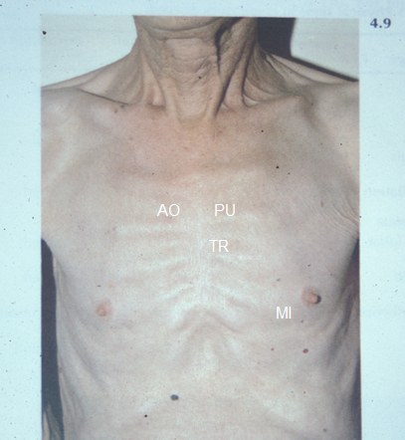

Slide 37
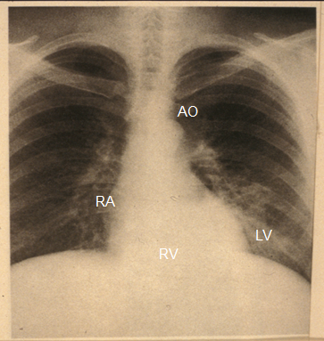

Slide 38
WHAT MAKES NOISES?
VALVES CLOSING: S1, S2
BLOOD STRIKING LEFT VENTRICULAR WALL: S3, S4
TURBULENCE: MURMURS

Slide 39
S1
AV VALVES CLOSING (MITRAL AND TRICUSPID)
START OF SYSTOLE
LOUDEST AT APEX

Slide 40
S2
SEMILUNAR VALVES CLOSING: AORTIC AND PULMONIC
A2 BEFORE P2
SPLITS WITH INSPIRATION AT PULMONIC AREA (LUSB)
LOUDEST AT BASE (TOP OF HEART)

Slide 41
S3
EARLY DIASTOLE (SOON AFTER S2)
BLOOD RUSHES IN JUST AFTER MITRAL VALVE OPENS, STRIKING LV WALL (PALPABLE)
AT APEX ONLY
CONGESTIVE HEART FAILURE (OR HEALTHY YOUNG PERSON)

Slide 42
S4
ATRIAL CONTRACTION
JUST BEFORE S1 (MITRAL VALVE CLOSURE) – LATE IN DIASTOLE
BLOOD STRIKES STIFF LEFT VENTRICLE (PALPABLE, AT APEX)
SIGN OF HIGH BLOOD PRESSURE OR HEART ATTACK (MI)

Slide 43
S4 QUESTION
SHORTLY AFTER S3?
HEALTHY ATHLETES?
REDUCED VENTRICULAR ELASTICITY
INTERMITTENT IN ATRIAL FIB?

Slide 44
HEART MURMURS
TURBULENCE
INCREASED FLOW ACROSS VALVE
TIGHT VALVE (STENOSIS)
LEAKY VALVE (REGURGITATION)
HOLE (SEPTAL DEFECT)

Slide 45
DESCRIBING MURMURS
SYSTOLIC (BETWEEN S1 AND S2) OR DIASTOLIC (AFTER S2)
INTENSITY: 1/6 TO 6/6
QUALITY (“SHAPE”)
LOCATION (VALVE AREA)

Slide 46
INTENSITY
1/6: NEED TRAINING TO HEAR
2/6: ANYONE WHO LISTENS WELL
3/6: LOUD
4/6: LOUD AND PALPABLE (THRILL)
5/6: HEAR WITH STETHOSCOPE PERPENDICULAR TO CHEST
6/6: DON’T NEED STETHOSCOPE

Slide 47
QUALITY/ SHAPE
DIAMOND: CAN HEAR S1 AND S2: STENOSIS OR INNOCENT
STENOSIS: OFTEN HARSH
CONSTANT, BLURS S1 AND S2: LEAK (REGURGITATION/ INSUFFICIENCY)

Slide 48
INNOCENT MURMUR
2/6 OR QUIETER
SYSTOLIC, BLOWING
LEFT UPPER STERNAL BORDER
S2 SHOULD SPLIT ONLY WITH INSPIRATION (IF FIXED SPLIT S2, ?ATRIAL SEPTAL DEFECT)
QUESTION 8: C

Slide 49
MITRAL INSUFFICIENCY
HOLOSYSTOLIC (BLURS S1 AND S2)
BLOWING
AT APEX; RADIATES TO AXILLA

Slide 50
AORTIC STENOSIS
HARSH, RIGHT STERNAL BORDER
SOFTER S2 (WHY?)
DIAMOND-SHAPED, PEAKS LATER
DELAY IN CAROTID PULSE
RADIATES TO CAROTID ARTERY
FAILURE TO RADIATE MAKES AORTIC STENOSIS LESS LIKELY (QUESTION 9)

Slide 51
SUMMARY
S1(AV),SYSTOLE, S2(TR/AO),DIASTOLE
S3 (SLOSHING IN), S4 (A STIFF WALL)
LOCATION,TIMING,QUALITY,INTENSITY
INNOCENT MURMUR (LUSB)
MITRAL REGURGITATION (APEX)
AORTIC STENOSIS (HARSH, RSB)

Slide 52
Auscultation
For detection of vascular murmurs in the carotid artery, abdominal aorta, renal artery, and femoral artery
Causes of vascular murmurs: alteration of local vessels and vascular walls
  Fistulae
  Aneurysms
  Vascular stenosis
    Auscultation of high-frequency, pulse-synchronous sounds proximal to the stenosis
  Hypercirculation and increased cardiac output
    E.g., pregnancy, fever, anemia, hyperthyroidism
    May occur physiologically in adolescents

Slide 53
Chest inspection
Approach
The patient is initially requested to remove their upper body attire to identify:
Scars (e.g., heart surgery, pacemakers)
Chest deformities (pectus carinatum or pectus excavatum)
Visible apex beat
Distended veins on chest (e.g., in SVC obstruction)
De Musset sign: head bobbing in time with pulse (seen in aortic regurgitation)

Slide 54
Chest palpation
Apex impulse
The apex impulse (apex beat) is the outermost and lowermost cardiac impulse on the chest wall that is definitely palpable.
The examiner places their flat hand on the cardiac apex to locate the apex beat; it is further localized and assessed by palpating with 2–3 fingers.
If the apex beat is not initially palpable, the patient should be positioned on his/her left lateral side and the cardiac apex should be palpated during expiration.

Slide 55
Position | Normal: 5th left intercostal space in the midclavicular line Abnormal Lateral and downward displacement → left ventricular hypertrophy Lateral displacement → right ventricular hypertrophy, right tension pneumothorax, large pleural effusion, chest wall deformities Displacement to the right hemithorax → dextrocardia

Slide 56
Quality | Normal: a brief (early systolic) impulse that is felt over an area of 2–3 cm² Abnormal Hyperdynamic impulse: a very brief, large-amplitude impulse that is palpable over a diffuse area (> 3 cm²) High cardiac output (e.g., thyrotoxicosis, anemia, sepsis, beriberi) Volume overload: aortic regurgitation, mitral regurgitation, ventricular septal defect, patent ductus arteriosus Heaving impulse: a prolonged (holosystolic), large-amplitude impulse Pressure overload: hypertension, HOCM, aortic stenosis Hypodynamic impulse: a weak or absent apex impulse Myocardial infarction Conditions that impair transmission of the apex impulse to the chest wall: obesity, pericardial effusion, left-sided pleural effusion, pneumothorax, COPD (emphysema)

Slide 57
No conclusion can be drawn from the location of the apex beat in the presence of spinal or chest wall deformities or a tracheal deviation (mediastinal shift)!

Slide 58
Other impulses
Parasternal heave: a heaving motion felt over the left parasternal area (palpate with right hand and straightened elbow)
  Suggests RV hypertrophy (e.g., pulmonary hypertension)
Thrills: a palpable murmur, usually over the region where the heart murmur is heard best (see auscultatory locations below)
Palpable heart sounds: palpate over valve areas (e.g., palpable P2: see auscultatory locations below)

Slide 59
Chest percussion
Although cardiac percussion can provide some information about the size and shape of the heart, it is very unreliable and dependent on the examiner and is thus of limited clinical use.

Slide 60
Chest auscultation
Approach
Performed in the supine position with slight elevation of the torso
Politely ask the patient to refrain from speaking while the heart sounds are being assessed.
The pulse should be simultaneously palpated during auscultation (mainly the radial artery).
If heart sounds are weakly audible, request that the patient holds their breath for a moment after expiration (respiratory rest position).
Assess the following:
  Location, timing, changes in intensity, and splitting of heart sounds
  Abnormal heart sounds
  Murmurs

Slide 61
LOCATION OF CHAMBERS
RIGHT VENTRICLE: ANTERIOR
LEFT VENTRICLE: LEFT HEART BORDER/ APEX/ POSTERIOR
RIGHT ATRIUM: RIGHT HEART BORDER
LEFT ATRIUM: POSTERIOR

Slide 62
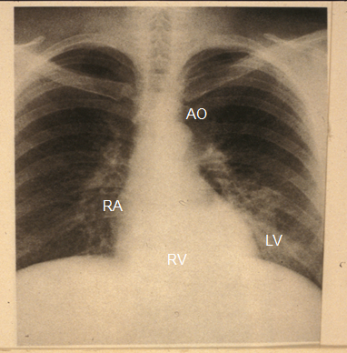

Slide 63
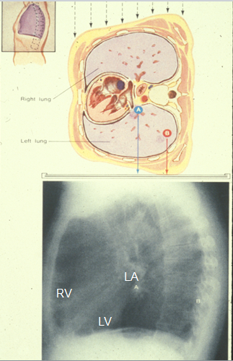

Slide 64
Location and timing
The first (S1) and second (S2) heart sounds are physiological sounds that are heard in all healthy individuals.
The third (S3) and fourth (S4) heart sounds may be physiological (particularly in young adults, pregnant women, and the elderly) or indicate an underlying pathology.

Slide 65
Heart sound | Origin | Timing | Occurrence
Primary heart sounds
1st heart sound (S1) | Closure of the mitral valve and tricuspid valve Best heard in the 5th left intercostal space in the midclavicular line (cardiac apex) | Onset of systole Heard just before the carotid pulsation is felt | Always

Slide 66
Heart sound | Origin | Timing | Occurrence
2nd heart sound (S2) | Closure of the aortic and pulmonary valve Two components: A2: closure of the aortic valve (louder) P2: closure of the pulmonary valve (softer) Best heard in the aortic region (A2) and pulmonary region (P2) | Transition from systole to diastole Heard immediately after the carotid pulsation | Always See splitting of S2 below.

Slide 67
Heart sound | Origin | Timing | Occurrence
3rd heart sound (S3) | Ventricular filling sound Rapid ventricular filling Sudden deceleration of blood when the ventricle reaches its elastic limit. | Immediately after S2 Ventricular gallop: Ken-tuc-key pattern (S1-S2-S3) | Physiological: young individuals(< 40 years) or pregnant women Pathological Chronic mitral regurgitation Heart failure (dilated ventricles) Dilated cardiomyopathy

Slide 68
Heart sound | Origin | Timing | Occurrence
Extra heart sounds (gallops)
3rd heart sound (S3) | Ventricular filling sound Rapid ventricular filling Sudden deceleration of blood when the ventricle reaches its elastic limit. | Immediately after S2 Ventricular gallop: Ken-tuc-key pattern (S1-S2-S3) | Physiological: young individuals(< 40 years) or pregnant women Pathological Chronic mitral regurgitation Heart failure (dilated ventricles) Dilated cardiomyopathy

Slide 69
Heart sound | Origin | Timing | Occurrence
4th heart sound (S4) | Ventricular filling sound: late diastolic contraction of the atria(“atrial kick”) against a high ventricular pressure | Immediately before S1 Atrial gallop: Ten-nes-seepattern (S4-S1-S2) | Physiological: advanced age Pathological: atrial gallop Ventricular hypertrophy (e.g., hypertension, aortic stenosis, cor pulmonale) Ischemic cardiomyopathy Acute myocardial infarction

Slide 70
Gallops more commonly arise from the left side of the heart. Gallops that originate from the left side of the heart become softer with inspiration while those that originate from the right side become louder!

Slide 71
Splitting of heart sounds
If the aortic and pulmonary valves do not close simultaneously, an apparent splitting of S2 can be heard upon auscultation.
 |  | Description | Cause
Splitting of S2 | Physiological split | During inspiration: The sound of aortic valve closure (A2) precedes the sound of pulmonary valve closure (P2). | The split is especially pronounced among young individuals.
 | Wide split | An exaggerated physiological split, i.e., more pronounced during inspiration (A2 precedes P2). | Pulmonary hypertension Massive pulmonary embolism Severe mitral regurgitation Wolff-Parkinson-White syndrome Constrictive pericarditis RBBB

Slide 72
 | Description | Cause
Fixed split | A split in S2 that does not change with respiration, i.e., the split is also audible during expiration. | Atrial septal defect (ASD) Severe RV failure
Paradoxical split(reversed split) | The split in S2 is audible during expiration but not inspiration. | Aortic stenosis Aortic insufficiency Left bundle branch block Hypertrophic obstructive cardiomyopathy (HOCM; LV outflow tract obstruction) Early excitation of the right ventricle (e.g., RV pacing, Wolff-Parkinson-White syndrome)
Absent split | No splitting of S2 | Severe aortic stenosis (geriatric) VSD with Eisenmenger syndrome (pediatric)

Slide 73
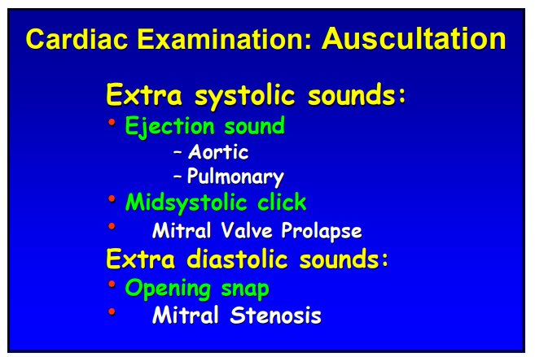

Slide 74
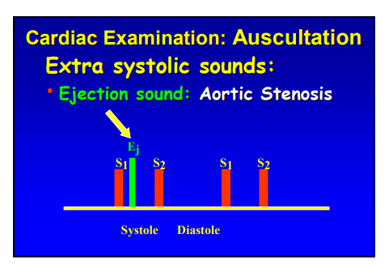

Slide 75
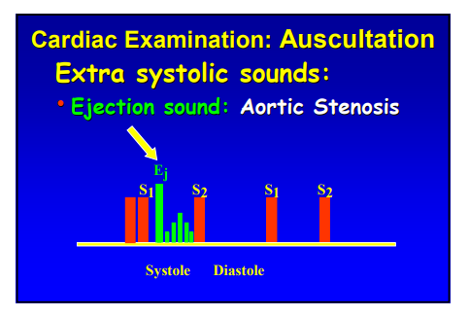

Slide 76
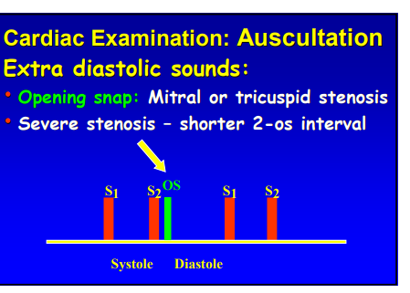

Slide 77
Abnormal heart sounds
Ejection sounds (Clicks)
Clicks are crisp sounds produced by the movement of abnormal valves.
 | Mechanism | Timing | Technique of auscultation
Aortic ejection click | Opening of a stiff aortic valve in aortic stenosis | Early-systolic sound(immediately after S1) | Best heard with the diaphragm of a stethoscope at the aortic region with the patient seated and leaning forward
Mitral valveopening snap | Opening of a stiff mitral valve in mitral stenosis | Early-diastolic sound (immediately after S2) | Best heard with the bell of a stethoscope at the mitral region with the patient in a left lateral position

Slide 78
 | Mechanism | Timing | Technique of auscultation
Mitral valve prolapse click | Mitral valve prolapse into the left atria during systole | Midsystolic sound | Best heard with the diaphragm of a stethoscope at the mitral region with the patient in left lateral position
Mechanical valve clicks | S1 and S2 sounds that are produced by prosthetic valves sound like clicks. | Appropriate (see S1 and S2 above) | With the diaphragm of a stethoscope

Slide 79
The presence of an aortic ejection click can
be used to differentiate
a pathological systolic murmur of aortic stenosis from a flow murmur!
The absence of a click in patients with prosthetic valves may indicate valve failure!

Slide 80
Heart murmurs
Sounds produced by the turbulent flow of blood within the heart are known as murmurs. They are described based on the location and radiation of the murmur, timing, intensity, configuration, frequency, and response to maneuvers. Murmurs can be classified as either functional or pathological.

Slide 81
 | Functional murmur (physiological or innocent) | Pathologic murmur
Cause | Non-cardiac or peripheral cause: due to increased blood flow across normal aortic and/or pulmonary valves (ejection murmur) Most commonly occurs in infants and children but also in individuals without cardiac conditions (particularly thin or pregnant individuals) due to e.g., hyperdynamic circulation Cardiac conditions and structural abnormalities (e.g., valvular defects) must be ruled out. | Caused by structural defects (valvular disease or heart defects)
Intensity | Soft (< 3/6 without a thrill) | Typically > 3/6 Thrill may be present

Slide 82
 | Functional murmur (physiological or innocent) | Pathologic murmur
Timing | Most commonly mid-systolic or continuous murmur | Systolic, diastolic, or continuous
Position change | Position-dependent; murmur varies in intensity or disappears | Murmur rarely disappears
 | Cervical venous hum: common benign auscultation finding in children Caused by turbulent flow in internal jugular veins Continuous murmur best heard at the infraclavicular and supraclavicular regions; more common on the right side Becomes softer or disappears with flexion of the head, compression of the jugular vein, or in supine position Still murmur | For specific auscultatory findings in valvular heart disease, see auscultation in valvular defects. For specific auscultatory findings of heart defects, see congenital heart defects.

Slide 83
Auscultatory locations
Region | Site at which a murmur is heard best | Pathology
Erb's point (cardiology) | 3rd left parasternal intercostal space | Diastolic murmurs: aortic regurgitation, pulmonic regurgitation Systolic murmurs: HCOM
Aortic region | 2nd right parasternal intercostal space | Aortic stenosis Aortic regurgitation Coarctation of the aorta
Pulmonary region | 2nd left parasternal intercostal space | Pulmonary stenosis Pulmonary regurgitation ASD

Slide 84
Region | Site at which a murmur is heard best | Pathology
Mitral region | 5th left intercostal space in the midclavicular line | Mitral stenosis Mitral regurgitation Mitral valve prolapse
Tricuspid region | 4th left parasternal intercostal space | Tricuspid stenosis Tricuspid regurgitation
Gibson's point | Left infraclavicular region | Continuous murmur of a PDA is heard best at this point.

Slide 85
Timing
Murmur | Timing | Occurrence
Systolicmurmurs | During ventricular contraction (i.e. occurs with or after S1 and before S2) May be classified as early-systolic, mid-systolic, late-systolic, and holosystolic according to the onset and termination of the murmur | Functional (innocent): Children Pregnancy During states of excitement or strenuous activity Anemia Fever, sepsis Thyrotoxicosis Beriberi Arteriovenous fistula | Pathological Aortic stenosis Pulmonary stenosis Mitral regurgitation Tricuspid regurgitation Ventricular septal defect Coarctation of the aorta Hypertrophic obstructive cardiomyopathy (HOCM)

Slide 86
Murmur | Timing | Occurrence
Diastolicmurmurs | During ventricular relaxation (i.e., occurs with or after S2 and before S1) May be classified as: early-diastolic, mid-diastolic, late-diastolic, or holo-diastolic according to the onset and termination of the murmur | Do not occur physiologically Next best step in management: transthoracic echocardiogram | Mitral stenosis Aortic regurgitation Tricuspid stenosis Pulmonary regurgitation
Continuous murmurs | During systole and diastole | Hyperdynamic state Cervical venous hum | PDA Arteriovenous fistulas

Slide 87
A mid-systolic murmur in an asymptomatic individual is most likely physiological! Unlike systolic murmurs, diastolic murmurs are almost always pathological!
Diastolic murmurs may require that certain maneuvers be performed to make them more apparent.

Slide 88
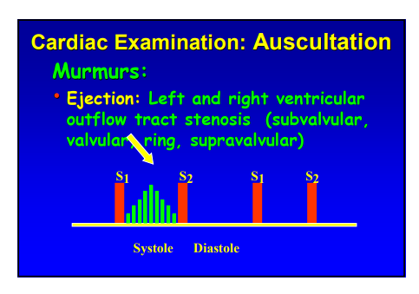

Slide 89
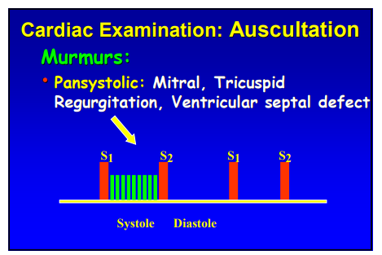

Slide 90
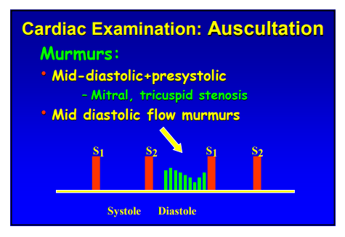

Slide 91
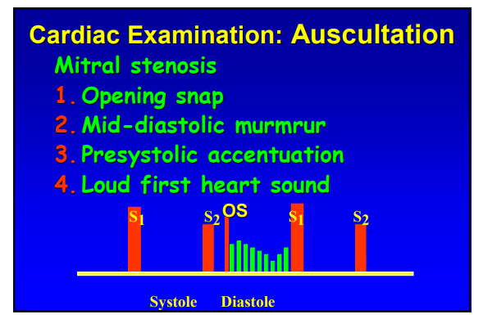

Slide 92
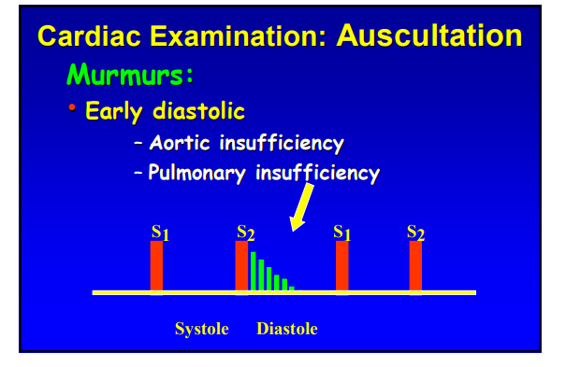

Slide 93
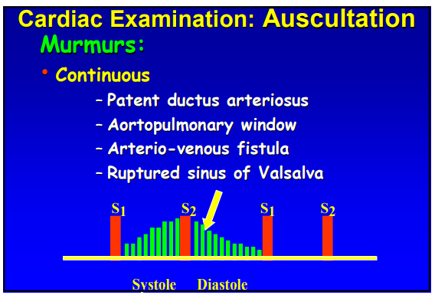

Slide 94
Radiation
A murmur may be auscultated at a site that does not lie directly over the heart.
Aortic stenosis: systolic murmur radiates to carotid arteries
Mitral regurgitation: systolic murmur radiates to the left axilla (in the left lateral recumbent position)
Pulmonary stenosis: systolic murmur radiates to the interscapular region

Slide 95
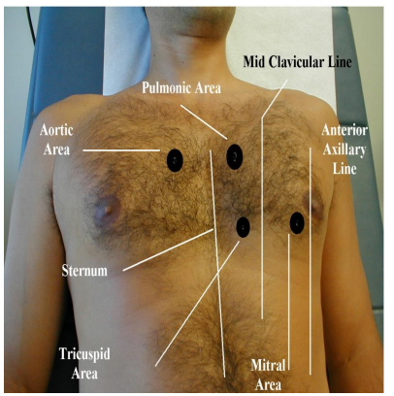

Slide 96
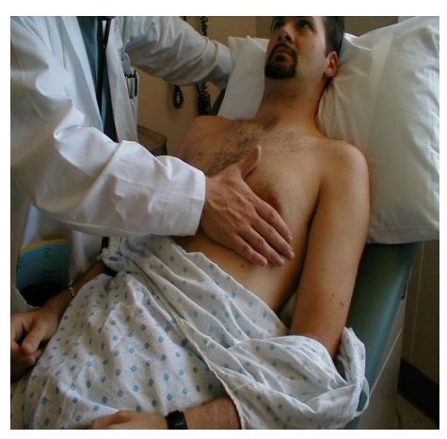

Slide 97
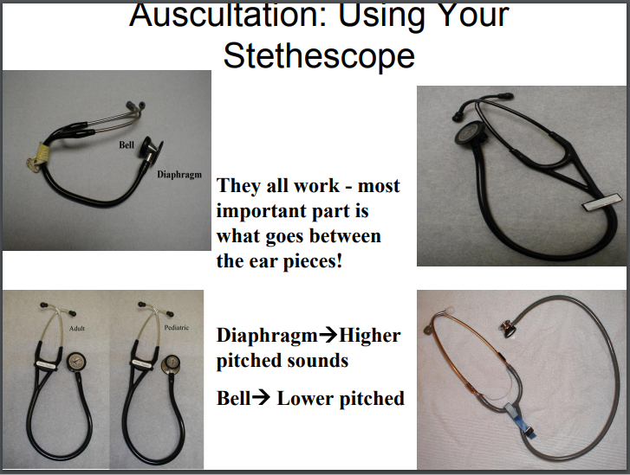

Slide 98
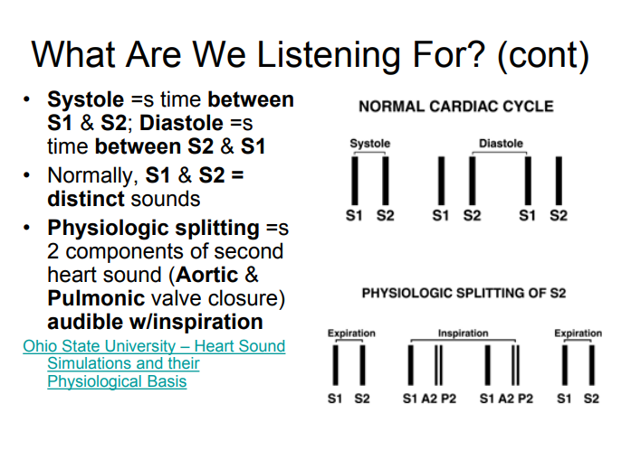

Slide 99
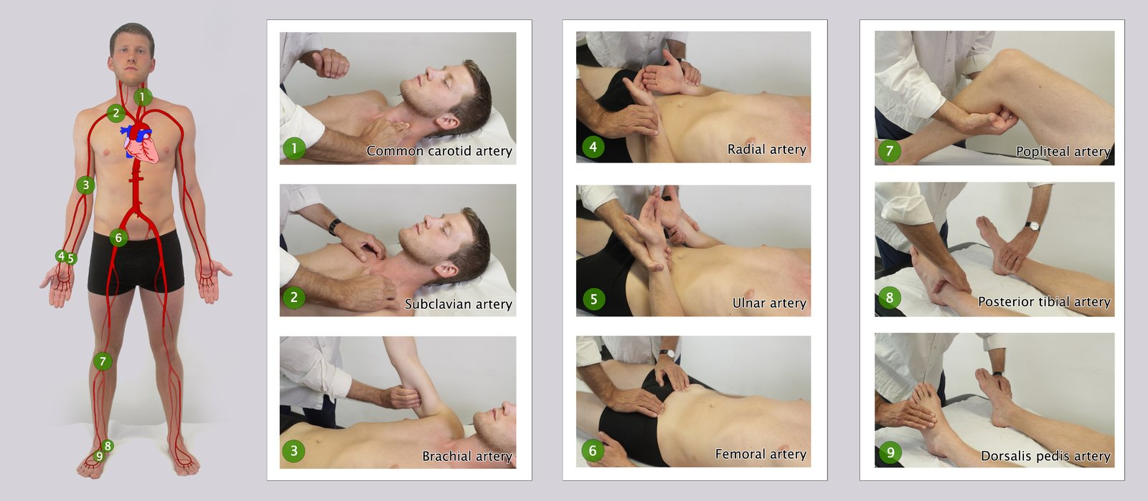

Slide 100
Palpation
Characteristics of pulse | Description | Possible causes
Rate | Number of beats per minute < 60 bpm → bradycardia > 100 bpm → tachycardia | Physiological variations Bradyarrhythmias Tachyarrhythmias

Slide 101
Characteristics of pulse | Description | Possible causes
Rhythm | Regularly irregular | Atrial tachyarrhythmias (e.g., atrial flutter) with a fixed AV block
 | Irregularly irregular | Atrial fibrillation Atrial tachyarrhythmias (e.g., atrial flutter) with a varying AV block Ventricular ectopics (premature ventricular contractions)
 | Pulse deficit: difference between the pulse rate measured by cardiac auscultation and the peripheral pulse rate obtained by palpating the radial artery | Pulse deficit > 10 → atrial fibrillation Pulse deficit < 10 → premature ventricular contractions Obstructive hypertrophic cardiomyopathy
 | Pulsus bigeminus: two heartbeats occur in rapid succession (usually a high volume pulsefollowed by a low volume pulse) followed by a long gap (therefore regularly irregular) | Severe left heart failure Digoxin toxicity

Slide 102
Characteristics of pulse | Description | Possible causes
Pulse volume (amplitude) | Hyperkinetic pulse (pulsus altus): bounding pulse Corrigan sign and water hammer pulse: bounding pulse best palpated on the radial, brachial, or carotid artery | Arterial hypertension High cardiac output states: anemia, sepsis PDA Aortic regurgitation VSD
 | Hypokinetic pulse (pulsus parvus): soft pulse with a low amplitude | Low blood pressure
 | Pulsus paradoxus: pathological decrease in the pulse wave amplitude and systolic blood pressure of > 10 mm Hg during inspiration | Constrictive pericarditis Cardiac tamponade Superior vena cava syndrome Severe obstructive airway disease (asthma, COPD) Obstructive sleep apnea Tension pneumothorax Croup

Slide 103
Characteristics of pulse | Description | Possible causes
Pulse volume (amplitude) | Reverse pulsus paradoxus: pulse volume increases with inspiration | HOCM AV dissociation Intermittent positive pressure ventilation (IPPV)
 | Pulsus alternans: alternation of strong and weak pulses caused by alterations in the stroke volume (cardiac output) Dicrotic pulse: two peaks in the pulse wave occurring in systole and diastole | Congestive heart failure

Slide 104
Characteristics of pulse | Description | Possible causes
Speed of pulse upstroke (wave contour) | Fast-rising pulse: rapid upstroke of the pulse | Aortic regurgitation
 | Low-rising pulse: delayed peak pressure of the carotid artery | Aortic stenosis
Delay | Radiofemoral delay | Coarctation of the aorta Vascular obstruction (atherosclerosis) Aneurysms

Slide 105
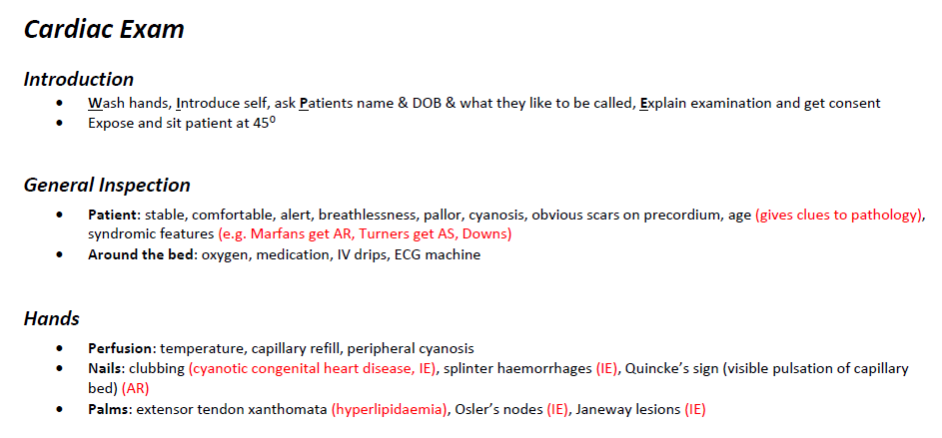
OSCE

Slide 106
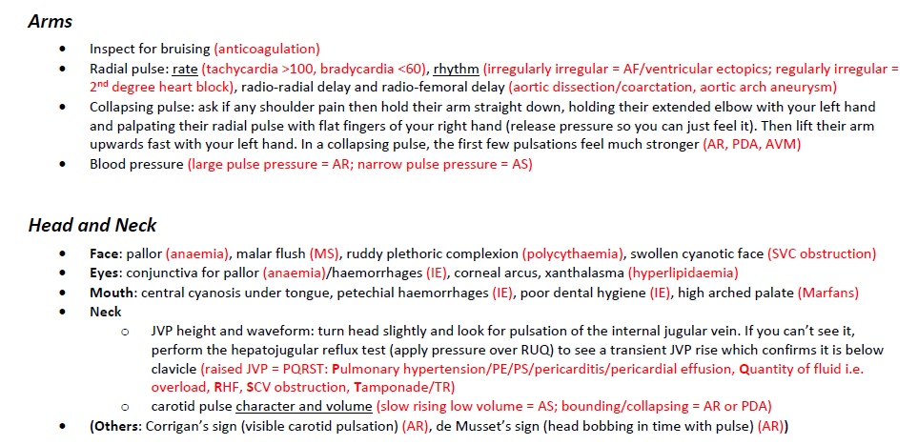

Slide 107
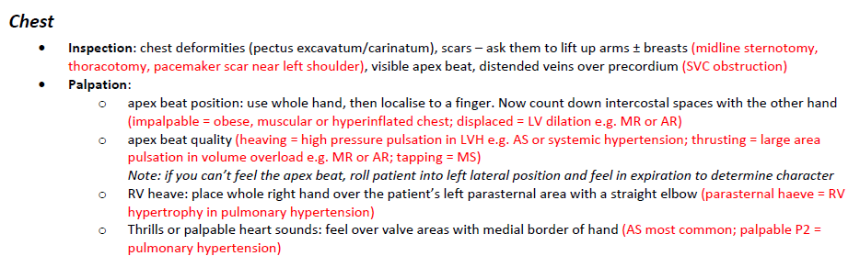

Slide 108
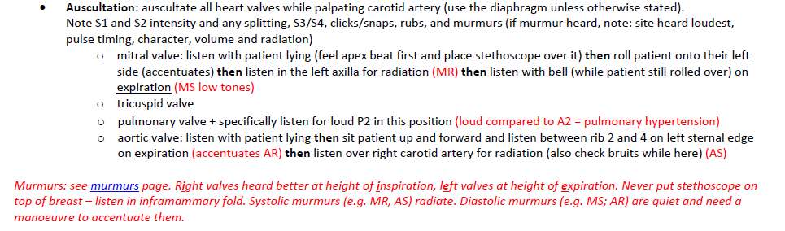

Slide 109
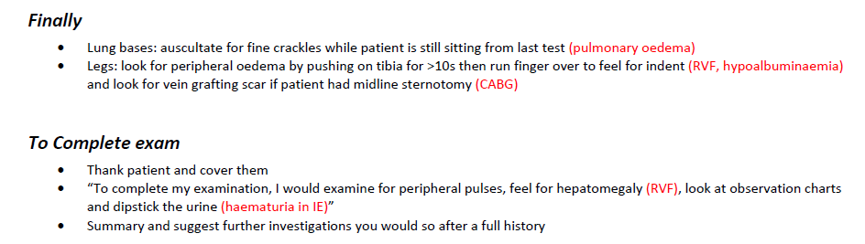

Slide 110
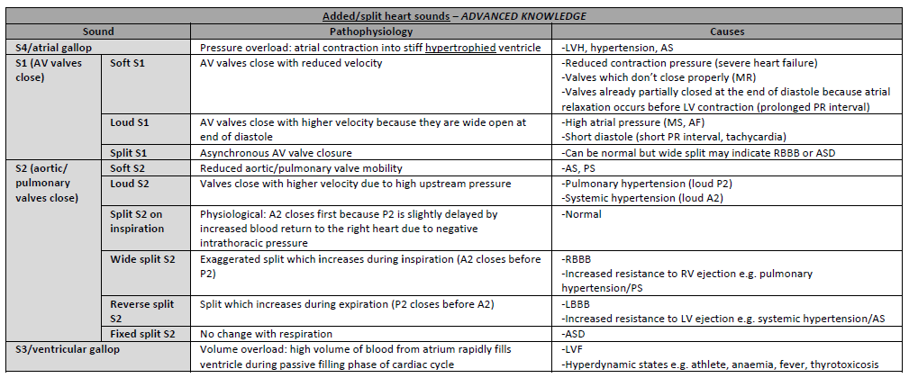

Slide 111
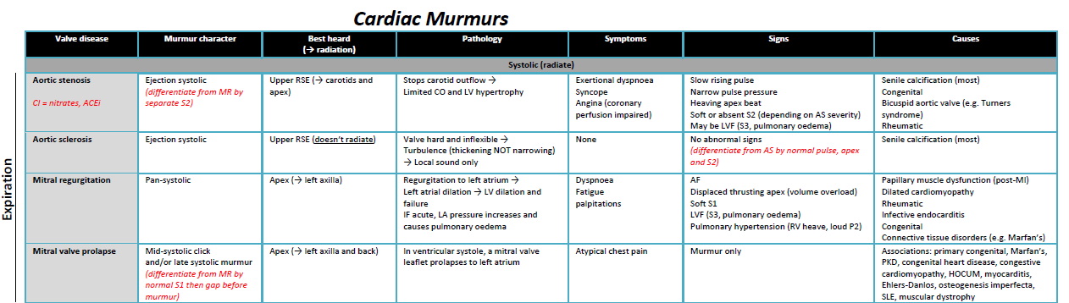

Slide 112
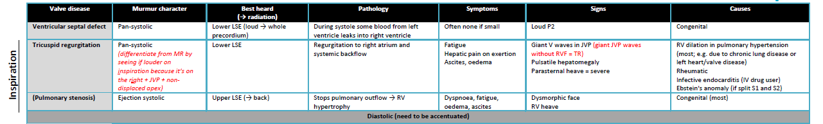

Slide 113
