Slide 1
ECG (EKG)
Dr. Jamal Dabbas
Interventional cardiologist & internist

Slide 2
ECG (EKG) Interpretation
The 12-lead ECG misleadingly only has 10 electrodes.
The leads can be thought of as taking a picture of the heart’s electrical activity from 12 different positions using information picked up by the 10 electrodes. These comprise 4 limb electrodes and 6 chest electrodes.

Slide 3
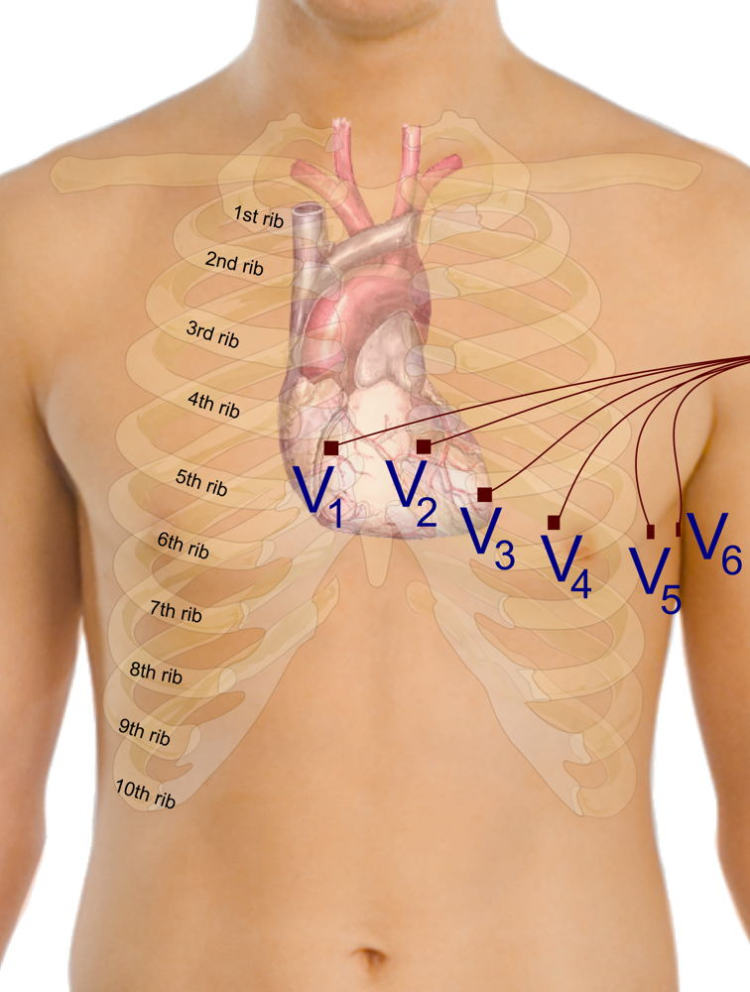
Electrode positions on an ECG (EKG).

Slide 4
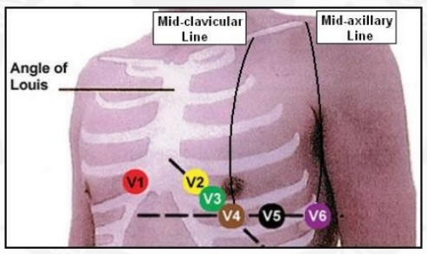

Slide 5
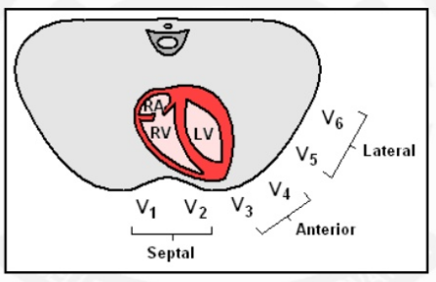

Slide 6
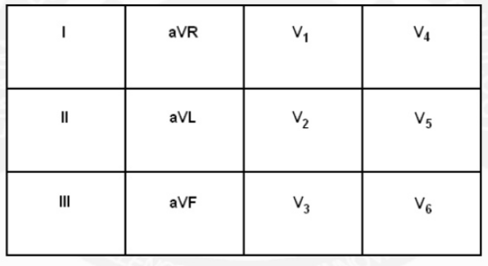

Slide 7
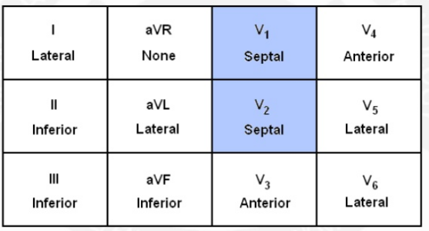

Slide 8
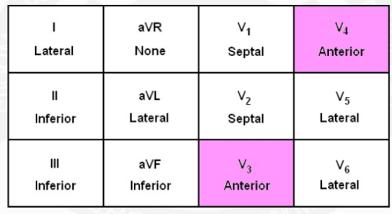

Slide 9
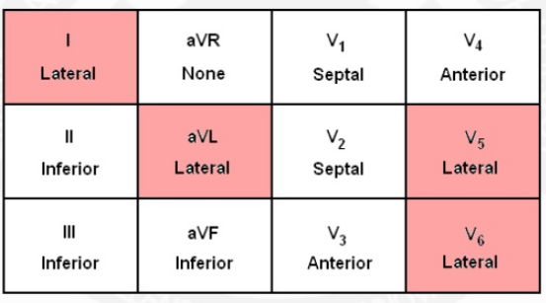

Slide 10
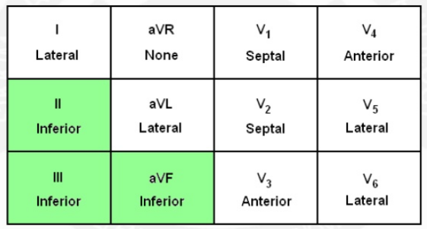

Slide 11
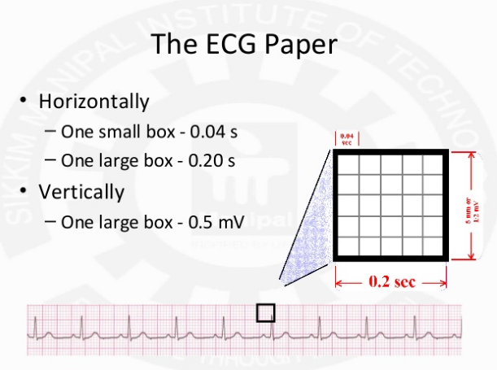

Slide 12
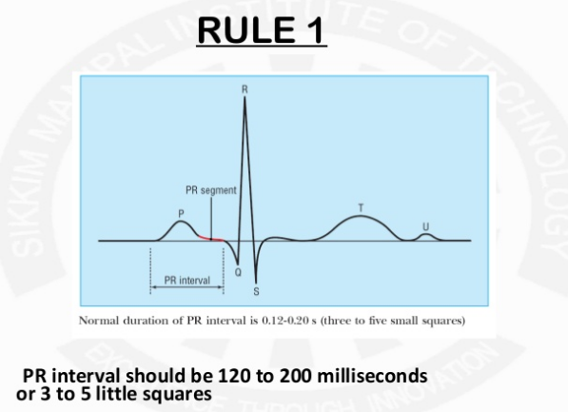

Slide 13
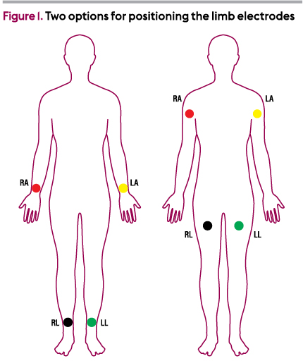
Limb electrodes

Slide 14
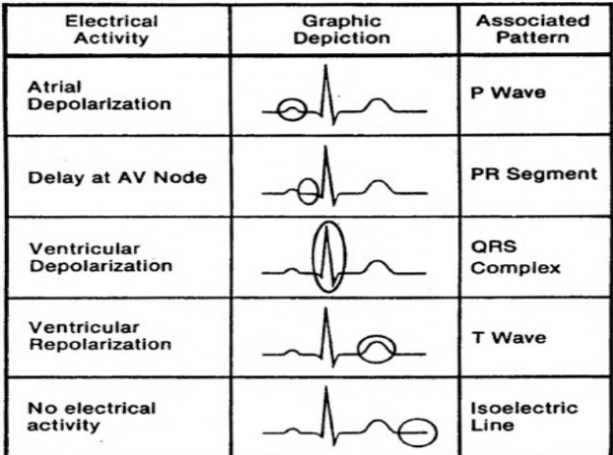

Slide 15
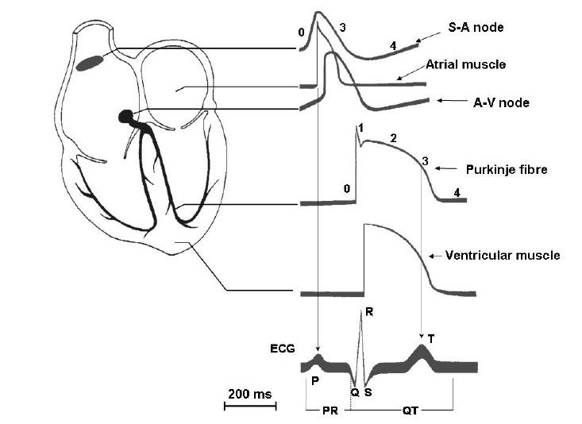

Slide 16
When electrical activity (or depolarisation) travels towards a lead, the deflection is net positive. When the activity travels away from the lead the deflection is net negative.

Slide 17
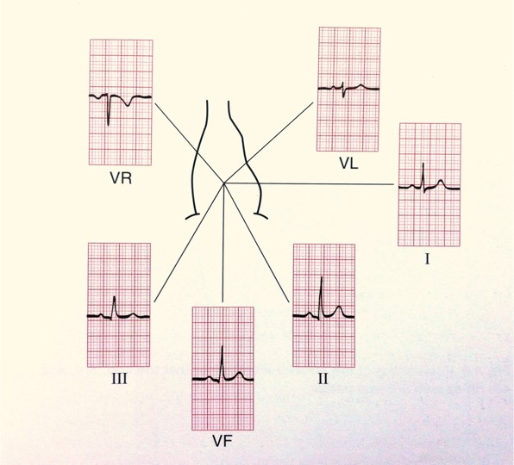
The electrical activity on an ECG (EKG).

Slide 18
1 large square is equivalent to 0.2 secs and a small square to 0.04 secs
(All boxes are based on the assumption that the paper speed is running at 25mm/sec).

Slide 19
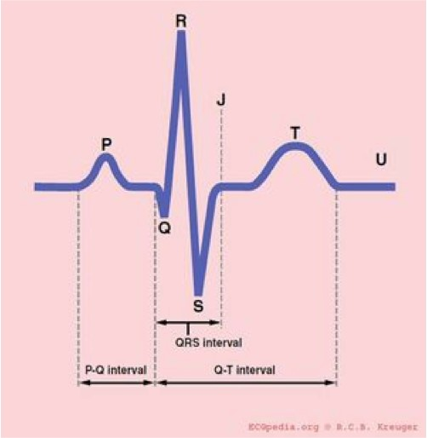
The segments of the ECG.

Slide 20
What do the segments of the ECG represent?
P-wave: Atrial contraction
PR interval: Represents the time taken for excitation to spread from the sino-atrial (SA) node across the atrium and down to the ventricular muscle via the bundle of His.
QRS: Ventricular contraction
ST segment: Ventricular relaxation
T-wave: Ventricular repolarisation
Normal duration of ECG segments:
PR interval: 0.12 – 0.2 secs (3-5 small squares)
QRS: <0.12 secs (3 small squares)
QTc: 0.38 – 0.42 secs

Slide 21
How to read an ECG
Patient name and details
Date
Rate
Rhthm
Axis
P-wave and P-R interval
Q-wave and QRS complex
ST segment
QT interval
T-wave
These components will now be explained in more detail.

Slide 22
Patient name and details
Patient’s name, date of birth and hospital number
Location
  This becomes important as in the ED or acute medical setting doctors are often shown multiple ECGs. You need to know where your patient is in order to ensure that they can be moved to a higher dependency area if appropriate.

Slide 23
Date and time reference of symptoms
A. When was the ECG done? The time
B. Did the patient have chest pain at the time?
(Or other relevant clinical details. For example, if you are wanted an ECG to look for changes of hyperkalaemia, note the patient’s potassium level on the ECG).

Slide 24
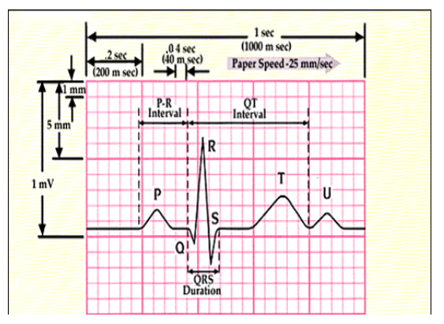
ECG paper Key
Thin Lines: 1 mm intervals or 0.04 sec
Thick lines: 5 mm intervals or .2sec
1 thick lined box (5 small boxes) = .20 sec or 5mm
5 thick lines boxes (25 small boxes)= 1 second
10 mm = 1 mV
Tick Marks on ECG paper rhythm strip: 3 secs

Slide 25
There are two different rates that can be determined on an ECG. The atrial rate is indicated by the frequency of the P waves. The ventricular rate is indicated by the frequency of the QRS complexes.
In the absence of disease, the atrial rate should be the same as the ventricular rate. However, certain conditions including third-degree atrioventricular nodal block or ventricular tachycardia can alter this normal relationship, causing “AV dissociation.” In this setting, the atrial rate (P waves) and ventricular rate (QRS complexes) are at different heart rates.

Slide 26
One quick and easy way to measure the ventricular rate is to examine the RR interval — that is, the distance between two consecutive R waves .
HR = 300 / number of large squares between successive R waves
Another quick way is the rule of six seconds to calculate. By counting the number of QRS complexes in 30 large squares and multiplying by 10. (Count the number of RR intervals between two Tick marks (6 seconds) in the rhythm strip and multiply by 10 to get the rate. This method is more effective when the rhythm is irregular).

Slide 27
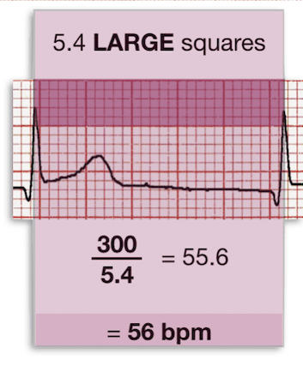

Slide 28
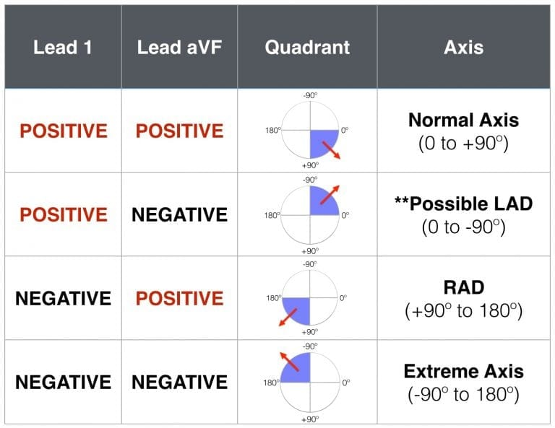

Slide 29
If you want to work it out more precisely you can use the method below:
  Count the number of small squares of positive or negative deflection in aVF and make a dot on the aVF axis (see Figure 5) moving a mm for each small square counted (e.g. x mm up for negative and x mm down for positive deflections).
  Count the number of small squares of positive or negative deflection in lead 1 and make a dot on the lead 1 axis moving a mm from the centre of the chart for each small square counted (e.g. x mm right for negative and x mm left for positive deflections).
  Draw a vertical line through your lead 1 dot and a horizontal line through your aVF dot then draw a line from this intersection back through 0 and this will give you the accurate axis.

Slide 30
Assessing the axis on an ECG
Axis is the sum of all the electrical activity in the heart.
The contraction travels from the atria to the right and left ventricles. As the left ventricle is larger and more muscular normal axis lies to the left (at -30 degrees to 90 degrees – see Figure ).
As a general rule if the net deflections in leads I and aVF are positive then the axis is normal.
  If lead I has a net negative deflection whilst aVF is positive then there is right axis deviation.
If lead I has a positive deflection and aVF has a negative deflection then there is left axis deviation

Slide 31
General
Leads: A 12-lead ECG with six limb leads (I, II, III, aVL, aVF, aVR ) and six precordial leads (V₁–V₆) is standard.
  Interpretation of the limb leads
    I → left ventricle, lateral wall
    II, III, and aVF → left ventricle, inferior wall
    aVL → left ventricle, high part of the lateral wall
    aVR → reciprocal of the left lateral side leads (II, aVL, V₅ and V₆)

Slide 32
  Interpretation of the precordial leads
    V₁ and V₂ → both ventricles, anterior wall
    V₃ and V₄ → anterior wall of the left ventricle and parts of the septum
    V₅ and V₆ → lateral wall of the left ventricle and apex of the heart

Slide 33
Paper speed
  A paper speed of 25 mm/s is usually used in the United States: 1 mm = 0.04 s
  Alternatively, in other countries a paper speed of 50 mm/s is used: 1 mm = 0.02 s
Amplitude: 1 mm (vertical) = 0.1 mV

Slide 34
Interpretation
Compare it with previous ECGs.

Slide 35
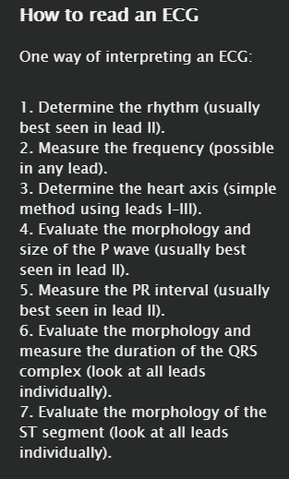

Slide 36
Determination of the heart rate
The atrial rate is sometimes calculated (e.g., in assessing some supraventricular arrhythmias).
Implementation
  If the QRS rhythm is regular (see determination of the heart rhythm below), then the heart rate can be estimated by dividing 300 by the number of large (5 mm) squares between successive QRS complexes, or by counting the number of QRS complexes in 6 seconds and multiplying by 10.
    Careful! This method is only a rough estimate.
    Only applies if paper speed is 25 mm/s

Slide 37
Interpretation
  Normal heart rate: 60–100/min
  Tachycardia: > 100/min (see also tachycardic arrhythmias)
  Bradycardia: < 50-60/min (see also bradycardic arrhythmias)

Slide 38
Determination of the heart rhythm
The heart rhythm is assessed by evaluating the frequency, regularity, and relationships between the P waves and QRS complexes.
Implementation
  P wave assessment
    Are they visible in any lead?
    Determine the atrial rate (i.e., PP interval).
    Determine the morphology of the P waves.
  Relationship of P waves to QRS complexes
    A 1:1 relationship of P with QRS is normal. If not present:
      Determine the atrial and ventricular heart rates.
      Is there an abnormal number of P waves compared to QRS complexes?
    A P wave before every QRS, and a QRS after every P are normal.
  QRS morphology
    Normal duration: 0.07–0.10 seconds
    Wide QRS: > 0.12 seconds or 3 small squares

Slide 39
Criteria for a sinus rhythm
Normal morphology of the P waves
A regular QRS complex follows every P wave.
Normal, constant PP and RR intervals

Slide 40
Determination of the axis
The axis represents the spread of intraventricular electrical activity projected along the frontal plane (determined from limb leads I, II, III, aVR, aVL, aVF).
The key here is to evaluate the QRS complex, and specifically whether it is positive or negative.
  Positive: if the area above the isoelectric line (i.e., the amplitude) is larger than the area beneath
  Negative: if the area below the isoelectric line is larger than the area above
The main QRS vector (position of the electrical axis of the heart) is close to the lead with the highest positive QRS amplitude.
The normal axis of the heart is between -30° and +90°.
A rapid approximation of the axis may be made by assessing the QRS complexes in leads I and aVF:

Slide 41
Axis | Lead |  | Degrees | Common causes
 | I | aVF
Left-axis deviation | + | - | (-30°)–(-90°) | Normal variant (especially with age), LVH, LBBB, LAFB, inferior MI
Normal | + | + | (-30°)–(+90°) | Normal axis
Right-axis deviation | - | + | (+90°)–(+180°) | Normal variant, RVH, LPFB, lateral MI, RV strain (e.g., PE), chronic lung disease (e.g., COPD)
Extreme right-axis deviation | - | - | (-90°)–(-180°) | Severe RVH, lateral MI

Slide 42
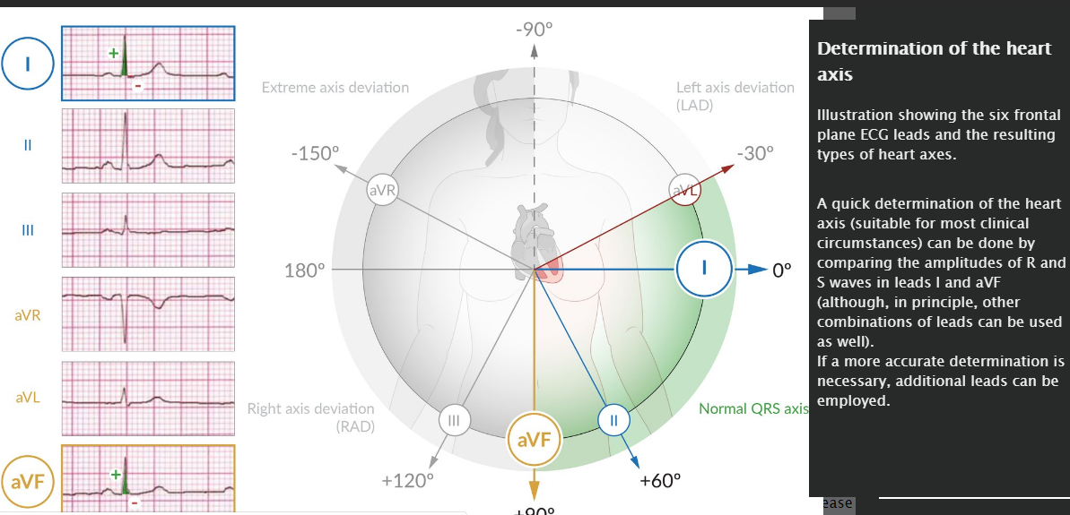

Slide 43
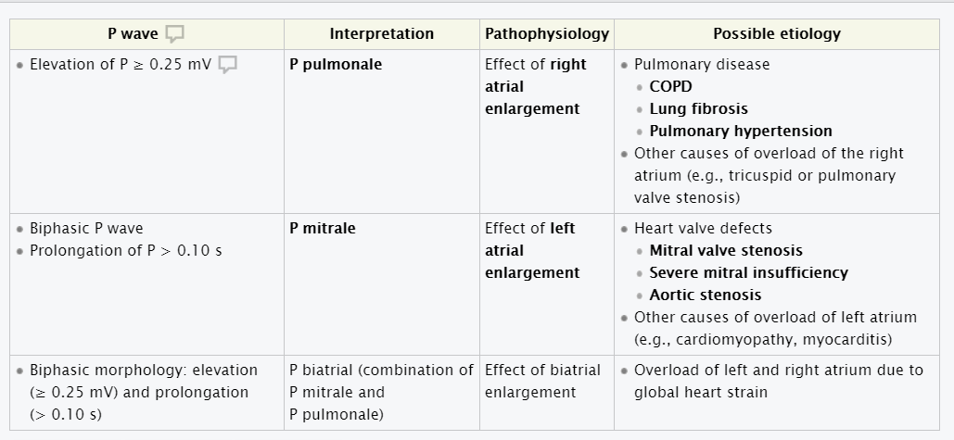
Interpretation of the P wave

Slide 44
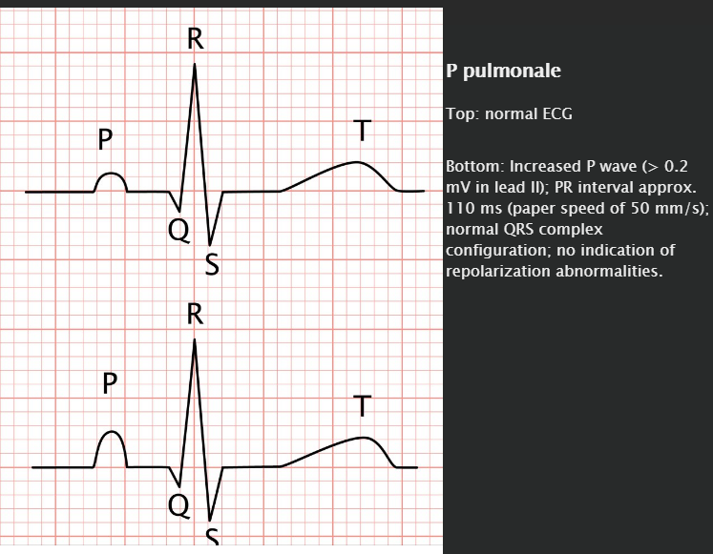

Slide 45
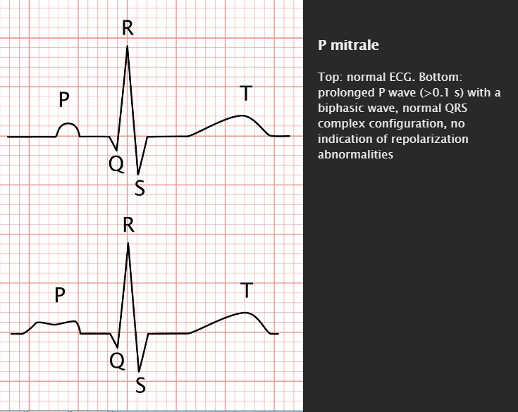

Slide 46
Interpretation of the QRS complex
The QRS complex represents depolarization of the ventricles and corresponds approximately to ventricular systole.
Interpretation of the duration
  ≤ 100 ms = normal
  100–110 ms = incomplete bundle branch block (BBB)
  ≥ 120 ms = complete bundle branch block (BBB)
    Signs of right bundle branch block (RBBB) are primarily seen in leads V_{1,2}
      Prolonged QRS complex
      rSR' formation (typical M shape/ “rabbit ear” shape)
      Wide S wave in lead I
      T wave inversions and ST-segment depression in V₁–-V₃
      Final negativity (intrinsicoid deflection) in V_{1,2} after > 0.03 s
    Signs of left bundle branch block (LBBB) are primarily seen in leads I, V_{5,6}
      Prolonged QRS complex
      Broad, notched R wave
      Loss of Q waves
      Possible rSR' formation in V₅ or ₆
      Deep S wave in V_{1,2}
      Final negativity (intrinsicoid deflection) in V_{5,6} after > 0.05

Slide 47
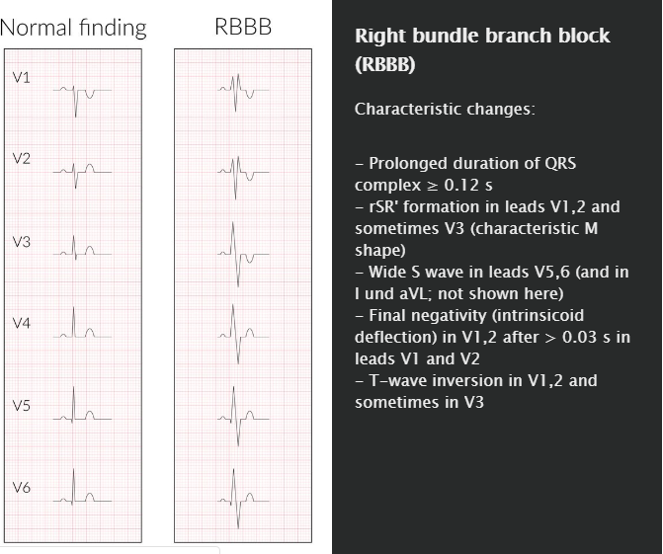

Slide 48

The name William Morrow can help you identify LBBB and RBBB by looking at the QRS morphology in V₁ and V₆. In LBBB the QRS looks like a W in V₁ and an M in V₆ (WiLLiaM), in RBBB the QRS looks like an M in V₁ and a W in V₆ (MoRRoW).

Slide 49
Interpretation of amplitude
Amplitude of the QRS complex in the precordial leads is used to assess for ventricular hypertrophy
Various grading criteria exist for electrocardiographic determination of ventricular hypertrophy.
The Sokolow-Lyon criteria are utilized below:
  Left ventricular hypertrophy (LVH): S_{V1 or 2} + R_{V5 or 6} ≥ 3.5 mV
  Right ventricular hypertrophy (RVH): R_{V1 or 2} + S_{V5 or 6} ≥ 1.05 mV

Slide 50
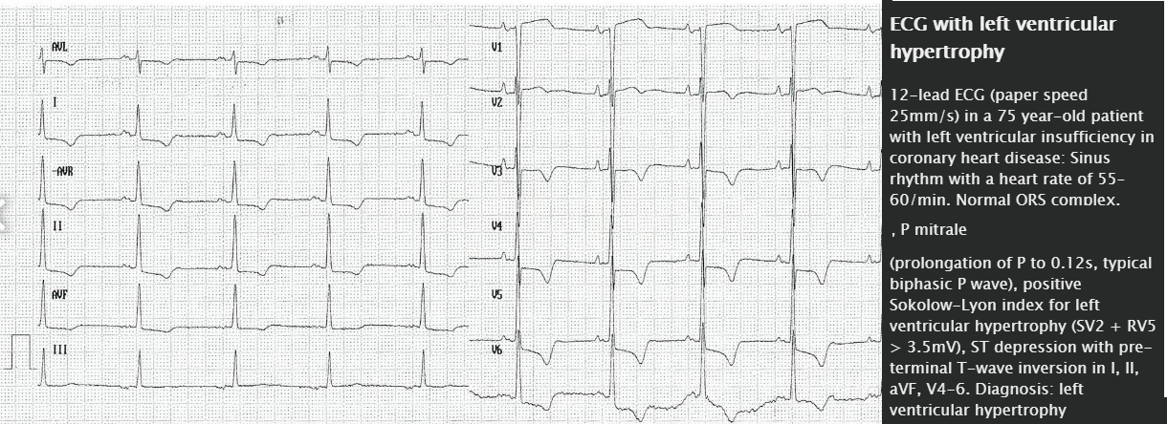

Slide 51
Interpretation of the PR interval
The time between the beginning of the P wave and the beginning of the Q wave
The PR interval represents atrioventricular transmission.

Slide 52
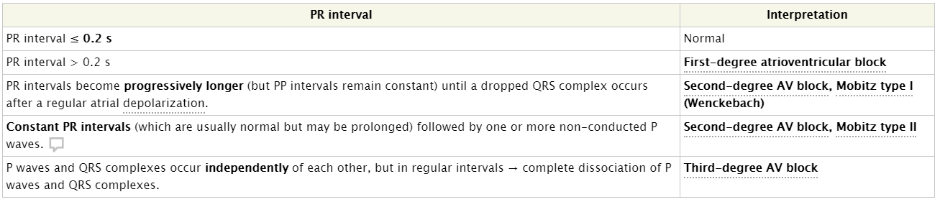

Slide 53
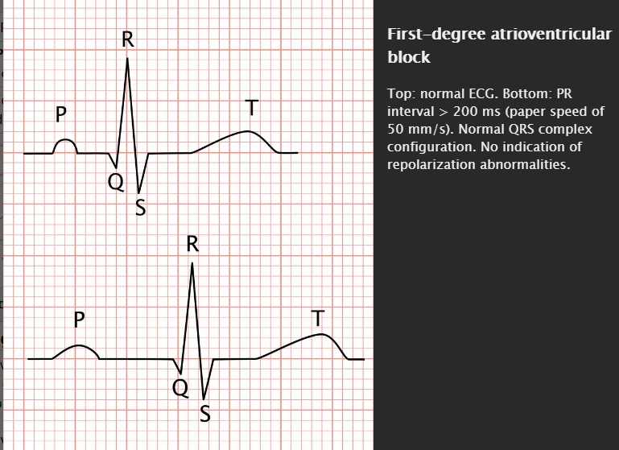

Slide 54
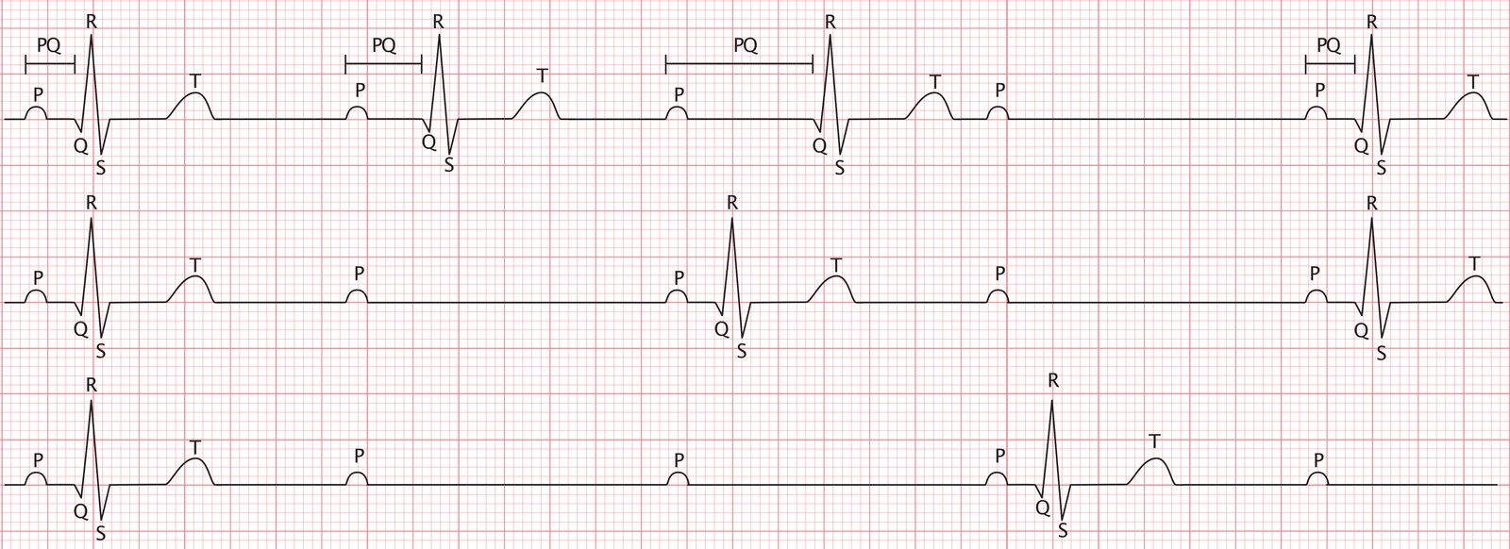
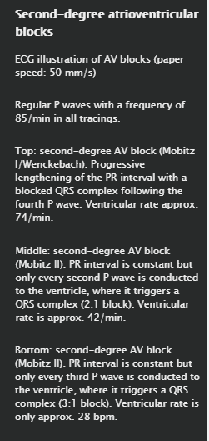

Slide 55
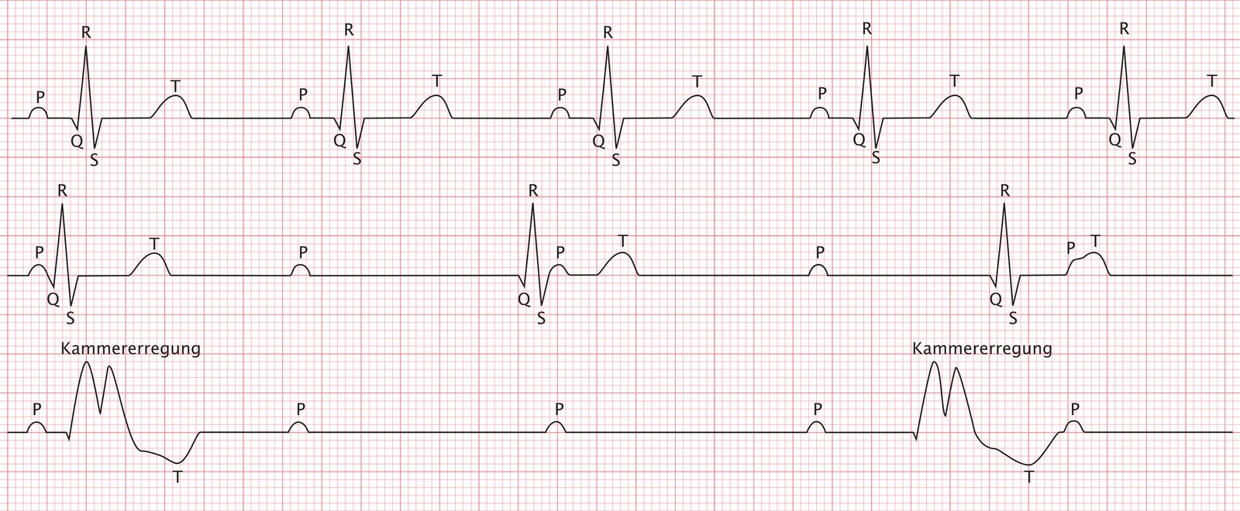
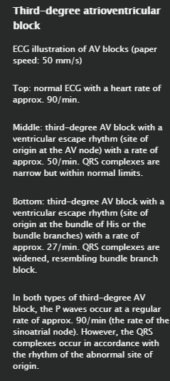

Slide 56
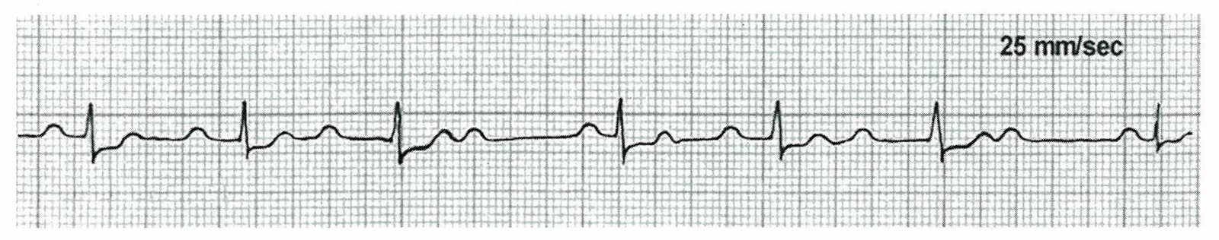
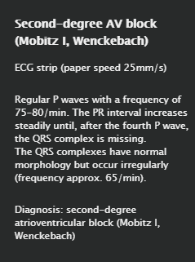

Slide 57
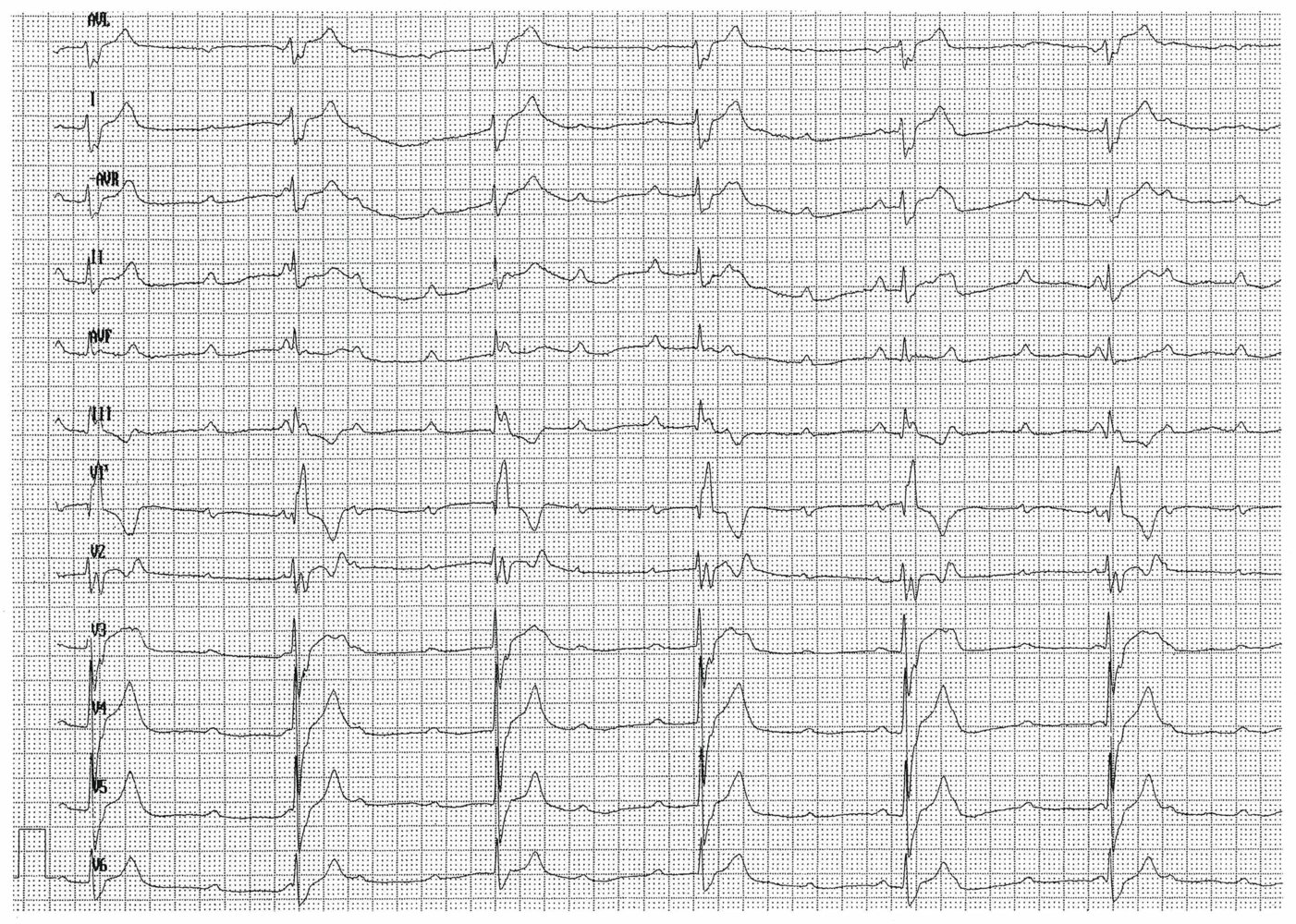
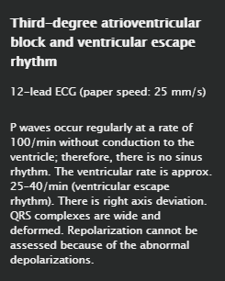

Slide 58
Interpretation of the Q wave
Physiological
The Q wave represents the beginning of ventricular depolarization.
A narrow (≤ 40 ms) Q wave is physiological in:
  All limb leads
  aVR
  V₅ and V₆

Slide 59
Pathological
Pathological Q waves are characteristically:
  Abnormally wide (≥ 40 ms)
  Abnormally deep (≥ 2 mV or > 25% of the R wave amplitude) or, detectable in V₁–V₃
Etiology
  Myocardial injury or replacement
    Myocardial infarction
    Cardiac infiltrative disease (e.g., sarcoidosis, amyloidosis)
  Ventricular enlargement
    Acute pulmonary embolism
    Hypertrophic cardiomyopathy
  Altered ventricular conduction
    Left bundle branch block
    Wolff-Parkinson-White syndrome

Slide 60
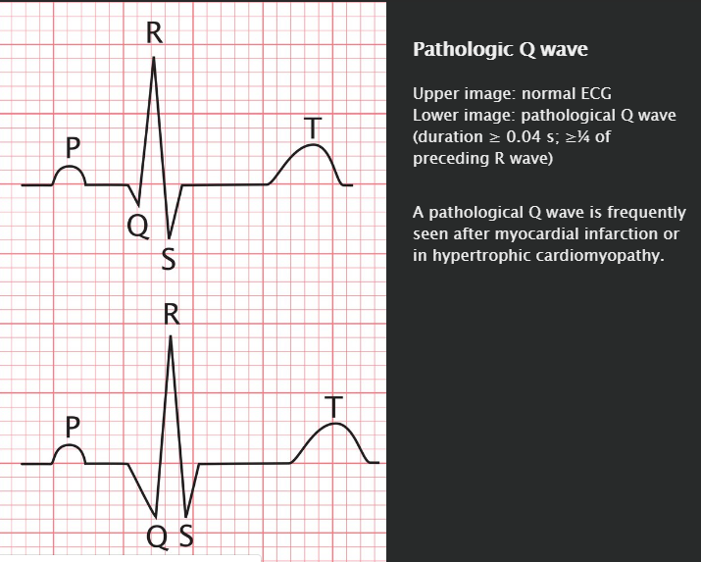

Slide 61
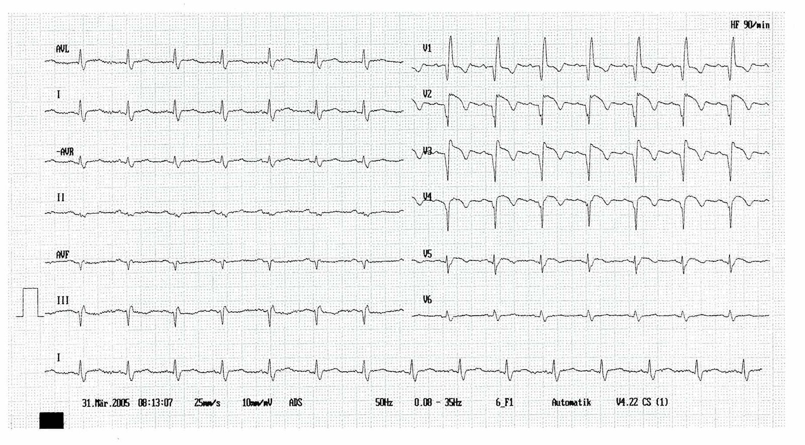
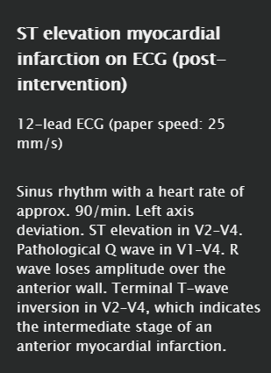

Slide 62

A new pathological Q wave represents myocardial infarction until proven otherwise!

Slide 63
ST segment
Physiological
The ST segment represents the interval between ventricular depolarization and repolarization
It is physiologically horizontal on the isoelectric line.

Slide 64
Pathological
ST elevation
An ST elevation is significant if:
  ≥ 0.1 mV in limb leads, or
  ≥ 0.2 mV in precordial leads!
The hallmark ECG finding of myocardial infarction!
  If significant ST elevations are present in ≥ 2 anatomically contiguous leads (corresponding to occlusion of a specific artery)
  The ischemia can be localized by which leads show ST elevation:
    Lateral MI (left circumflex artery occlusion): I, aVL, V₅₋₆
    Anterior MI (left anterior descending (LAD) artery occlusion): V₁₋₄
    Inferior MI (terminal branches of right or left coronary artery occlusion): II, III, aVF
Widespread ST elevations suggest pericarditis
LBBB may cause ST elevations due to repolarization abnormalities, therefore ST elevation cannot be used to diagnose MI in the presence of a LBBB.
Small, concave ST elevations may be a normal finding in young, healthy adults due to early repolarization.
From descending R: The most important cause is a myocardial infarction.
From (deep) S: perimyocarditis

Slide 65
Brugada pattern
Associated with Brugada syndrome: rare autosomal dominant condition that affects sodium channels and disturbs repolarization
Epidemiology: most common in Asian males
Clinical features
  Often an incidental finding, as patients are mostly asymptomatic
  Syncope
  Sudden cardiac death
Diagnosis
  Brugada pattern on ECG: Pseudo-RBBB with ST elevation in leads V₁₋₂
  Rule out underlying heart disease (e.g., stress test and echocardiography)
Treatment
  Implantable cardiac defibrillator (ICD) placement
  Screen all 1st-degree relatives annually with clinical exam and ECG
Complications
  Syncope
  Sudden cardiac death
  Increased risk of atrial fibrillation

Slide 66
ST elevation from a descending R is likely caused by a myocardial infarction!

Slide 67
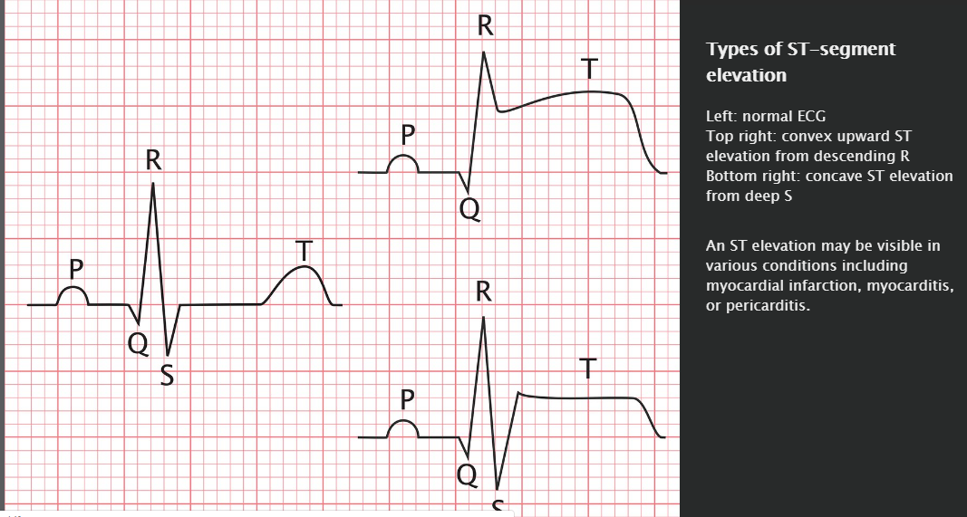

Slide 68
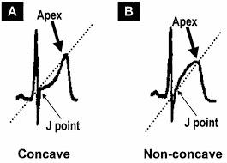

Slide 69
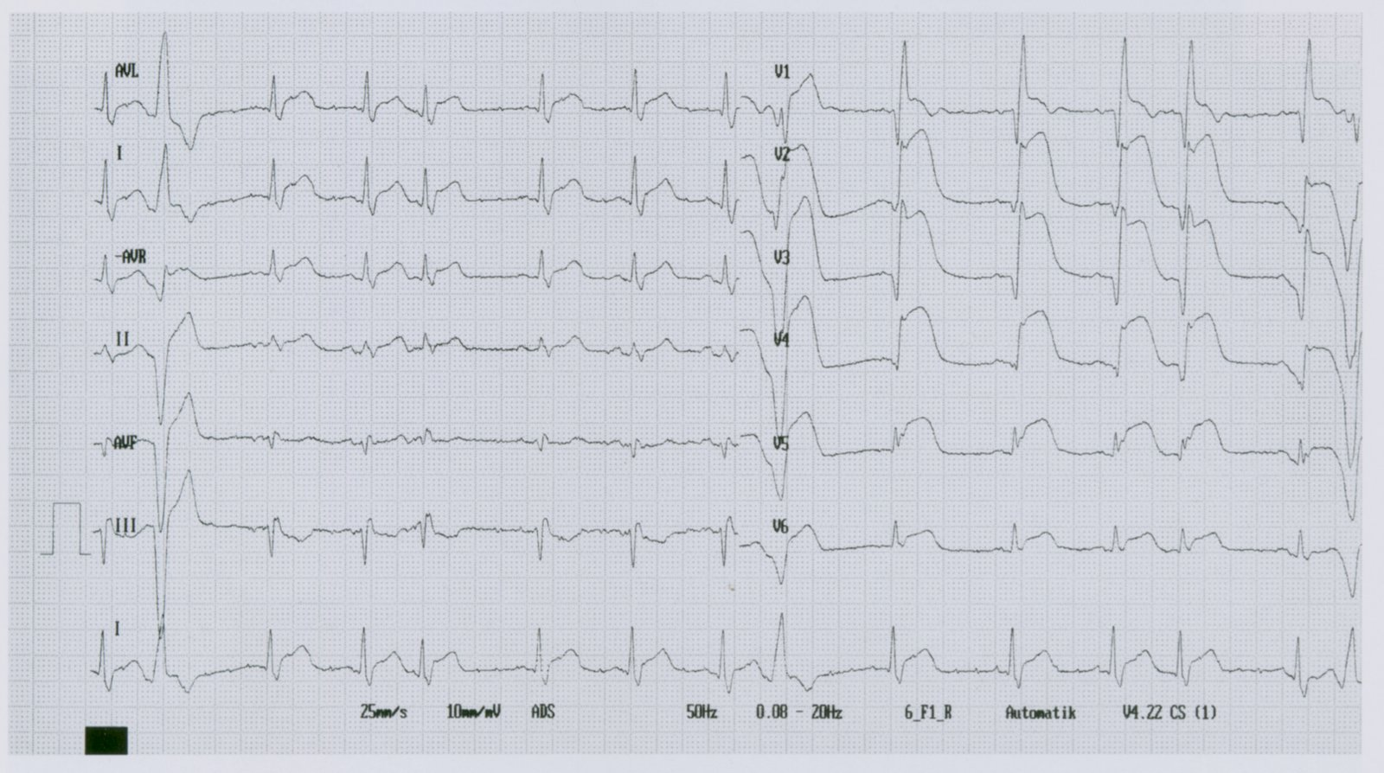
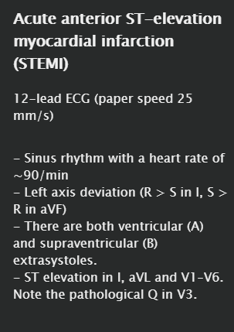

Slide 70
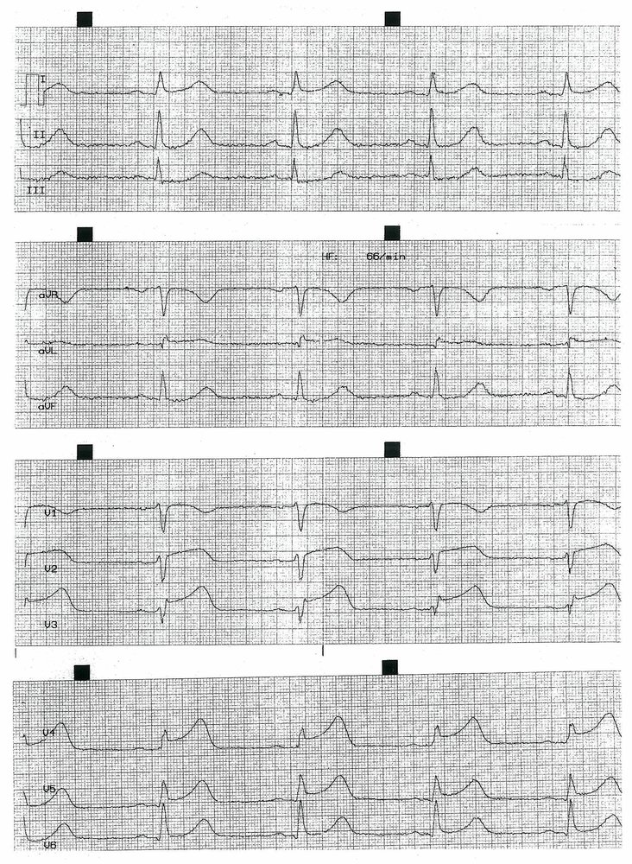
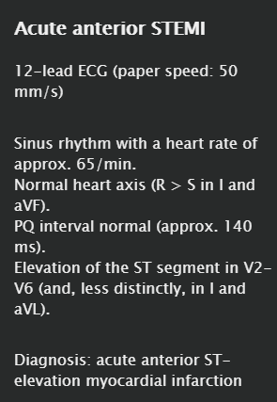

Slide 71
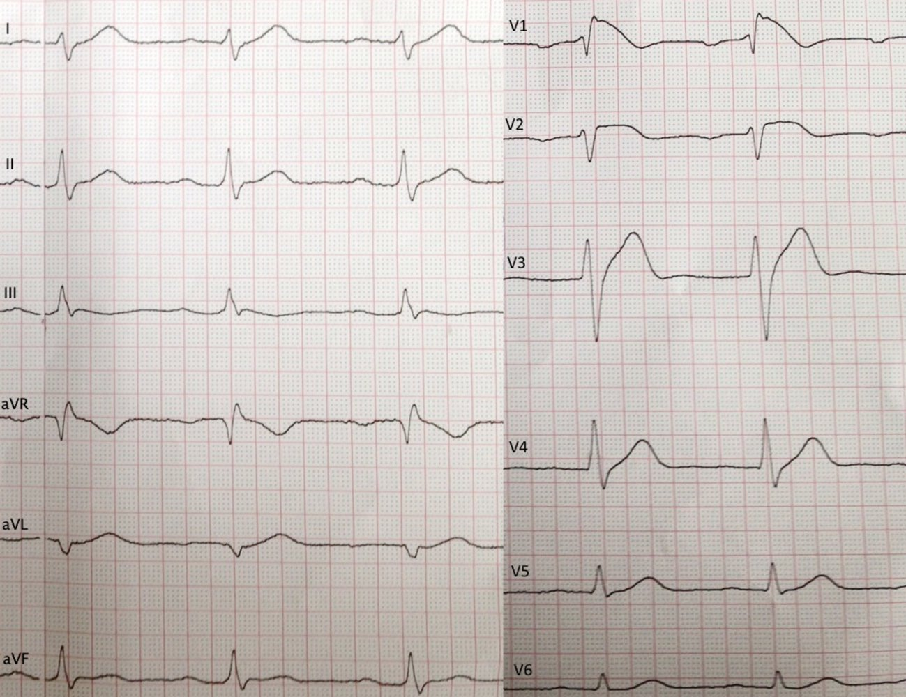
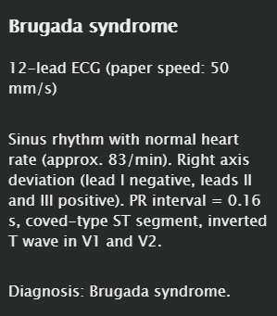

Slide 72
ST depression
Differential diagnosis
  Subendocardial myocardial ischemia (MI) (i.e., NSTEMI)
  Stress-induced MI (sign of coronary artery disease)
  Reciprocal change from MI
  Ventricular hypertrophy
    Left ventricular hypertrophy: ST depression with pre-terminal T-wave inversion in V₄₋₆
    Right ventricular hypertrophy: ST depression with pre-terminal T-wave inversion in V₁₋₃₍₄₎
  Digoxin effect
  Hypokalemia
  LBBB

Slide 73
The shape of the ST segment suggests the etiology of the depression.
  Downsloping ST depression or horizontal ST depression: myocardial ischemia
  Upsloping ST depression: mild manifestations may be normal, but may also occur in cases of tachycardia; sign of coronary heart disease if significantly manifested
  Sagging type ST-segment depression: characteristic of digoxin intake

Slide 74
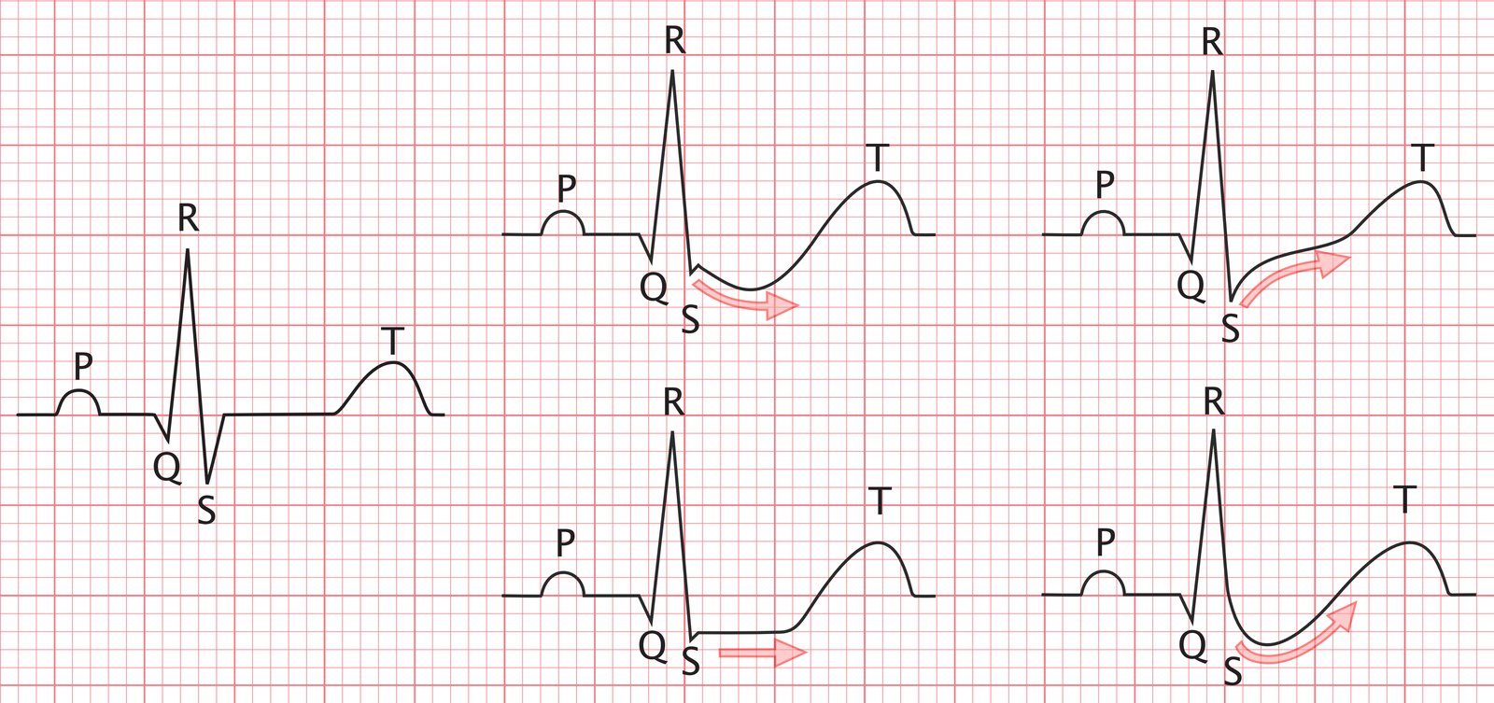
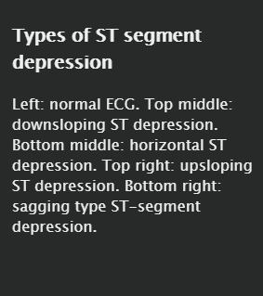

Slide 75
Progression of ST elevation myocardial infarction (STEMI) on ECG
The stages of myocardial ischemia are associated with characteristic (but variable) ECG findings:
Hyperacute T waves: very early and transient; usually have disappeared by the time ECG is performed
ST elevation at the J point: point at which the QRS complex completes and returns to the isoelectric line (i.e., the intersection of the S wave and the ST segment)
Progressive ST segment elevation, with added convexity
ST merges with T wave, forming a QRS-T segment (i.e., tombstone): usually with associated reciprocal ST depressions (see ST depression)
ST segment returns to isoelectric line, Q wave develops, and R wave loses amplitude
T-wave inversion
Progressive Q wave deepening and R wave shrinkage
T wave may or may not return to upright position

Slide 76
T wave
Physiological
The T wave represents the repolarization of the ventricles
The T wave is physiologically concordant to the QRS complex: positive if the QRS complex is positive or negative if the QRS complex is negative.

Slide 77
Pathological
T-wave inversion
Small T-wave inversions may be normal in the limb leads
Differential diagnosis
  Coronary heart disease
  Ventricular hypertrophy
  Perimyocarditis
  Myocardial infarction (STEMI (in the intermediate stage) or NSTEMI)
  Ventricular aneurysm
  Intracranial hemorrhage
  LBBB
  Acid/base disturbance

Slide 78
The shape of the T wave may help to narrow the differential diagnosis.Pre-terminal T-wave inversion: If the T wave is bisected, it points to the left. It may occur in:
  Perimyocarditis
  Ventricular hypertrophy
  Coronary heart disease
Terminal T-wave inversion: If the T wave is bisected, it points either to the right or upwards. It may occur in:
  Intracranial hemorrhage
  Perimyocarditis
  A persistent negative T wave following myocardial infarction may suggest an aneurysm.
  Myocardial infarction (STEMI (in the intermediate stage) or NSTEMI)

Slide 79
Peaked T wave
Tall, narrow, symmetrically-peaked
Differential diagnosis
  Hyperkalemia
  Hypermagnesemia
  High vagal tone

Slide 80
Hyperacute T wave
Broad, asymmetrically-peaked
Differential diagnosis
  Early stages of ST (segment) elevation myocardial infarction (STEMI)
  Prinzmetal's angina

Slide 81

Normally, if electric conduction in the heart is pathological (bundle branch block), repolarization is also disturbed → reliable evaluation of the ST segment or T wave is not possible!

Slide 82

New occurrence of a left bundle branch block associated with angina chest pain is defined as a STEMI!

Slide 83
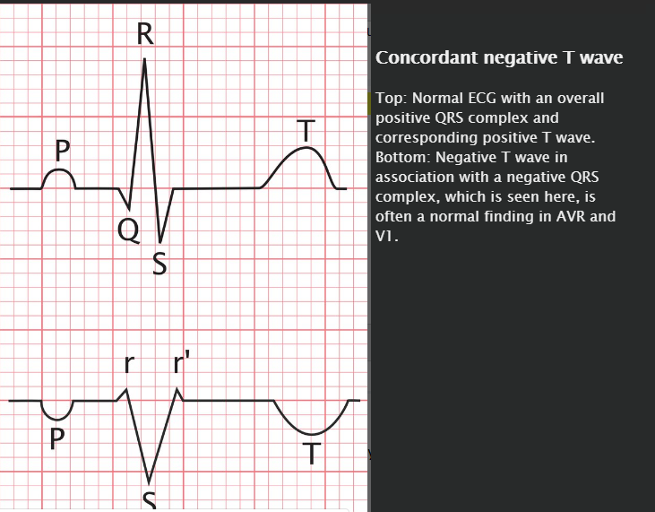

Slide 84
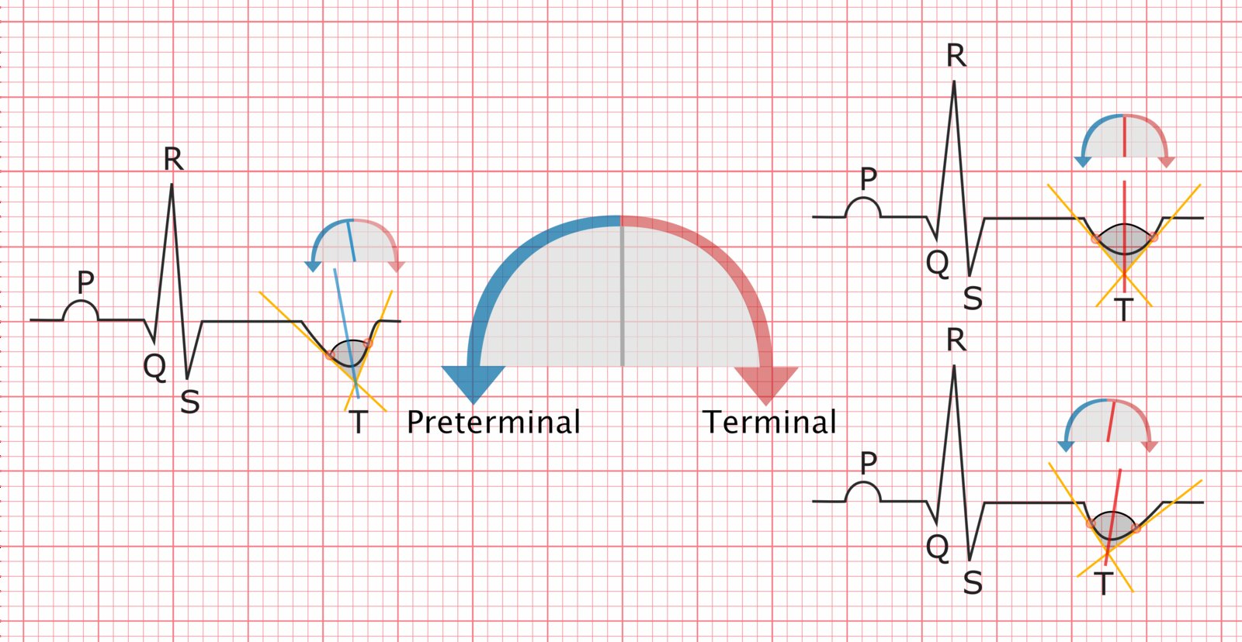


Slide 85


Slide 86
QT interval
Physiological
Measured from the beginning of the Q wave to the end of the T wave
Represents the entire duration of ventricular depolarization
Varies with heart rate, so correction for the heart rate is necessary (=QTc )
  QTc normally < 350–440 ms

Slide 87
Pathological
Prolongation of the QT interval
Possible differential diagnoses include:
Hypocalcemia
Hypokalemia
Inflammatory heart diseases (myocarditis, pericarditis)
Bundle branch block
High vagal tone
Rare congenital syndromes (e.g., congenital long QT syndromes such as Romano-Ward syndrome)
Acquired long QT syndrome
Hypothyroidism
Drug side effect (e.g., antiarrhythmic agents, antidepressants, phenothiazines, 1st-generation antihistamines)

Slide 88
Shortening of the QT interval
Possible differential diagnoses include:
Hypercalcemia
Hyperkalemia
Digoxin effect
Increased sympathetic tone (e.g., hyperthyroidism or fever)

