Slide 1
Hypertension
Updated 2024
Dr. Jamal Dabbas
Interventional cardiologist & internist

Slide 2
Summary
Hypertension
Hypertension is a common condition that affects one in every three adults. It is defined by the
The 2023 European Society of Hypertension (ESH) :
≥ 140/90 (if no other risk factors for IHD).
> 130/80 (if at least 2 risk factors for IHD).
By the AHA/ACC guideline as ≥ 130/80 mm Hg. Hypertension can be classified as either primary (essential) or secondary.

Slide 3
The 2023 European Society of Hypertension (ESH) and 2017 American College of Cardiology/American Heart Association (ACC/AHA) hypertension guidelines both emphasize, cardiovascular (CV) risk assessment.
Both guidelines recommend a lower BP target (<130/80 mm Hg) for adults at high risk to reduce the risk of CV events (10 year mortality risk more than 10 ).
Key differences include a lower diagnostic threshold by ACC/AHA criteria (<130/80 mm Hg) than by ESH criteria (<140/90 mm Hg) and age-based treatment targets (ESH criteria).

Slide 4
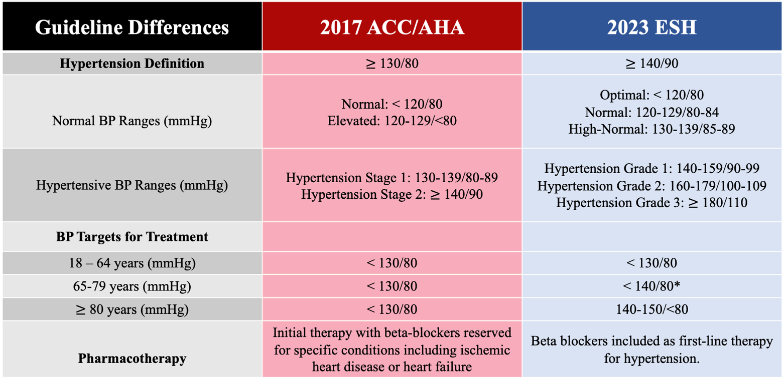

Slide 5
10-year risk of having a cardiovascular problem:
The ASCVD (atherosclerotic cardiovascular disease) risk score is a national guideline developed by the American College of Cardiology. It is a calculation of your 10-year risk of having a cardiovascular problem, such as a heart attack or stroke. This risk estimate considers age, sex, race, cholesterol levels, blood pressure, medication use, diabetic status, and smoking status.

Slide 6
What does risk score mean?
The ASCVD risk score is given as a percentage. This is your chance of having heart disease or stroke in the next 10 years. There are different treatment recommendations depending on your risk score.
A 0 to 4.9 percent risk is considered low. Eating a healthy diet and exercising will help keep your risk low.
Medication is not recommended unless your LDL, or “bad” cholesterol, is greater than or equal to 190.
A 5 to 7.4 percent risk is considered borderline. Use of a statin medication may be recommended if you have certain conditions, or “risk enhancers.” These conditions may increase your risk of a heart disease or stroke. Talk with your primary care provider to see if you have any of the risk enhancers in the list below.
A 7.5 to 20 percent risk is considered intermediate. It is recommended that you start with moderate-intensity statin therapy.
A greater than 20 percent risk is considered high. It is recommended that you start with high-intensity statin therapy.

Slide 7
ASCVD risk enhancers
Having any of the following conditions or risk enhancers should be considered to start treatment for hyperlipidemia and in borderline hypertension and hyperlipidemia:
Family history of early-onset ASCVD
Continually elevated LDL greater than or equal to 160 mg / dL ( ≥ 4.1 mmol / L)
Chronic kidney disease
Metabolic syndrome
Preeclampsia or premature menopause
Inflammatory diseases such as rheumatoid arthritis, psoriasis, or HIV
South Asian ancestry
Continually elevated triglycerides

Slide 8
Primary hypertension accounts for approx. 95% of cases of hypertension and has no detectable cause, whereas secondary hypertension is due to a specific underlying condition. Typical underlying conditions include renal, endocrine, or vascular diseases (e.g., renal failure, primary hyperaldosteronism, or coarctation of the aorta).

Slide 9
Clinically, hypertension is usually asymptomatic until organ damage occurs,
Which then commonly affects the brain, heart, kidneys, or eyes (e.g., retinopathy, myocardial infarction, stroke).
Common early symptoms of hypertension include headache, dizziness, tinnitus, and chest discomfort. Hypertension is diagnosed if blood pressure is persistently elevated on two or more separate measurements.

Slide 10
Further diagnostic measures include evaluation of possible organ damage (e.g., kidney function tests) and additional tests if an underlying disease is suspected.

Slide 11
Treatment of primary hypertension includes lifestyle changes (e.g., diet, weight loss, exercise) and pharmacotherapy. Commonly prescribed antihypertensive medications includes ACE inhibitors, angiotensin receptor blockers, thiazide diuretics, and calcium channel blockers.

Slide 12
To treat secondary hypertension, the underlying cause needs to be addressed. In cases of hypertensive emergency, a condition with a sudden and severe increase in blood pressure and impending end-organ damage, immediate treatment with intravenously administered antihypertensives is required to prevent serious consequences such as cerebral hemorrhage.

Slide 13
AHA/ACC 2017
BP catergory | Systolic blood pressure (mm Hg) |  | Diastolic blood pressure (mm Hg)
Normal blood pressure | < 120 | and | < 80
Elevated | 120–129 | and | < 80
Stage 1 hypertension | 130–139 | or | 80–89
Stage 2 hypertension | ≥ 140 | or | ≥ 90

Slide 14
Epidemiology
Most common risk factor for cardiovascular disease
One in three adults is affected (∼ 65% among those ≥ 60 years of age)
African American populations are more commonly affected than white or Asian populations.
60–75% of obese and overweight patients are affected.

Slide 15
Etiology
Primary (essential) hypertension
Accounts for 85–95% of cases of hypertension in adults
No specific cause; multifactorial etiology including genetic and environmental factors
Non-modifiable risk factors
  Positive family history
  Ethnicity (Africans)
  Advanced age
Modifiable risk factors
  Obesity
  Diabetes
  Smoking, excessive alcohol or caffeine intake
  Diet high in sodium, low in potassium
  Physical inactivity
  Psychological stress

Slide 16
Secondary hypertension
Accounts for 5–15% of cases of hypertension in adults.
Caused by a specific organic condition
  Endocrine hypertension
    Primary hyperaldosteronism (Conn syndrome)
    Primary hyperparathyroidism
    Pheochromocytoma
    Hypercortisolism (Cushing syndrome)
    Hyperthyroidism
    Acromegaly
    Congenital adrenal hyperplasia

Slide 17
  Renal hypertension
    Renovascular hypertension (e.g., due to renal artery stenosis)
    Polycystic kidney disease (ADPKD)
    Renal failure (renal parenchymal hypertension)
    Glomerulonephritis
    Systemic lupus erythematodes
    Renal tumors

Slide 18
Others
  Coarctation of the aorta
  Obstructive sleep apnea
  Medication: sympathomimetic drugs, corticosteroids, NSAIDs, oral contraceptives
  Recreational drug use: amphetamines, cocaine, phencyclidine

Slide 19
Clinical features
Hypertension is usually asymptomatic until complications of end-organ damage arise or an acute increase in blood pressure occurs ( hypertensive urgency below). Possible symptoms include:
Headaches, esp. early morning or waking headache
Dizziness, tinnitus, blurred vision
Flushed appearance
Epistaxis
Chest discomfort, palpitations; strong, bounding pulse on palpation
Nervousness
Fatigue, sleep disturbances
Additional symptoms of an underlying disease in secondary hypertension ( “Etiology” above)
Symptoms of end-organ damage (“Complications” below)

Slide 20
Since hypertension is often asymptomatic, regular screening is necessary to prevent end-organ damage!

Slide 21
Subtypes and variants
White coat hypertension (white coat effect)
Definition: arterial hypertension detected only in clinical settings or during blood pressure measurement at a physician's practice
Etiology: anxiety experienced by the patient
Clinical features: consistently normal blood pressure measurements and normalization of elevated blood pressure outside of a clinical setting
Diagnostics: 24-hour blood pressure monitoring

Slide 22
Isolated systolic hypertension (ISH)
Definition: increase in systolic blood pressure (≥ 140 mm Hg) with diastolic BP within normal limits (≤ 90 mm Hg)
Etiology
  Aging : ISH in elderly: decreased arterial elasticity and increased stiffness → decreased arterial compliance
  ISH secondary to increased cardiac output
    Anemia
    Hyperthyroidism
    Chronic aortic regurgitation
    AV fistula

Slide 23
Clinical features of ISH:
  Often asymptomatic
  Signs of increased pulse pressure: e.g., head pounding, rhythmic nodding, or bobbing of the head in synchrony with heartbeats
  Symptoms of hypertension ( “clinical features” above)
Diagnostics: “diagnosis of hypertension” below.
Treatment: thiazide diuretics or dihydropyridine calcium antagonists
Prognosis: high risk of cardiovascular events (MI, stroke, renal dysfunction)

Slide 24
Diagnostics in HTN:
General approach
Blood pressure monitoring
  Repeated measurements on both arms → Hypertension is diagnosed if the average blood pressure of ≥ 2 readings obtained on ≥ 2 separate visits is elevated
  Increased Bp at home readings or Long-term measurement of blood pressure (24 hours)

Slide 25
Initial evaluation of newly diagnosed hypertensive patients:Stratification of cardiovascular risk: fasting blood glucose, lipid profile (HDL, LDL, and triglycerides levels)
Evaluation of end-organ damage and underlying causes
  Complete blood count
  Renal function tests: serum creatinine and eGFR
  Serum Na⁺, K⁺, and Ca²⁺
  Urinalysis
  TSH
  Electrocardiogram (ECG)

Slide 26
Evaluation of secondary hypertension if an underlying condition is suspected (Next)

Slide 27
Approach to diagnosing secondary hypertension
General indicators of secondary hypertension
  Young age (< 30 years) at onset of hypertension or onset of diastolic hypertension at an older age (> 55 years)
  Abrupt onset of hypertension
  End-organ damage that is disproportionate to the degree of hypertension
  Recurrent hypertensive crises
  Resistant hypertension: hypertension that is resistant to treatment with ≥ 3 antihypertensives of different classes

Slide 28
Symptoms/signs of hypertension/coexistent illnesses:
Chest pain, shortness of breath, palpitations, claudication, peripheral edema, headaches, blurred vision, nocturia, hematuria, dizziness.Symptoms suggestive of secondary hypertension: Muscle weakness/tetany, cramps, arrhythmias (hypokalemia/primary aldosteronism), flash pulmonary edema (renal artery stenosis), sweating, palpitations, frequent headaches (pheochromocytoma), snoring, daytime sleepiness (obstructive sleep apnea), symptoms suggestive of thyroid disease (full list of symptoms).

Slide 29
Physical ExaminationA thorough physical examination can assist with confirming the diagnosis of hypertension and the identification of secondary hypertension and should include:Circulation and heart: Pulse rate/rhythm/character, jugular venous pulse/pressure, apex beat, extra heart sounds, basal crackles, peripheral edema, bruits (carotid, abdominal, femoral), radio-femoral delay.Other organs/systems: Enlarged kidneys, enlarged thyroid, increased body mass index (BMI)/waist circumference, fatty deposits and coloured striae (Cushing disease/syndrome).

Slide 30
Laboratory Investigations and ECGBlood tests: Sodium, potassium, serum creatinine and estimated glomerular filtration rate (eGFR). If available, lipid profile and fasting glucose and HbA1c.Urine test: urine analysis.12-lead ECG: Detection of atrial fibrillation, left ventricular hypertrophy (LVH), ischemic heart disease.Additional Diagnostic TestsAdditional investigations when indicated can be undertaken to assess and confirm suspicion of end organ damage or complications, coexistent diseases or/and secondary hypertension.

Slide 31
Imaging TechniquesEchocardiography: LVH, systolic/diastolic dysfunction, atrial dilation, aortic coarctation.Kidneys/renal artery and adrenal imaging: Ultrasound/renal artery Duplex ; CT-/MR-angiography: renal disease, renal artery stenosis, adrenal lesions, other abdominal pathology.Fundoscopy: Retinal changes, hemorrhages, papilledema, tortuosity, nipping.Brain CT/MRI: Ischemic or hemorrhagic brain injury due to hypertension( only if CNS symptoms or signs).Functional Tests and Additional Laboratory InvestigationsFurther testing for secondary hypertension (if suspected): Aldosterone-renin ratio, 24 hr urine catecholamine or metanephrines, late-night cortisol or other screening tests for cortisol excess.-Urinary albumin/creatinine ratio (if renal disease is suspected).-Serum kft , lipids , Ca, TSH .uric acid levels-Liver function tests

Slide 32
Diagnostic findings | Underlying condition
Hypokalemia | Conn syndrome Renal artery stenosis

Slide 33
Diagnostic findings | Underlying condition
Metabolic alkalosis and ↑ aldosterone-to-renin ratio | Conn syndrome

Slide 34
Diagnostic findings |  | Underlying condition
Difference in blood pressure | In both arms | Takayasu's arteritis Aortic dissection Aortic arch syndrome Subclavian steal syndrome
 | Of upper and lower limbs | Coarctation of the aorta distal to the left subclavian artery

Slide 35
Diagnostic findings | Underlying condition
Day time sleepiness (Epworth scale, Berlin questionnaire) Nondipping in 24-hour blood pressure monitoring | Obstructive sleep apnea

Slide 36
Diagnostic findings | Underlying condition
Increased 24-hour urinary metanephrines | Pheochromocytoma

Slide 37
Diagnostic findings | Underlying condition
↑ Serum calcium, ↑ PTH level, ↓ serum phosphates | Hyperparathyroidism

Slide 38
Diagnostic findings | Underlying condition
↑ Serum cortisol | Excess of glucocorticoids (e.g., Cushing syndrome)

Slide 39
Diagnostic findings | Underlying condition
↓TSH, ↑ free T4 | Hyperthyroidism

Slide 40
Nonpharmacologic measures (lifestyle changes)
Intervention | Target | Approximate systolic BP reduction in hypertensive patients
Decrease dietary sodium | Daily sodium intake < 1500 mg/day | 5-6 mm Hg
Increase dietary potassium | Daily potassium intake < 3.5–5 g | 4-5 mm Hg
DASH diet | Diet rich in fruits, vegetables, whole grains and low in staturated and trans fats | 11 mm Hg
Weight loss | Ideal body weight | 1 mm Hg per kg reduction in body weight in overweight individuals

Slide 41
Intervention |  | Target | Approximate systolic BP reduction in hypertensive patients
Exercise | Aerobic | 90 minutes per week 65–75% of maximum heart rate (e.g., brisk walk) | 5–8 mm Hg
 | Dynamic resistance (e.g., weight training) | 50–80% of maximum strength 90 minutes per week | 4 mm Hg
 | Isometric resistance (e.g., hand grip exercise) | 30–40% of maximum strength 4 repetitions/session, 3 sessions/week for 8–10 weeks | 5 mm Hg

Slide 42
Intervention | Target | Approximate systolic BP reduction in hypertensive patients
Decreased alcohol intake | ♂: ≤ 2 drink daily ♀: ≤ 1 drink daily | 4 mm Hg
Smoking cessation | Completely quit smoking | 3–5 mm Hg after 1 year; 6–7 mm Hg after 3 years ^{[39]}

Slide 43
Non-pharmcological measures should be implemented in any patient with a systolic BP > 120 mm Hg or a diastolic BP > 80 mm Hg!

Slide 44
Pharmacologic treatment
Guideline | JNC 8 | AHA/ACC 2017
Indication for pharmacological therapy | Adults without diabetes mellitus or chronic kidney disease Age ≥ 60 years: BP ≥ 150/90 mm Hg Age < 60 years: BP ≥ 140/90 mm Hg Adults with diabetes mellitus and/or chronic kidney disease: ≥ 140/90 mm Hg | BP ≥ 140/90 mm Hg BP ≥ 130/80 mm Hg with a 10-year-risk of cardiovascular death ≥ 10% (e.g., patients with age ≥ 65 years, diabetes mellitus, chronic kidney disease, heart failure, stable ischemic heart disease, peripheral artery disease, and/or previous stroke)

Slide 45
Specific recommendations
Initial treatment (including those with diabetes):
treatment should include a thiazide-type diuretic, calcium channel blocker (CCB), angiotensin-converting enzyme inhibitor (ACE-I), or angiotensin receptor blocker (ARB)
In adults with chronic kidney disease, initial (or add-on) treatment should include an ACE inhibitor or ARB to improve kidney outcome.

Slide 46
Initiation of treatment and follow-up
Number of antihypertensives
  Newly diagnosed hypertension with BP < 150/90 mm Hg: begin therapy with one primary antihypertensive
  Newly diagnosed hypertension with BP > 150/90 mm Hg: begin therapy with two primary antihypertensives

Slide 47
Reassess within one month of initiating or changing pharmacological therapy.
  If treatment goal is not reached with one drug: Increase the dose of the initial drug or add a second drug
  If treatment goal cannot be reached with two drugs
    Add a third drug.
    Evaluate for secondary causes of hypertension
  If blood pressure is controlled: reassess after 3–6 months and annually thereafter

Slide 48
Overview of antihypertensive drugs
Drug class | Comments | Side effects
Primary drugs
ACE inhibitors (e.g., lisinopril, captopril, enalapril) | Preferred as a first-line drug among patients with diabetes mellitus, renal disease (nephroprotective), ischemic heart disease, and heart failure ACEi and ARBs should not be used in combination | Dry cough, angioedema ↑ K⁺ Teratogenic
Angiotensin-receptor blockers (ARB) (e.g., losartan, valsartan) |  | ↑ K⁺ Teratogenic

Slide 49
Drug class | Comments |  |  | Side effects
Primary drugs
Thiazide diuretics (e.g., hydrochlorothiazide, chlorthalidone) |  | Preferred as a first-line drug among African Americans, salt-sensitive patients, and patients with isolated systolic hypertension | ↓ K⁺, ↓ Na ↑ Glucose and cholesterol

Slide 50
Drug class |  |  | Comments |  | Side effects
Primary drugs
Calcium channel blockers | Dihydropyridines (e.g., nifedipine, amlodipine) | Preferred as a first-line drug among African Americans and patients with isolated systolic hypertension Non-dihydropyridines are not commonly used Non-dihydropyridines are contraindicated in patients with reduced ejection fraction |  | Headache Constipation Gastroesophageal reflux Pedal edema Bradycardia (non-dihydropyridines)
 | Non-dihydropyridines (e.g., diltiazem, verapamil)

Slide 51
Drug class | Comments | Side effects
Secondary drugs
Beta blockers (e.g., propranolol, metoprolol, labetalol) | Should be avoided in hypertension due to aortic regurgitation Often used as a primary drug in patients with any of the following co-morbidities: Ischemic heart disease Heart failure Atrial fibrillation Thoracic aortic disease (e.g., dissection, aneurysm) Thyrotoxicosis Migraine Essential tremor | Bronchoconstriction with non-cardioselective beta blockers Increased triglycerides

Slide 52
Drug class | Comments | Side effects
Secondary drugs
Aldosterone antagonists (e.g., eplerenone, spironolactone) | Used in hypertension due to primary aldosteronism Can be used as add-on therapy in resistant hypertension | ↑ K⁺ Gynecomastia (spironolactone)

Slide 53
Drug class | Comments |  | Side effects
Secondary drugs
Direct renin inhibitors (e.g., aliskiren) |  | Should not be used in combination with ACEi or ARBs |  | ↑ K⁺
Alpha-1 blockers (e.g., prazosin, doxazosin) |  | Used in hypertension due to pheochromocytoma May be used as an adjunct in patients with benign prostatic hypertrophy |  | Postural hypotension Headache

Slide 54
Drug class | Comments | Side effects
Secondary drugs
Alpha-2 agonists (e.g., clonidine) | Rarely used | CNS depression Bradycardia Rebound hypertension
Direct arteriolar vasodilators (e.g., hydralazine) | Hydralazine is a first-line treatment in pregnancy Sodium nitroprusside is used only in hypertensive emergencies | Reflex tachycardia Sodium and water retention Cyanide toxicity with long-term use of sodium nitroprusside

Slide 55
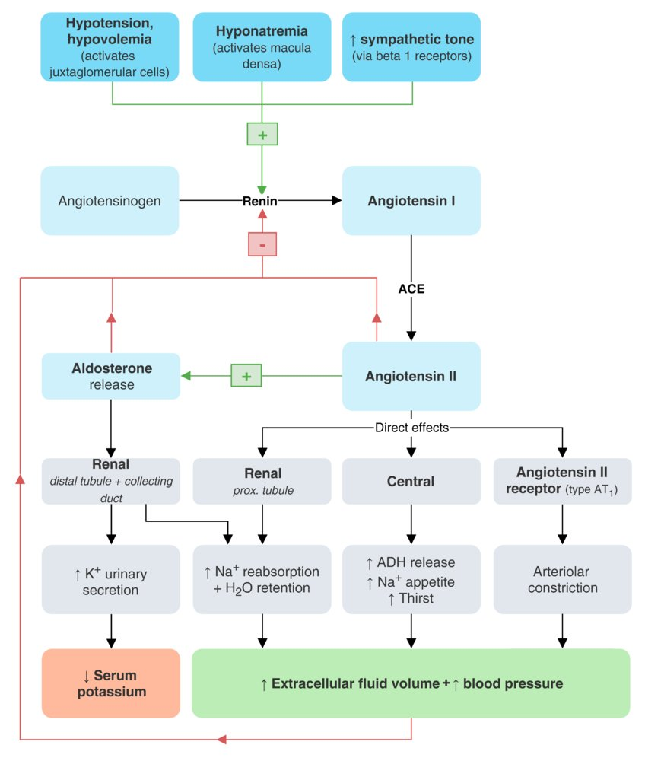

Slide 56
Pharmacologic treatment in pregnancy
First-line treatment:
methyldopa , labetalol, hydralazine (vasodilator), and nifedipine (CCB)
Second-line treatment:
thiazides, clonidine (a2-agonist)
Contraindicated:
furosemide, ACE-I, ARB, renin inhibitors (aliskiren)

Slide 57
Complications
Arterial hypertension leads to changes in the vascular endothelium, particularly of the small vessels, and can therefore affect any organ system.

Slide 58
Cardiovascular system
Congestive heart failure, dilated cardiomyopathy, hypertrophic cardiomyopathy
Coronary artery disease and myocardial infarction
Atrial fibrillation
Aortic aneurysm
Aortic dissection
Carotid artery stenosis
Peripheral artery disease

Slide 59
Brain
Stroke , TIA
Cognitive changes such as memory loss

Slide 60
Kidneys
Hypertensive nephrosclerosis
  Pathophysiology: chronic hypertension → narrowing of afferent and efferent arterioles → reduction of glomerular blood flow → glomerular and tubular ischemia → arteriolonephrosclerosis and fibrosis (focal segmental glomerulosclerosis) → end-stage renal disease
  Typical findings
    Initially microalbuminuria and microhematuria
    With disease progression, nephrosclerosis with macroalbuminuria (usually < 1 g/day) and progressive renal failure occur
    Biopsy: sclerosis in capillary tufts, arterial hyalinosis

Slide 61
Eyes
Hypertensive retinopathy
  Arteriosclerotic and hypertension-related changes of the retinal vessels
  Fundoscopic examination: cotton-wool spots, retinal hemorrhages (i.e., flame-shaped hemorrhages), arteriovenous nicking , marked swelling and prominence of the optic disk with indistinct borders due to papilledema and optic atrophy (end-stage disease)

Slide 62
Local treatment of the eye is not possible; therefore, systemic reduction of blood pressure is critical!

Slide 63
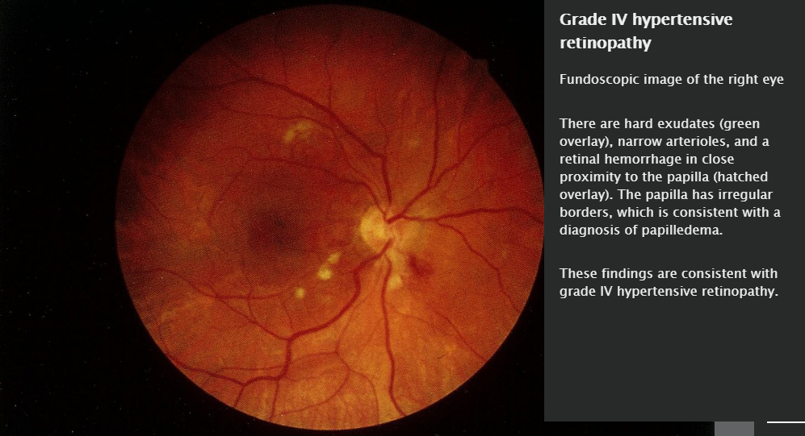

Slide 64
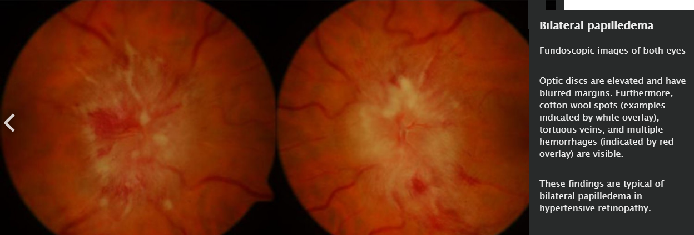

Slide 65
Hypertensive crisis (acute severe hypertension)
Definition: acute increase in blood pressure > 180/120 mm Hg

Slide 66
Classification
Hypertensive urgency: acute increase in blood pressure without symptoms and with no signs of organ damage
Hypertensive emergency: severely increased BP with signs of end-organ damage (mainly in the cardiovascular, central nervous, and renal system)

Slide 67
Cardiac presentation (chest pain, dyspnea)Pulmonary edema
Myocardial infarction
Congestive heart failure and dilated cardiomyopathy
Aortic dissection

Slide 68
Neurologic presentation (headache, confusion, blurry vision)Hypertensive encephalopathy
Ischemic or hemorrhagic stroke
Malignant hypertension: severe hypertension that occurs with retinopathy (flame hemorrhages, papilledema)

Slide 69
  Renal presentation:
  azotemia and/or oliguria due to acute renal failure

Slide 70
Treatment
Hypertensive urgency
Reinstitute or increase dosage of oral antihypertensive therapy

Slide 71
Hypertensive emergency
ICU admission and immediate initiation of intravenous antihypertensive therapy

Slide 72
Rate of blood pressure reduction
General goal
  Reduce BP by max. 25% within the first hour to prevent coronary insufficiency and to ensure adequate cerebral perfusion!
  Reduce BP to 160/100–110 mm Hg over next 2–6 hours
  Reduce BP to normal over 24–48 hours

Slide 73
In summary, blood pressure management is crucial in both intracerebral hemorrhage and acute ischemic stroke. To optimize best results , intensivists should aim to keep systolic blood pressure in intracranial hemorrhage below 140 mm Hg. In acute ischemic stroke, treatment is recommended for blood pressure above 220/110 if no intervention of thrombolytics is planned( in first 24hr post ischemic stroke). For patients eligible for intravenous alteplase therapy, maintaining a goal of <185/110 prior to thrombolytic therapy and below 180/105 after thrombolytic therapy or in cases of thrombectomy is recommended by guidelines.If blood pressure is above 220/110 mm Hg, a reduction of approximately 15% (but no more than 25%) over the first 24 hours is suggested, with gradual reduction thereafter to reach target as in regular HTN guidelines.

Slide 74
Special cases
Severe pre-eclampsia /eclampsia or pheochromocytoma:
systolic BP < 140 mm Hg within the first hour

Slide 75
Aortic dissection: systolic BP < 120 mm Hg within 20 minutes

Slide 76
Acute stroke:
Acute ischemic / intracerebral hemorrhage stroke
  If the patient qualifies for thrombolytic therapy
    Systolic BP < 185 mm Hg and diastolic BP < 110 mm Hg before thrombolysis
    BP < 180/105 mm Hg for the first 24 hours after thrombolysis
  If the patient does not qualify for thrombolytic therapy
    BP ≤ 220/110 mm Hg: DO NOT lower BP during the first 48–72 hours
    BP > 220/110 mm Hg: lower BP by 15% in the first 24 hours

Slide 77
Choice of intravenous antihypertensive drug
The selection of an intravenous antihypertensive and its dosing is based on the desired rate of BP decrease, the presence or absence of certain co-morbidities, and the drug's pharmacodynamic properties

Slide 78
Associated co-morbidity | Preferred intravenous antihypertensive | Comments
Aortic dissection | First-line: esmolol or labetalol Second-line (as an adjunct): nitroprusside or nicardipine | Beta blockers should precede administration of vasodilators (e.g., nicardipine, nitroprusside)

Slide 79
Associated co-morbidity | Preferred intravenous antihypertensive | Comments
Pulmonary edema | Clevidipine Nitroprusside Nitroglycerin | Nitroglycerin is contraindicated if the patient had received a phosphodiesterase inhibitor (e.g., sildenafil, tadafil) within the past 48 hours Beta blockers are contraindicated if the patient has pulmonary edema, bradycardia, 2nd/3rd degree heart block, or cardiogenic shock
Acute coronary syndrome | Nitroglycerin Esmolol Labetalol Nicardipine

Slide 80
Associated co-morbidity | Preferred intravenous antihypertensive | Comments
Acute renal failure | Clevidipine Nicardipine Fenoldopam | Nitroprusside and esmolol should be avoided

Slide 81
Associated co-morbidity | Preferred intravenous antihypertensive | Comments
Catecholamine excess | Clevidipine Nicardipine Phentolamine | Beta blockers should be avoided

Slide 82
Associated co-morbidity | Preferred intravenous antihypertensive | Comments
Acute ischemic stroke | Labetalol Clevidipine Nicardipine | Fenoldopam, nitroprusside, and nitroglycerin should be avoided
Acute intracerebral hemorrhage

Slide 83
Associated co-morbidity | Preferred intravenous antihypertensive | Comments
Eclampsia/severe pre-eclampsia | Hydralazine Labetalol Nicardipine | Nitroprusside is contraindicated

Slide 84
Intravenous antihypertensives
Calcium channel blocker: nicardipine, clevidipine Nitric-oxide dependent vasodilators: sodium nitroprusside, nitroglycerin Direct arterial vasodilators: hydralazine Anti-adrenergic drugs Selective beta-1 blocker: esmolol Non-selective beta blocker with alpha-1 antagonism: labetalol Non-selective alpha blocker: phentolamine D1 agonist: fenoldopam

Slide 85
The most commonly used drugs to treat hypertensive emergency are nitroprusside, labetalol, and nicardipine.

Slide 86
Update in hypertension therapy (AHA-December 28/12/2023):
Novel Antihypertensive May Boost Medication compliance.Fewer than 25% of adults being treated for hypertension keep their blood pressure (BP) within the target range, often due to low compliance with daily oral medication. Zilebesiran, an investigational, subcutaneously administered RNA interference therapeutic targeting angiotensinogen drug , has the potential to change that.In the phase 2 KARDIA-1 study, a single injection of zilebesiran effectively lowered BP in adults with hypertension for up to 6 months, with an encouraging side-effect profile.It is is a SQ injection every 3-6 months to control BP!! Zilebesiran, has the potential to control BP.

