Slide 1
ISCHEMIA HEART DISEASES (CAD)
Dr. Jamal Dabbas
Interventional cardiologist & internist

Slide 2
Chest pain (Anginal chest pain or angina pectoris, whether acute or chronic ) is the hallmark of IHD .

Slide 3
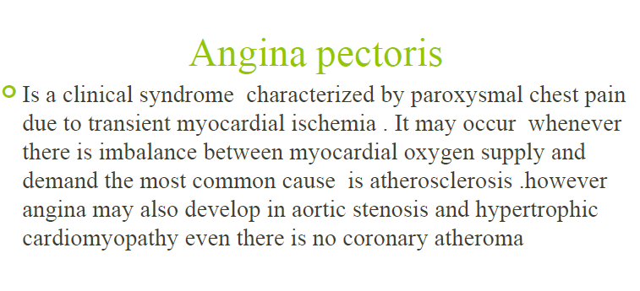

Slide 4
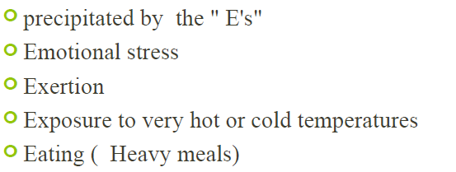

Slide 5
The 2023 (AHA)/ACC) Guidelines for the Management of Patients with Chronic Coronary Disease acknowledge chronic coronary disease (CCD) is heterogeneous group of conditions that includes obstructive and nonobstructive CAD with or without IHD or previous myocardial infarction (MI) , diagnosed only by noninvasive testing, and includes chronic angina symptoms. It acknowledges a shift in terminology away from “stable ischemic heart disease” to “chronic coronary disease.” This change reflects the continuum of care in patients with coronary artery disease from acute to chronic and mirrors the change made recently by the European Society of Cardiology (ESC). It reflects a terminology of acute versus chronic CAD, or acute versus chronic chest pain.This guideline provides a similar approach to management of patients with CCD.

Slide 6
Higher-risk signs in MI or unstable Angina (USA) . Signs include the following:
•Systolic blood pressure less than 100 mm Hg or overt hypotension
•Elevated jugular venous pressure
•Presence of a third or fourth heart sound
•New or worsening apical systolic murmur due to papillary muscle dysfunction
•Rales or crackles

Slide 7
Summary :
Acute coronary syndrome (ACS) refers to acute myocardial ischemia and/or infarction due to partial or complete occlusion of a coronary artery. There are three clinical entities grouped under ACS: unstable angina pectoris, non-ST-segment elevation myocardial infarction (NSTEMI), and ST-segment elevation myocardial infarction (STEMI). These conditions are often difficult to distinguish from one another based on clinical symptoms alone and require ECG and cardiac biomarker measurement to diagnose.

Slide 8
Typical cardiac chest pain is substernal in nature, often described as a feeling of pressure, and is relieved with rest and/or nitrate use. The pain may radiate to the left jaw, neck, epigastrium, upper back, and/or left arm. Additionally, autonomic symptoms such as diaphoresis, nausea, and vomiting are common. ECG and laboratory tests are important diagnostic tools in the initial evaluation.

Slide 9
In contrast to angina pectoris, NSTEMI and STEMI are characterized by the destruction of cardiac muscle tissue, which results in elevated cardiac enzymes in the blood (i.e., the elevation of troponin after 3–4 hours). Unlike unstable angina and NSTEMI, STEMI results in specific ECG changes (e.g., ST-segment elevation), which can help to determine the location and stage of the infarct.

Slide 10
The need for revascularization with either fibrinolysis or cardiac catheterization should be evaluated immediately, as revascularization significantly affects the prognosis of patients with myocardial infarction. Cardiac catheterization should be performed as soon as possible in STEMI and electively within 2–72 hours in high-risk NSTEMI and/or unstable angina.

Slide 11
Medical management of ACS includes anticoagulation, analgesics, and antiplatelet agents. Complications of ACS include congestive heart failure, papillary muscle rupture, arrhythmias, and sudden cardiac death. Subsequent management and secondary prevention of ACS depends on the presence of comorbidities, but most patients should be started on indefinite aspirin and statin therapy.

Slide 12
Summary :
Definition
Myocardial infarction: myocardial cell death caused by prolonged ischemia
Acute coronary syndrome: suspicion or confirmed presence of acute myocardial ischemia and/or myocardial infarction
  Further classified as unstable angina, NSTEMI, and STEMI
Sudden cardiac death (SCD): sudden, unexpected death caused by loss of cardiac function (most commonly due to lethal arrhythmia, e.g., ventricular fibrillation)

Slide 13
Acute Coronary Syndrome
•It consist of
–Myocardial Infarction: ST-elevation myocardial infarction (STEMI) or Non-ST-elevation myocardial infarction (NSTEMI)
•symptoms occur at rest
•evidence of myocardial necrosis - increased cardiac troponin or Creatine kinase-MB isoenzyme
–Unstable angina (UA).
•new-onset or rapidly worsening angina (crescendo angina),
•angina on minimal exertion
•or angina at rest in the absence of myocardial damage

Slide 14
Incidence
  ♂ > ♀ (3:1)
Risk factors: See atherosclerosis.
  Increasing age
  Male gender
  Personal history of angina and/or known coronary artery disease
  Family history of CAD
  Diabetes mellitus
  Systolic hypertension
  Tobacco use
  Hyperlipidemia

Slide 15
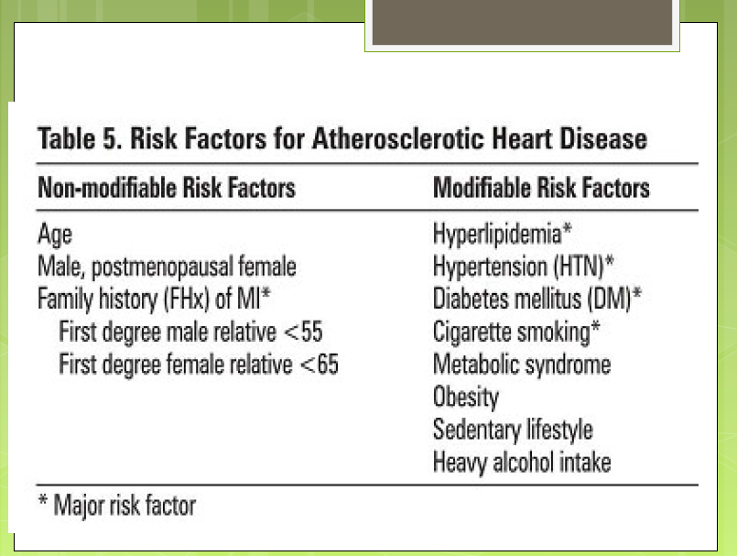

Slide 16
Etiology
Most common cause: coronary artery atherosclerosis
Less common
  Coronary artery dissection
  Coronary artery vasospasm (e.g., Prinzmetal angina, cocaine use)
  Vasculitis (e.g., polyarteritis nodosa, Kawasaki syndrome)
  Myocardial oxygen supply-demand mismatch
    Hypotension
    Severe anemia
    Hypertrophic cardiomyopathy
    Severe aortic stenosis

Slide 17
 | Unstable angina | Non-ST-segment elevation myocardial infarction (NSTEMI) | ST-segment elevation myocardial infarction (STEMI)
Description | Acute myocardial ischemia that is not severe enough to cause detectable quantities of myocardial injury biomarkers or ST-segment elevations on ECG | Acute myocardial ischemia that is severe enough to cause detectable quantities of myocardial injury biomarkers but without ST-segment elevations on ECG | Acute myocardial ischemia that is severe enough to cause ST-segment elevations on ECG

Slide 18
 | Unstable angina | Non-ST-segment elevation myocardial infarction (NSTEMI) | ST-segment elevation myocardial infarction (STEMI)
Clinical presentation | Angina at rest or with minimal exertion New-onset angina Severe, persistent, and/or worsening angina (crescendo angina) Autonomic symptoms may be present: diaphoresis, syncope, palpitations, nausea, and/or vomiting

Slide 19
 | Unstable angina | Non-ST-segment elevation myocardial infarction (NSTEMI) | ST-segment elevation myocardial infarction (STEMI)
Pathophysiology | Partial occlusion of coronary vessel → decreased blood supply → ischemic symptoms (also during rest) | Classically due to partial occlusion of a coronary artery Affects the inner layer of the heart (subendocardial infarction) | Classically due to complete occlusion of a coronary artery Affects full thickness of the myocardium (transmural infarction)
Cardiac biomarkers | No elevated cardiac biomarkers | Elevated cardiac biomarkers (e.g., troponin) | Cardiac biomarkers usually elevated (e.g., troponin)

Slide 20
 | Unstable angina | Non-ST-segment elevation myocardial infarction (NSTEMI) | ST-segment elevation myocardial infarction (STEMI)
ECG findings | Normal | Normal or nonspecific (e.g., ST depression, loss of R wave, or T-wave inversion) No ST elevations | ST elevations (in two contiguous leads) or new left bundle branch block
Treatment | Anticoagulation, aspirin, ADP receptor inhibitor Invasive management depends on risk stratification (TIMI score). |  | Immediate revascularization Anticoagulation, aspirin, ADP receptor inhibitor

Slide 21
Pathophysiology
ACS is most commonly due to unstable plaque formation and subsequent rupture.
Plaque formation and rupture
For plaque formation, see principles of coronary heart disease and atherosclerosis.
Stable atherosclerotic plaque: manifests as stable angina (symptomatic during exertion)
Unstable plaques are lipid-rich and covered by thin fibrous caps → high risk of rupture
Inflammatory cells in the plaque (e.g., macrophages) secrete matrix metalloproteinases → breakdown of extracellular matrix → weakening of the fibrous cap → minor stress → rupture of the fibrous cap → exposure of highly thrombogenic lipid core → thrombus formation → coronary artery occlusion

Slide 22
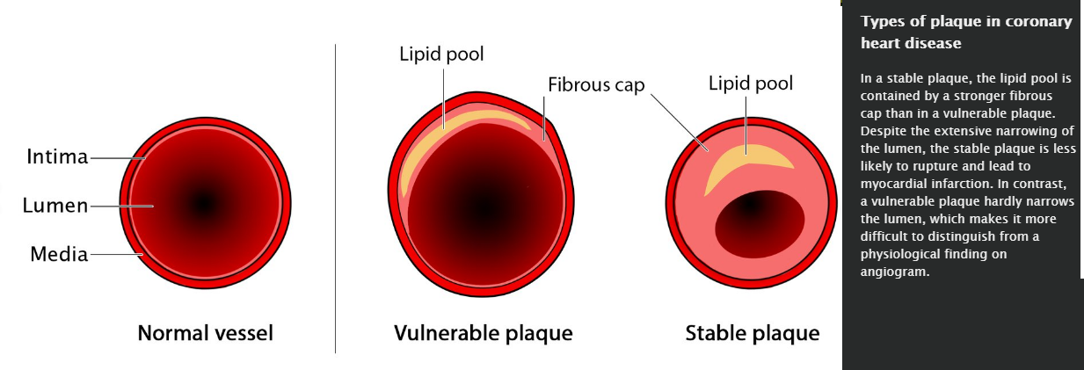

Slide 23
Pathophysiology of myocardial ischemia
Myocardial oxigen supply is decreased
  Narrowed coronary arteries (sclerosis, thrombus, spasmus, coronary embolism, vasculitis)
  Hypotension
  Severe anemia
  Methemoglobinemia, increased carboxyhemoglobin
Myocardial oxigen demand is increased
  Left ventricle hypertrophy
  Fever
  Hyperthyroidism
  Tachycardy

Slide 24
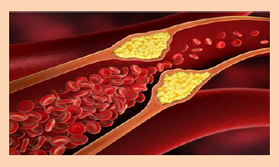
Atherosclerosis
The leading cause of ischemia
•Can affect any artery in the body
•Heart: angina, MI and sudden death;
•Brain: stroke and transient ischaemic attack;
•Limbs: claudication and critical limb ischaemia.

Slide 25
Atherosclerosis
•Progressive inflammatory disorder of the arterial wall characterised by focal lipid rich deposits of atheroma
•Remain clinically asymptomatic until
–large enough to impair tissue perfusion,
–Ulceration and disruption of the lesion result in thrombotic occlusion
•Clinical manifestations depend upon the site of the lesion.

Slide 26
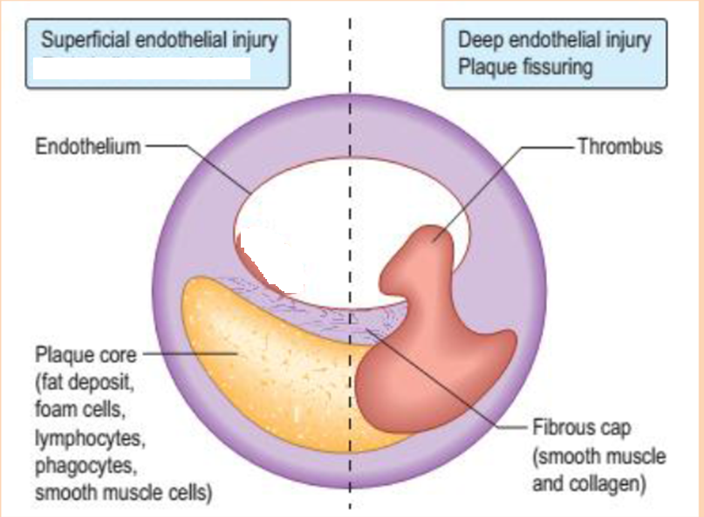

Slide 27
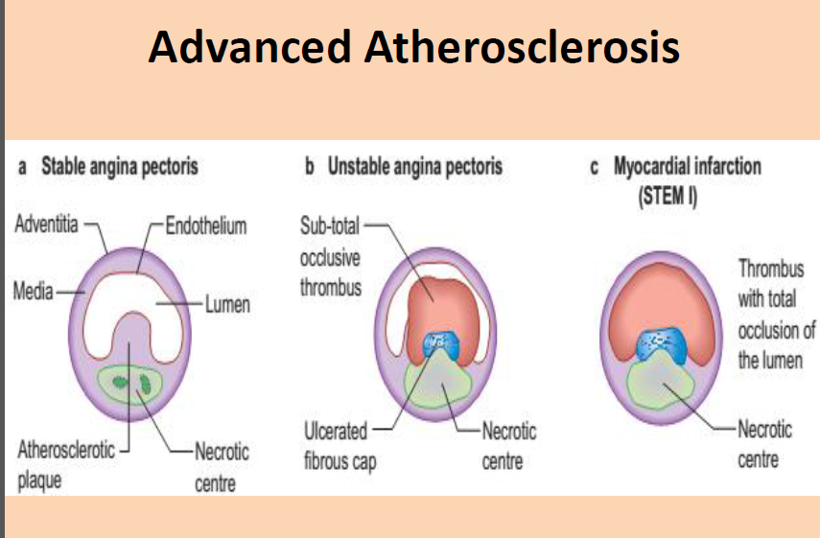

Slide 28
Coronary artery occlusion
Partial coronary artery occlusion
  Decreased myocardial blood flow → supply-demand mismatch → myocardial ischemia
  Usually affects the inner layer of the myocardium (subendocardial infarction)
  Typically manifests clinically as unstable angina and/or NSTEMI
Complete coronary artery occlusion
  Impaired myocardial blood flow → sudden death of myocardial cells (if no reperfusion occurs)
  Usually affects the full thickness of the myocardium (transmural infarction)
  Typically manifests clinically as STEMI

Slide 29
Clinical features
Classic presentation
  Acute retrosternal chest pain
    Typically described as dull, squeezing pressure and/or tightness
    Commonly radiates to left chest, arm, shoulder, neck, jaw, and/or epigastrium
    Precipitated by exertion or stress
    See also angina.
    The peak time of occurrence is usually in the morning (8–11 a.m.). ^{[10]}
  Dyspnea (especially with exertion)
  Pallor
  Nausea, vomiting
  Diaphoresis, anxiety
  Dizziness, lightheadedness, syncope

Slide 30
Other findings
  Tachycardia, arrhythmias
  Symptoms of CHF (e.g., orthopnea, pulmonary edema) or cardiogenic shock (e.g., hypotension, tachycardia, cold extremities)
  New heart murmur on auscultation (e.g., new S₄)
Specific to inferior wall infarction
  Epigastric pain
  Bradycardia
  Clear lung fields

Slide 31
Atypical presentation: minimal to no chest pain More likely in elderly, diabetic individuals, and women
Autonomic symptoms (e.g., nausea, diaphoresis) are often the chief complaint.
In patients with diabetes, chest pain may be completely absent (e.g., silent MI) due to polyneuropathy.

Slide 32

STEMI classically manifests acutely with more severe symptoms, while unstable angina/NSTEMI has a continuous course with milder symptoms.

Slide 33
The clinical manifestations of ischemic heart disease
Ischemic heart disease without clinical symptoms. Sudden death can be the presenting manifestation.
Cardiomegaly and heart failure that may have caused no symptoms prior the development of heart failure – ischemic cardiomyopathy.
Angina pectoris. Stable angina pectoris.
Unstable angina/Non ST-elevation myocardial infarction (NSTEMI)/STEMI = acut coronary syndromes

Slide 34
Angina pectoris
Angina pectoris is the most common manifestation of the ischemic heart disease.
The prevalence of angina pectoris is 16% in male and 11% in female population between 65 and 74 year of age.

Slide 35
The context of the symptom development can give clues to diagnosis and management
Effort angina
  Angina, which occurs predictably at a certain level of activity – stable exertional pectoris
  Angina only after minor exertion (a short walk or shaving) in the morning: first effort or warm-up angina The patient by midday may capable of much greater effort without symptoms.
  Emotional stress situation, haevy meal, exposure to cold, or smoking induced angina
Angina (1) that occurs at rest or with minimal exertion, usually lasts more than 10 min, (2) is severe and new of onset, and/or (3) that occurs with a crescendo pattern – more severe, prolonged, or frequent than previously -unstable angina, acute coronary syndrome
Focal spasm of an epicardial coronary artery (usually close to a noncritical obstruction of right coronary artery) leading to severe myocardial ischemia. It occurs at rest, and associated with transient ST-segment elevation. Prinzmetal’s variant angina

Slide 36
The typical clinical features of angina pectoris
The typical location of pain is retrosternal.
When the patient is asked to localize the sensation, he or she will typically place their hand over the sternum, somtetimes with a clenched fist, to indicate the squezzing. The pain can not be localized with one finger.
Usually described as heaviness, pressure, squezzing, or choking.
Usually associates with gradual intensification of symptoms over a period of minutes.
It lasts typically 2-5 min.
It can radiate to either shoulder and to both arms (especially the ulnar surfaces of the forearm and hand.
It can also arise in or radiate to the back, interscapular region, root of neck, jaw, teeth, and epigastrium. Rarely localized below the umbilicus or above the mandible.
Exertional angina is typically relieved by rest and nitroglycerin.

Slide 37
Associated symptoms and physical signs of angina pectoris
Associated symptoms
  Dyspnoe
  Fatique, faintness
  Nausea, vomiting
  Sweating
  Sense of impending doom (mostly in case of myocardial infarction)
Physical signs
  Third and fourth heart sounds
  Apical systolic murmur due to mitral regurgitation (impaired papillary muscle function)
  Pulmonary congestion

Slide 38
Summary of the characteristics of angina pectoris
Typical angina pectoris:
  Retrosternal chest pain (discomfort)
  Complaints occur after exertion or emotional stress
  The pain is relieved by rest and nitroglycerin
Atypical angina pectoris: only two from three characteristics (especially in women and diabetics, angina may be atypical in location and not strictly related to provocing factors)

Slide 39
Cardial and extracardial causes of chest discomfort
CARDIOVASCULAR DISEASES
  Ischemic heart disease
  Pericarditis
  Aortic dissection
  Aortic stenosis and regurgitation
  Hypertrophic cardiomyopathy
  Pulmonary hypertension
LUNG DISEASES
  Pulmonary embolism
  Pneumothorax
  Pleuritis
GASTROESOPHAGEAL DISEASES
  Gastroesophageal reflux
  Esophageal motility disorders
  Paptic ulcer
  Gallstones
NEUROMUSCULOSKELETAL DISEASES
  Fracture of a rib
  Spondylarthrosis
  Intercostal muscle cramp
  Tietze’ s syndrome
MISCELLANEOUS
  Subphrenic abscess
  Herpes zoster
  Splenic infraction

Slide 40
Differencial diagnosis of chest discomfort
Acute myocardial infarction
  The duration of the pain often more than 30 min
  Often more severe than angina
  Unrielived by nitroglicerin
  May be associated with evidence of heart failure or arrhythmia
Aortic dissection
  Tearing, ripping pain with abrupt onset
  Associated with hypertension, and/or connective tissue disorder
  Depending on the location of dissection:
    Loss of peripheral pulse
    Pericardial tamponad
    Murmur of aortic insufficiency

Slide 41
Differencial diagnosis of chest discomfort
Pericarditis
  The duration of the pain is hours to days
  Sharp, retrosternal pain that is aggravated by coughing, deep breath, or changes in body position (relieved by sitting and leaning forward)
Pulmonary embolism
  Abrupt onset of the pain. Location is often lateral
  Associated symptoms are dyspnea, tachycardy,and occasionally hemoptysis
Pneumothorax
  Sudden onset of pleuritic chest pain. Location:lateral to side of pneumothorax
  Dyspnea, decreased breath sounds, tympanic percussion sound.
Pneumonia or pleuritis
  Localized sharp, knifelike pain
  Pain is aggravated by inspiration and coughing
  Dyspnea, fever, rales, occasionally pleural rub

Slide 42
Differencial diagnosis of chest discomfort
Esophageal reflux
  Deep, burning discomfort that may be exacerbated by alcohol, aspirin, or some foods
  Worsened by postprandial recumbency, relieved by antacids
Ulcer disease
  Symptoms do not associated with exertion
  Prolonged burning pain
  Typically occurs 60 to 90 min after meals.

Slide 43
ECG
12-lead ECG is the best initial test if ACS is suspected.
Dynamic changes require serial ECG evaluation.
Compare to prior ECGs (if available).
ECG changes in STEMI
Acute stage: myocardial damage ongoing
  Hyperacute T waves ("peaked T wave")
  ST elevations in two contiguous leads with reciprocal ST depressions
Intermediate stage: myocardial necrosis present
  Absence of R wave
  T-wave inversions
  Pathological Q waves
Chronic stage: permanent scarring
  Persistent, broad, and deep Q waves
  Often incomplete recovery of R waves
  Permanent T wave inversion is possible.

Slide 44
The sequence of ECG changes over several hours to days: hyperacute T wave → ST elevation → pathological Q wave → T-wave inversion → ST normalization → T-wave normalization

Slide 45
An acute left bundle branch block accompanied by symptoms of acute coronary syndrome is also considered an ST-elevation myocardial infarction (STEMI) because ST elevations cannot be adequately assessed in the setting of an LBBB.

Slide 46
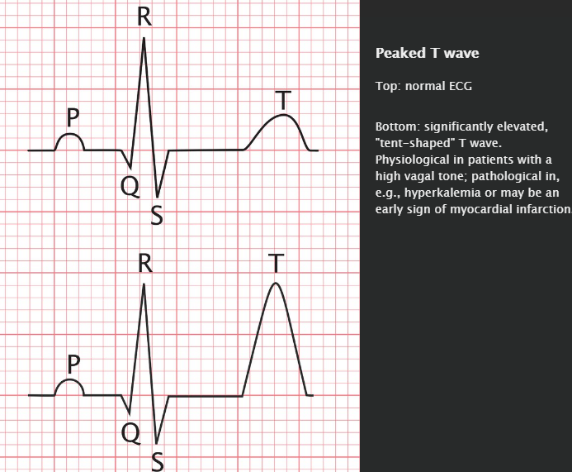

Slide 47
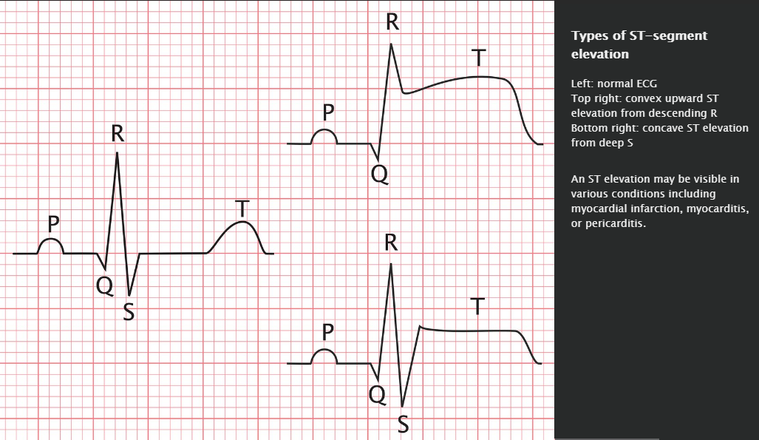

Slide 48
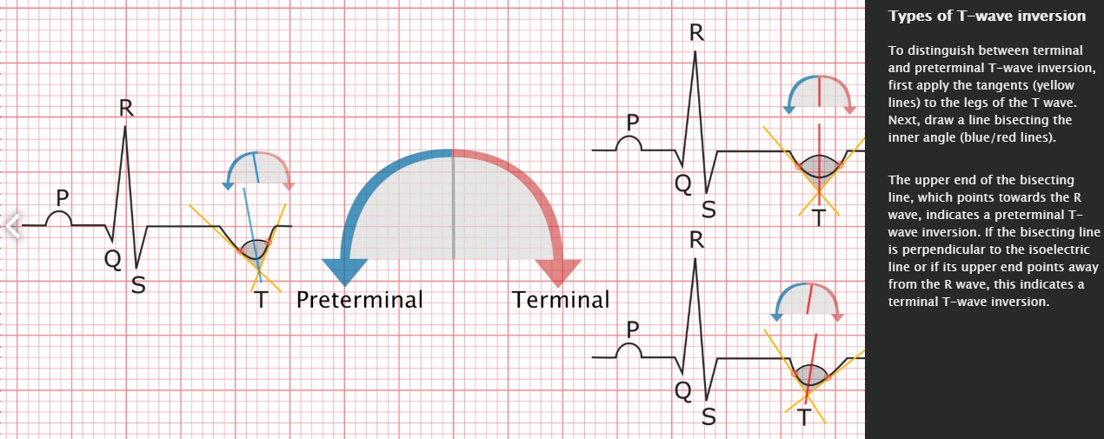

Slide 49
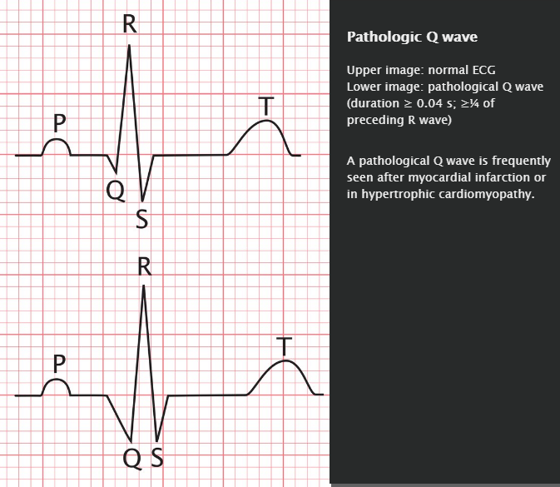

Slide 50
ECG changes in NSTEMI/unstable angina
No ST elevations present
Nonspecific changes may be present.
  ST depression
  Inverted T wave
  Loss of R wave

Slide 51
Localization of the myocardial infarct on ECG
ECG leads affected | Infarct location | Vessel involved
V₁–V₆ | Extensive anterior (Leads aVL and I can also be affected.) | Proximal left anterior descending artery (LAD)
V₁–V₂ | (Antero)septal | LAD
V₃–V₄ | (Antero)apical | Distal LAD
V₅–V₆ | (Antero)lateral | Diagonal branch of LAD Distal LAD Left circumflex artery (LCX) In rare cases, can also be caused by right coronary artery (RCA) infarct
I, aVL | Lateral | Proximal LCX
II, III, aVF | Inferior | RCA (more common) Distal LCX (less common)
V₃R–V₆R
V₇-V₉ | Posterior/posterolateral | Posterior descending artery (from RCA or LCX) Reciprocal ST depressions in V_{1–3} may also be seen

Slide 52

Infarction of the anterior wall is caused by obstruction of the LAD or its branches. Depending on the extent of anterior wall infarction, it results in ECG changes in the anterior wall leads (V_{1–6}) and/or I and aVL. Infarction of the inferior wall is caused by obstruction of the LCX or RCA or their branches, and ECG changes are seen in leads II, III, and aVF.

Slide 53

To remember the ECG leads with maximal ST elevation in anterior MI, think “SAL”: “Septal (V1–2), Apical (V3–4), Lateral (V5–6).

Slide 54

In severe transmural posterior wall infarction, there may not be any ST elevation on a standard 12-lead ECG.

Slide 55
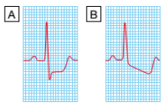
Investigation
•Resting ECG
–may show evidence of previous MI but is often normal, even in patients with severe CAD.
–The most convincing evidence of myocardial ischaemia - reversible ST segment depression or elevation, with or without T-wave inversion, at the time the patient is experiencing symptoms (during Angina or MI)
•Exercise ECG
–Exercise tolerance test (ETT) - standard treadmill or bicycle while monitoring the patient’s ECG, BP and general condition.
–Planar or down-sloping ST segment depression of ≥ 1mm is indicative of ischaemia (A, B)

Slide 56
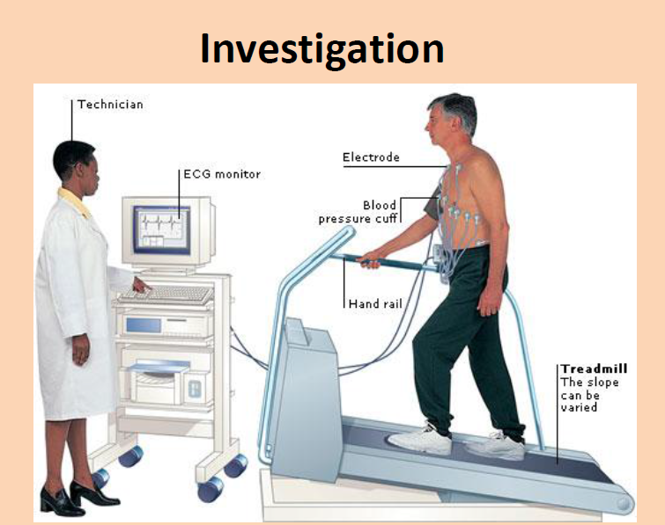

Slide 57
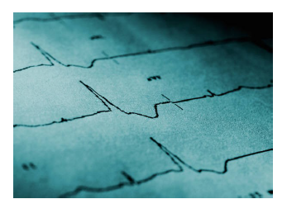
ECG in MI :
ST segment elevation / or depression , and/ or T inversion.
Differential diagnosis of ST segment depression
Myocardial Ischemia
LVH
Severe hypertension
Cardiomyopathy
Anemia
Hypokalemia
Digitalis effect

Slide 58
Differential diagnosis of ST segment elevation
Myocardial infarction
Prinzmetal’s angina
Ventricular aneurysm (post MI )
Acute pericarditis

Slide 59
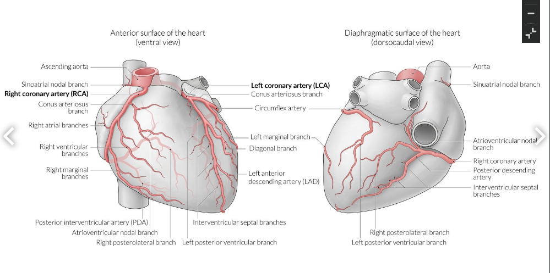

Slide 60
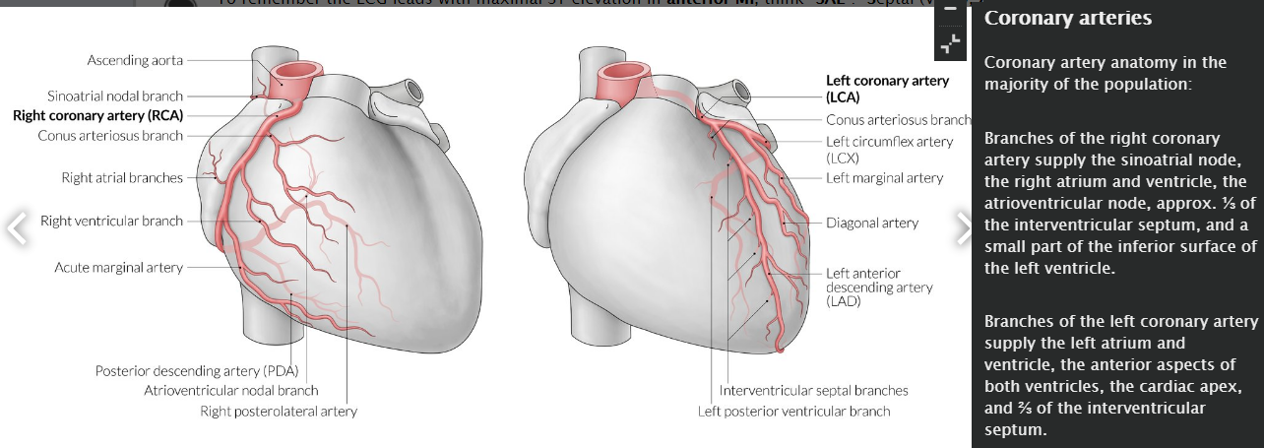

Slide 61
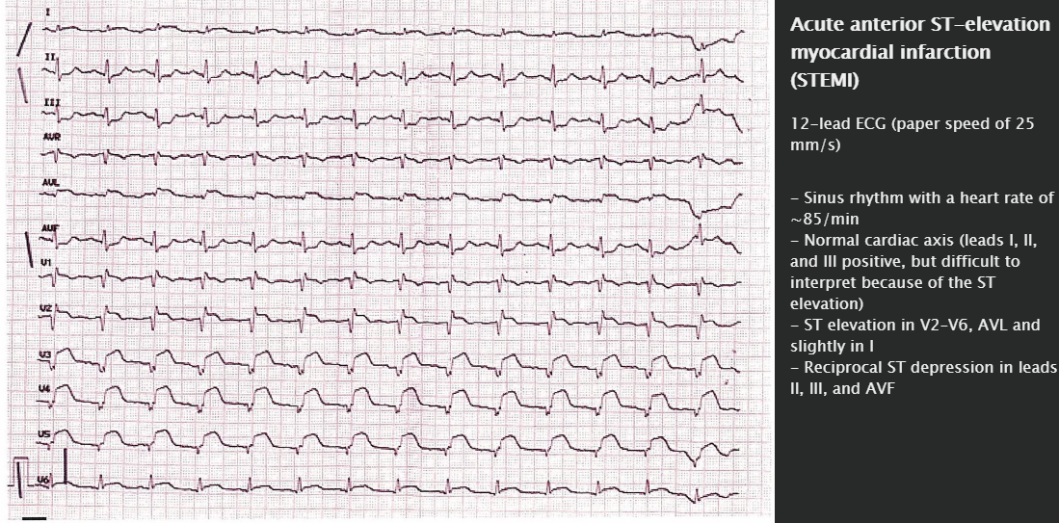

Slide 62
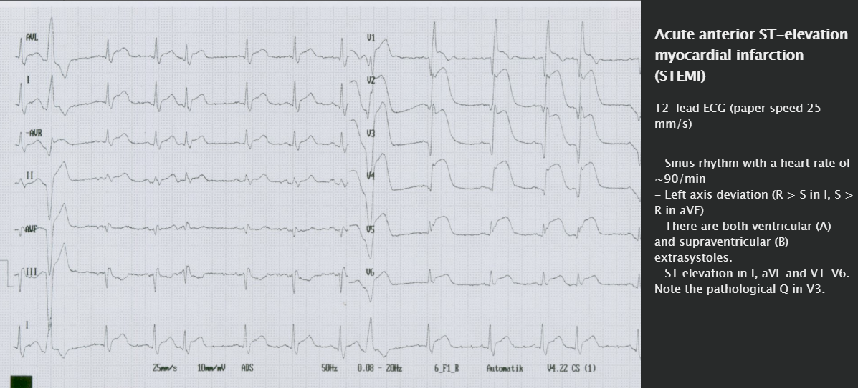

Slide 63
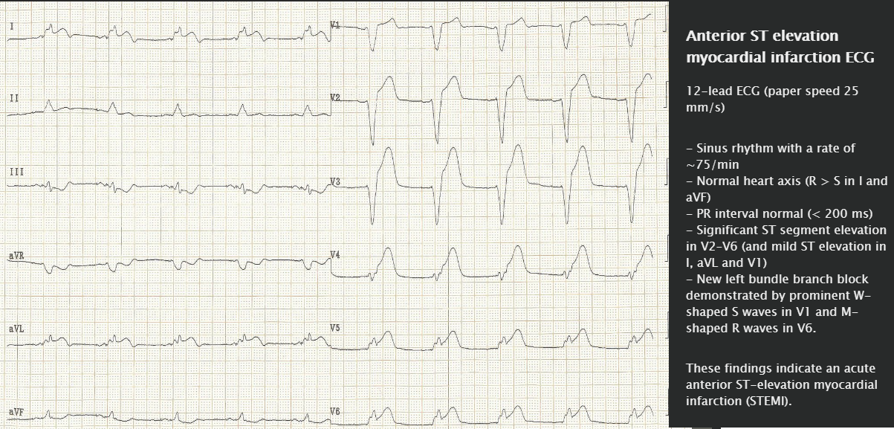

Slide 64
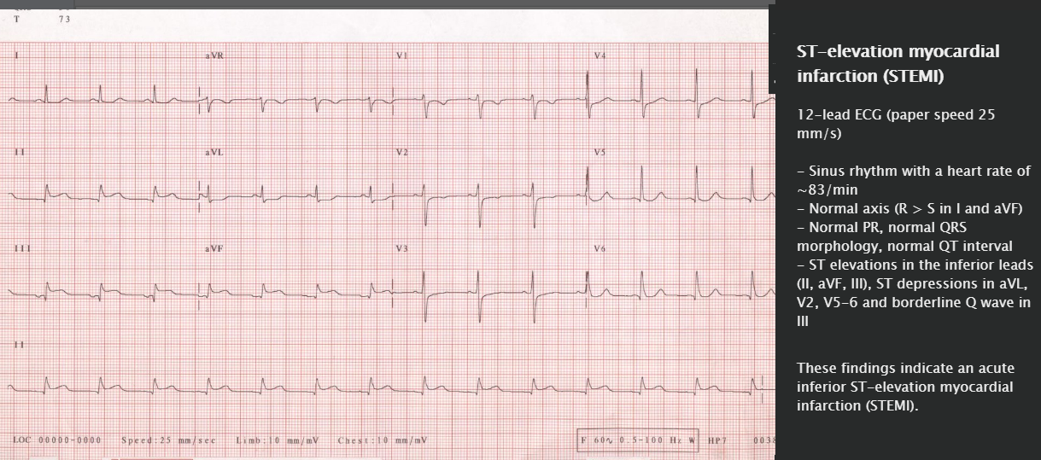

Slide 65
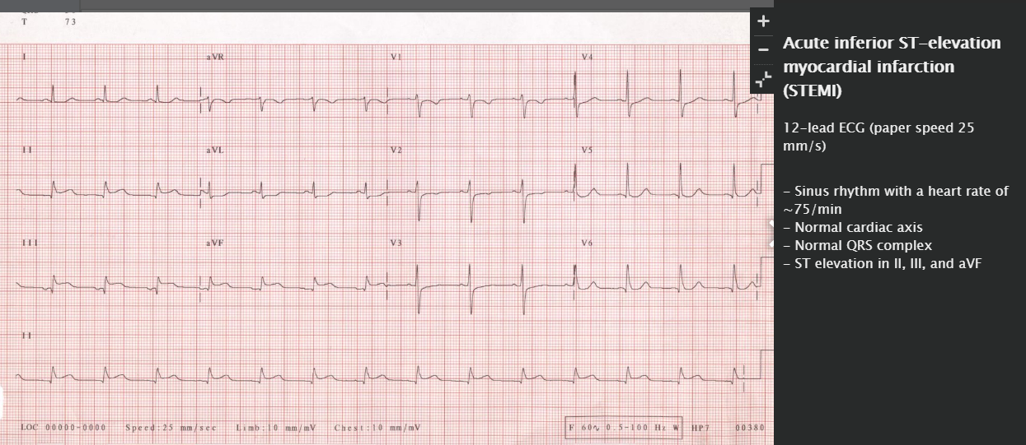

Slide 66
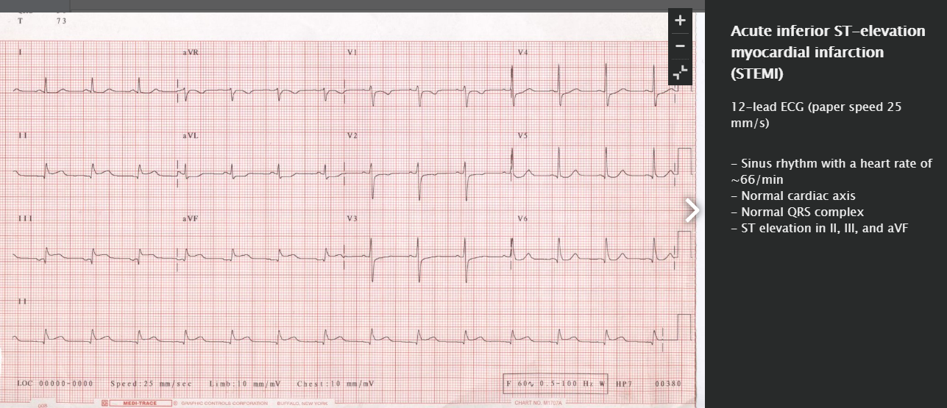

Slide 67
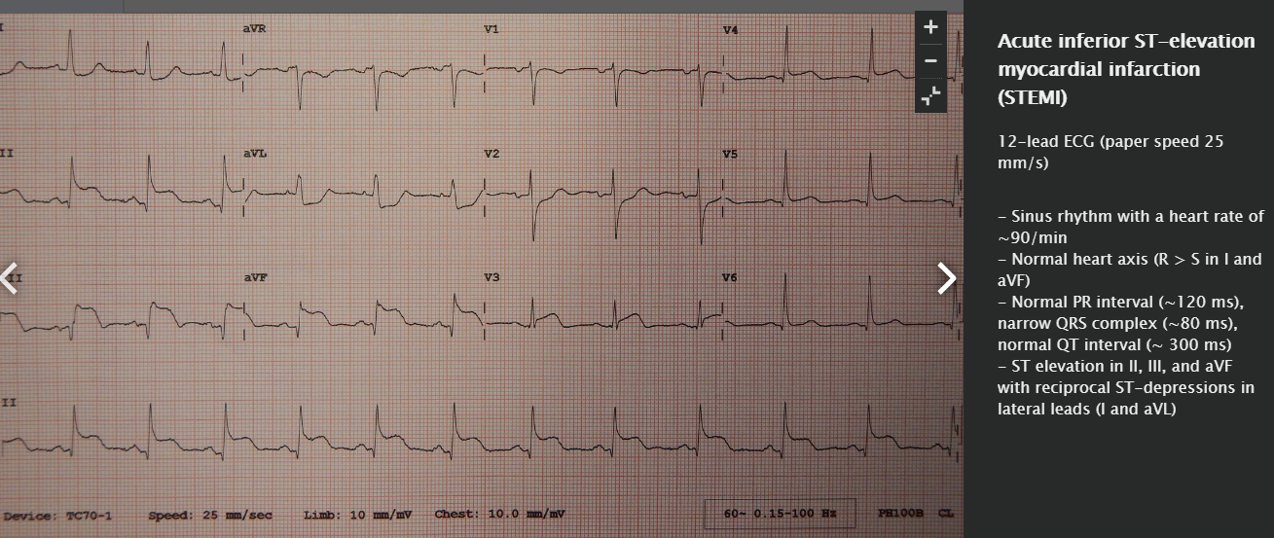

Slide 68
Laboratory findings
Cardiac biomarkers
Biomarker/enzyme | Rise* | Maximum* | Normalization* | Characteristics
Troponin T/I | 6-8 h | 12–24 h | 7–10 days | Cardiac-specific with high sensitivity for myocardial ischemia The degree of elevation often correlates with the size of the infarct. High sensitivity troponin assays (HscTn) may detect an increase in serum troponin level as early as 90 to 180 minutes after myocardial ischemia has occurred ^{[20]} Can also be elevated in other cardiac and noncardiac conditions: See differential diagnosis of increased troponin below.
Myoglobin | ∼ 1 h | 4–12 h | 24 h | Nonspecific marker that is no longer commonly used
CK-MB | ∼ 4–9 h | 12–24 h | 2–3 days | CK-MB is more specific to cardiac tissue than total CK. Can be helpful for evaluating reinfarction because of its short half-life but is no longer commonly used The degree of elevation often correlates with the size of the infarct.
* The values rise, reach a certain maximum, and normalize in the span of hours or days following the onset of myocardial infarction or its symptoms. Values and time references may vary based on the precise laboratory methods employed.

Slide 69
Serum troponin T is the most important cardiac-specific marker and may be measured 3–4 hours after the onset of myocardial infarction. CK-MB values correlate with the size of the infarct, reach a maximum after approximately 12–24 hours, and normalize after only 2–3 days, making CK-MB a good marker for evaluating reinfarction.

Slide 70
Additional findings
Elevated inflammatory markers: ↑ WBC, CRP
Elevated BNP: especially in heart failure
Elevated LDH
Elevated AST (SGOT)

Slide 71
Coronary angiography
Best test for definitive diagnosis of acute coronary occlusion
Can be used for concurrent intervention (e.g., PCI with stent placement)
Can identify site and degree of vessel occlusion
Indications include
  Acute STEMI
  Other high-risk ACS ( TIMI score below)
  See also cardiac catheterization.

Slide 72
The most commonly occluded coronary arteries (descending order): left anterior descending artery, right coronary artery, circumflex artery.

Slide 73
Coronary angiograph
Coronary angiography visualizes the location and
severity of coronary after stenosis. Narrowing
greater than 50% of luminal diameter is considered
clinically significant.

Slide 74
Indication of cath :
Unstable angina
Post myocardial infarction
Stable angina

Slide 75
Additional studies
Transthoracic echocardiogram
  Identification of any wall motion abnormalities and to assess LV function
  Important for risk assessment: In STEMI, the best predictor of survival is LVEF.
  Evaluation for complications: aneurysms, mitral valve regurgitation, pericardial effusion, free wall rupture
Cardiac CT
  May be considered as an alternative to invasive coronary angiography in patients with an intermediate risk of ACS (based on TIMI score)
  Allows for noninvasive visualization of the coronary arteries
  Contraindication: arrhythmias, tachycardia

Slide 76
Differential diagnosis of increased troponin
Cardiac causes
  Myocarditis
  Decompensated congestive heart failure
  Pulmonary embolism
  Cardiac arrhythmia, tachycardia
  Cardiac trauma
  Takotsubo cardiomyopathy
Noncardiac causes
  Renal failure
  Stroke
  Critical illness (e.g., sepsis)

Slide 77
Differential diagnosis of ST-elevations on ECG
Early repolarization
LBBB
Brugada syndrome
Myocarditis
Pericarditis
Pulmonary embolism
Hyperkalemia
Tricyclic antidepressant use
Poor ECG lead placement

Slide 78
Treatment
Any patient with ST elevations on ECG requires immediate evaluation for urgent revascularization. The administration of other therapies should not delay care.

Slide 79
All patients
Monitoring
  Serial 12-lead ECG
  Continuous cardiac monitoring
  Serial serum troponin measurement
Pharmacologic therapy
  Sublingual or intravenous nitrate (nitroglycerin or ISDN)
    For symptomatic relief of chest pain
    Does not improve prognosis
    Contraindications: inferior wall infarct (due to risk for hypotension), hypotension, and/or PDE 5 inhibitor (e.g., sildenafil) taken within last 24 hours

Slide 80
  Morphine IV or SC (3–5 mg)
    Only if the patient has severe, persistent chest pain or severe anxiety related to the myocardial event
    Administer with caution due to increased risk of complications (e.g., hypotension, respiratory depression) and adverse events
  Beta blocker
    Recommended within the first 24 hours of admission
    Avoid in patients with hypotension, features of heart failure, and/or risk of cardiogenic shock (e.g., large LV infarct, low ejection fraction).
  Statins: early initiation of high-intensity statin (such as atorvastatin 80 mg) regardless of baseline cholesterol, LDL, and HDL levels
  Loop diuretic (e.g., furosemide) if the patient has flash pulmonary edema or features of heart failure
Supportive care
  Intravenous fluids (e.g., normal saline): in patients with an inferior MI that causes RV dysfunction
  Oxygen: only in case of cyanosis, severe dyspnea, or SpO₂ < 90% (< 95% in STEMI)

Slide 81
Primary interventions of MI treatment include “MONA”: Morphine, Oxygen, Nitroglycerin, and Aspirin. But remember: Morphine, oxygen, and nitroglycerine are not necessarily indicated for every patient .

Slide 82
STEMI
Immediate revascularization
Revascularization is the most important step in the management of acute STEMI and initiation of further therapies (e.g., DAPT, anticoagulation) should not delay this step in management.
Emergent coronary angiography: with percutaneous coronary intervention (PCI)
  Preferred method of revascularization
  Balloon dilatation with stent implantation ( cardiac catheterization)
  Ideally, door-to-PCI time should be < 90 minutes. It should not exceed 120 minutes.

Slide 83
Thrombolytic therapy: tPA, reteplase, or streptokinaseIndications:
  If PCI cannot be performed < 120 minutes after onset of STEMI
  If PCI was unsuccessful
  No contraindications to thrombolysis
Contraindications
  Any prior intracranial bleeding
  Recent large GI bleeding
  Recent major trauma, head injury, and/or surgery
  Ischemic stroke within the past 3 months
  Hypertension (> 180/110 mm Hg)
  Known coagulopathy

Slide 84
Timing
  Symptom onset was within the past 3–12 hours
  Should be administered within < 30 minutes of patient arrival to the hospital
  Contraindicated if > 24 hours after symptom onset
PCI should be performed even if lysis is successful.

Slide 85
Coronary artery bypass grafting
Not routinely recommended for acute STEMI
Indications
  If PCI is unsuccessful
  If coronary anatomy is not amenable to PCI
  If STEMI occurs at the time of surgical repair of a mechanical defect

Slide 86
Medical therapy
Dual antiplatelet therapy: start as soon as possible
  Aspirin loading dose 162 mg–325 mg
  PLUS ADP receptor inhibitor: prasugrel, ticagrelor, or clopidogrel
  Dual antiplatelet therapy should be continued for at least 12 months after PCI with DES.
GP IIb/IIIa receptor antagonist (e.g., eptifibatide or tirofiban): should be considered in precatheterization setting
Anticoagulation
  Heparin or bivalirudin recommended
  Continue until PCI is performed or for 48 hours after a fibrinolytic is given.

Slide 87
"Time is muscle": Revascularization should occur as soon as possible in patients with STEMI!

Slide 88
Unstable angina/NSTEMI
Dual antiplatelet therapy: start as soon as possible
  Aspirin loading dose
  Plus ADP receptor inhibitor: clopidogrel or ticagrelor
  Dual antiplatelet therapy should be continued for at least 12 months if PCI with DES was performed.
Anticoagulation
  Heparin or enoxaparin
  Continue for the duration of hospitalization or until PCI is performed.
Immediate vs. delayed revascularization
  The indication for and timing of revascularization depends on the mortality risk (e.g., TIMI score).
  In patients with therapy-resistant chest pain, a TIMI score ≥ 3, ↑ troponin, and/or ST changes > 1 mm
    Consider the addition of a GPIIb/ IIIa inhibitor (e.g., tirofiban or eptifibatide)
    Plan for revascularization within 72 hours (e.g., angiography with PCI or CABG)

Slide 89
Fibrinolytic treatment is not recommended in patients with unstable angina or NSTEMI.

Slide 90
Management: Medical
•Antiplatelet therapy
–Low-dose (75-100 mg) aspirin
•reduces the risk of adverse events such as MI
•prescribed for all patients with CAD indefinitely
–Clopidogrel (75 mg daily)
•equally effective ALTERNATIVE and additive to Aspirin in cases of MI or USA.
•if aspirin causes dyspepsia or other side-effects
•Anti-anginal drug treatment: Five groups of drug
–Nitrates
–β-blockers
–calcium antagonists

Slide 91
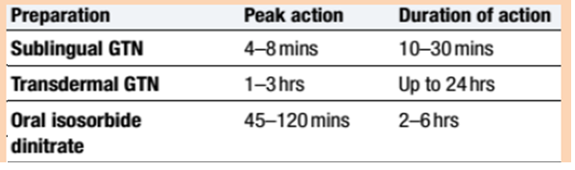
Management: Medical
•Nitrates
–act directly on vascular smooth muscle to produce venous and arteriolar dilatation
–Increase in myocardial oxygen supply
–Continuous nitrate therapy can cause pharmacological tolerance
•avoided by a 6–8-hour nitrate-free period
•Nocturnal angina: longacting nitrates can be given at the end of the day

Slide 92
Management: Medical
β-blockers: lower myocardial oxygen demand by reducing heart rate, BP and myocardial contractility
First line treatment
•provoke bronchospasm in patients with asthma.
Calcium antagonists (Non-dihydropyridine drugs)
Second line treatment (because of their rate-limiting action, verapamil and diltiazem are the calcium channel antagonists of choice if a β-blocker is contraindicated).
Don’t use combination of β-blockers and Non-dihydropyridine drugs) , Dihydropyridine calcium channel antagonist like nifedipine or amlodipine can be added to the β-blocker if there is persistent chest discomfort , but may cause an unwanted tachycardia if used alone.
A statin

Slide 93
Other drugs that occasionally used in Refractory Angina
•Potassium channel activators
–Do not exhibit the tolerance seen with nitrates.
–Nicorandil (10–30mg 12-hourly orally) - only drug in this class currently available for clinical use
•If channel antagonist
–Ivabradine is the first of this class of drug
–Induces bradycardia by modulating ion channels in the sinus node
–Comparatively, does not have other cardiovascular effects
–Safe to use in patients with heart failure

Slide 94
Coronary artery bypass grafting (CABG)
Alternative treatment to Percutaneous intervention cath.
•Stenosed artery is by-passed with
–internal mammary arteries
–radial arteries
–reversed segments of the patient’s own saphenous vein
•Major surgery under cardiopulmonary bypass,
•But in some cases, grafts can be applied to the beating heart: ‘off-pump’ surgery
•Operative mortality is approximately 1.5% but risks are higher
–elderly patients,
–with poor left ventricular function
–those with significant comorbidity, such as renal failure .

Slide 95
Subsequent measures
Secondary prophylaxis: See prevention of coronary heart disease, therapy of atherosclerotic diseases, and PTCA.
See coronary artery surgery.

Slide 96
Complications
0–24 hours post-infarction
Sudden cardiac death
  The most common underlying cause in elderly individuals is acute coronary syndrome (∼ 70% of cases).
  The most common cause is ventricular arrhythmia.
Arrhythmias
  Ventricular tachyarrhythmias
  AV block
  Asystole
  Atrial fibrillation
Acute left heart failure: death of affected myocardium → absence of myocardial contraction→ pulmonary edema
Cardiogenic shock

Slide 97
1–3 days post-infarction
Early infarct-associated pericarditis
  Typically occurs within the first week of a large infarct close to the pericardium
  Clinical features of acute pericarditis: pleuritic chest pain , dry cough , friction rub, diffuse ST elevations on ECG
  Complications (rare): hemopericardium, pericardial tamponade

Slide 98
3–14 days post-infarction
Papillary muscle rupture
  Usually occurs 2–7 days after myocardial infarction
  Can lead to acute mitral regurgitation
  Rupture of the posteromedial papillary muscle due to occlusion of the posterior descending artery is most common.
  Clinical features
    New holosystolic, blowing murmur over the 5th ICS on the midclavicular line
    Signs of acute mitral regurgitation: dyspnea, cough, bilateral crackles, hypotension

Slide 99
Ventricular septal ruptureUsually occurs 3–5 days after myocardial infarction
Due to structural degradation by macrophages
Most commonly due to LAD infarction (septal arteries arise from LAD)
Clinical features
  New holosystolic murmur over the left sternal border
  Acute-onset right heart failure (jugular venous distention, peripheral edema)
  Can progress to cardiogenic shock: tachycardia, hypotension, cool extremities, altered mental status
Treatment: emergency surgery and revascularization (often via CABG)

Slide 100
Left ventricular free wall rupture Usually occurs 5–14 days after myocardial infarction
Greatest risk during macrophage-mediated removal of necrotic tissue
Clinical features: chest pain, dyspnea, signs of cardiac tamponade (e.g., Beck triad)
Complications
  Cardiac tamponade
  LV pseudoaneurysm formation: rupture of LV wall that is contained by the pericardium

Slide 101
2 weeks to months post-infarction
Atrial and ventricular aneurysms
  Clinical features
    Persistent (> 3 weeks post-MI) ST elevation and T-wave inversions
    Systolic murmur, S₃ and/or S₄
  Diagnosis: echocardiography
  Complications
    Cardiac arrhythmias (risk of ventricular fibrillation)
    Rupture → cardiac tamponade
    Mural thrombus formation → thromboembolism (stroke, mesenteric ischemia, renal infarction , acute obstruction of peripheral arteries)
  Treatment: anticoagulation, possibly surgery

Slide 102
Postmyocardial infarction syndrome (Dressler syndrome): pericarditis occurring 2–10 weeks post-MI without an infective cause Thought to be due to circulating antibodies against cardiac muscle cells (autoimmune etiology)
Clinical features
  Signs of acute pericarditis: pleuritic chest pain , dry cough , friction rub
  Fever
  Laboratory findings: leukocytosis, ↑ serum troponin levels
  ECG: diffuse ST elevations
Treatment: aspirin, acetaminophen
Complications (rare): hemopericardium, pericardial tamponade

Slide 103
Arrhythmias (e.g., AV block)
Congestive heart failure (e.g., ischemic cardiomyopathy)
  Can occur at any time after an ischemic event
  Treatment: for patients with LVEF < 40% or signs of heart failure, ACE inhibitor/ARB and aldosterone antagonists have been shown to confer a mortality benefit.
Reinfarction

Slide 104
Prevention
Primary prevention
Treatment/avoidance of modifiable risk factors for atherosclerosis (e.g., smoking cessation, treatment of hypertension, etc.)
Healthy, plant-based diet
Regular physical activity and exercise
Low-dose aspirin is beneficial for certain high-risk groups. The choice to prescribe it should be made on an individual basis.

Slide 105
Secondary prevention
Lifestyle modification and treatment of modifiable risk factors (see “Primary prevention” above and treatment of diseases caused by atherosclerosis)
Platelet-aggregation inhibitors
  Lifelong low-dose aspirin 75–100 mg/day
  DAPT with the addition of an ADP receptor inhibitor (e.g., prasugrel, ticagrelor, or clopidogrel) is recommended for 12 months for all patients who have undergone PCI.
  Glycoprotein IIb/IIIa antagonists (e.g., abciximab) may be considered but are not used routinely.
Beta blockers: Unless contraindicated, all patients should be started on a beta blocker, which has been shown to confer a mortality benefit.
Statin: All patients should be started on a high-intensity statin (e.g., atorvastatin).
An aldosterone antagonist and ACE inhibitor/ARB are recommended for all patients with ischemic cardiomyopathy and an LV ejection fraction < 40% or symptoms of heart failure.

Slide 106

THANKS……

