Slide 1
Infective endocarditis
Dr. Jamal Dabbas
Interventional cardiologist & internist

Slide 2
Summary
Infective endocarditis (IE) is an infectious inflammation of the endocardium that affects the heart valves. The condition is a result of bacteremia, which is most commonly caused by dental procedures, surgery, distant primary infections, and nonsterile injections.

Slide 3
IE clinically presents with either an acute or subacute course. Acute disease is usually caused by Staphylococcus aureus and causes rapid endocardium destruction. Subacute progression is most commonly caused by viridans streptococci species and generally affects individuals with pre-existing damage to the heart valves, structural heart defects, or the presence of prosthetic valves.

Slide 4
Unlike acute disease, in which patients develop symptoms over a period of hours to days, subacute disease is associated with a progression of symptoms over weeks to months. Clinical features include constitutional symptoms (fatigue, fever/chills, malaise) in combination with signs of pathological cardiac changes (e.g., new or changed heart murmur, heart failure signs) and possibly manifestations of subsequent damage to other organs (e.g., glomerulonephritis, septic embolic stroke).

Slide 5
Diagnosis is made based on the Duke criteria, whose main features include positive blood cultures and evidence of endocardial involvement in echocardiography. Initial treatment of IE consists of empiric IV antibiotic therapy, which is then adapted to blood culture results and continued for four to six weeks. Prophylaxis is only administered in specific circumstances, e.g., in patients with preexisting heart conditions undergoing dental or surgical procedures. If left untreated, infective endocarditis can be fatal within a few weeks.

Slide 6
Etiology
Pathogens
Main pathogens | Characteristics
Staphylococcus aureus (45–65%) | Most common cause of acute IE for all groups (including IV drug users and patients with prosthetic valves or pacemakers/ICDs) Affects previously healthy valves Usually fatal within 6 weeks (if left untreated)

Slide 7
Main pathogens | Characteristics
Viridans streptococci (30%): S. sanguinis, S. mutans, S. mitis | Most common cause of subacute IE, especially in predamaged native valves (mainly the mitral valve Common cause of IE following dental procedures Produce dextrans that facilitate binding fibrin-platelet aggregates on damaged heart valves

Slide 8
Main pathogens | Characteristics
Staphylococcus epidermidis | IE transmitted via infected peripheral venous catheters Common cause of subacute IE in patients with prosthetic heart valves or pacemakers/ICDs

Slide 9
Main pathogens | Characteristics
Enterococci, especially Enterococcus faecalis (< 10%) | Multiple drug resistance Common cause of IE following nosocomial urinary tract infections (UTIs) Following gastrointestinal or genitourinary procedures

Slide 10
Main pathogens | Characteristics
Streptococcus gallolyticus | S. gallolyticus is associated with colorectal cancer If S. gallolyticus is detected, colonoscopy is indicated

Slide 11
Main pathogens | Characteristics
Gram-negative HACEK group | Physiological oral pharyngeal flora (∼ 3% of cases of IE) In patients with poor dental hygiene and/or periodontal infection

Slide 12
Main pathogens | Characteristics
Candida species Aspergillus fumigatus | Causes IE in immunosuppressed patients Causes IE in IV drug abusers Cause of IE after cardiosurgical interventions

Slide 13
Risk factors
Demographics
  Male sex
  Age > 60 years

Slide 14
Preexisting conditions
  Previous IE
  Prosthetic heart valves
  Congenital heart defects: cyanotic congenital heart disease, & unrepaired congenital heart disease.
  Heart transplantation.

Slide 15
Bacteremia source
  Dental procedures (highest risk), infected peripheral venous catheters, or infected surgery
  Non-sterile venous injections (e.g., IV drug abuse)
  Bacterial infections of various organs (e.g., UTIs, spondylodiscitis)

Slide 16
Pathophysiology
Pathogenesis: localized infection or contamination → bacteremia → bacterial colonization of damaged valve areas → formation of fibrin clots encasing the vegetation → valve destruction with loss of function
  Preexisting valvular endothelial damage or prosthetic valves predispose to bacterial colonization, especially of those that cause subacute IE
  Frequency of valve involvement: mitral valve > aortic valve > tricuspid valve > pulmonary valve

Slide 17
Clinical consequences
  Bacterial thromboemboli from bacterial vegetation → vessel occlusion with infarctions
  Formation of immune complexes and antibodies against tissue antigens → glomerulonephritis, Osler nodes

Slide 18
Clinical features
Course of disease
 | Acute bacterial endocarditis | Subacute bacterial endocarditis | Prosthetic valve endocarditis
Course | Acute onset Rapid, fulminant progression ( days to weeks) More severe constitutional symptoms (e.g., high fever) | Insidious onset Slow progression (weeks to months) Less severe constitutional symptoms (e.g., low fever possible, often absent) | Early-onset: < 60 days after surgery Late-onset: ≥ 60 days after surgery

Slide 19
 | Acute bacterial endocarditis | Subacute bacterial endocarditis | Prosthetic valve endocarditis
Main pathogens | Most common: S. aureus Others: group A hemolytic streptococci, S.pneumoniae,N.gonorrhoeae | Most common: viridans streptococci species Others: nonenterococcal group D streptococci and enterococci | Early onset: S. epidermidis or S. aureus (most common) Late-onset: S. epidermidis (most common)

Slide 20
Constitutional symptoms
Fever and chills (∼ 90% of cases), tachycardia
General malaise, weakness, night sweats, weight loss
Dyspnea, cough, pleuritic chest pain
Arthralgias, myalgias

Slide 21
Cardiac manifestations
New heart murmur development or change to a preexisting one
  Mitral valve regurgitation → holosystolic murmur, loudest at the heart's apex, and radiates to the left axilla
  Tricuspid valve regurgitation → holosystolic murmur; loudest at the left sternal border ; seen in IV drug users and concomitant HIV infection, immunosuppressed patients, and patients with central venous catheters
  Aortic valve regurgitation → early diastolic murmur; loudest at the left sternal border

Slide 22
Signs of progressive heart failure (e.g., dyspnea, edema)
Signs of acute cardiac decompensation (pulmonary edema)
Arrhythmias
  Suspect perivalvular abscess in patients with infective endocarditis who develop a new conduction abnormality (e.g., a third-degree atrioventricular block)

Slide 23
Extracardiac manifestations
These manifestations are mainly caused by bacterial microemboli and/or the precipitation of immune complexes .
Petechiae; especially splinter hemorrhages (hemorrhages underneath fingernails)
Janeway lesions: non-tender, erythematous macules on palms and soles (due to microemboli and microabscesses with neutrophilic capillary infiltration)
Osler nodes: painful nodules on pads of the fingers and toes

Slide 24
Roth spots: retinal hemorrhages with pale centers
Signs of acute renal injury, including hematuria and anuria
Splenomegaly and possible LUQ pain
Neurological manifestations (e.g., seizures, paresis)
Signs of pulmonary embolism (e.g., dyspnea)
Possible arthritis

Slide 25

Infective endocarditis should always be considered as a cause of fever of unknown origin (FUO), especially if a new heart murmur develops!

Slide 26

FROM JANE - Fever, Roth's spots, Osler nodes, Murmur, Janeway lesions, Anemia, Nail bed hemorrhage, Emboli

Slide 27
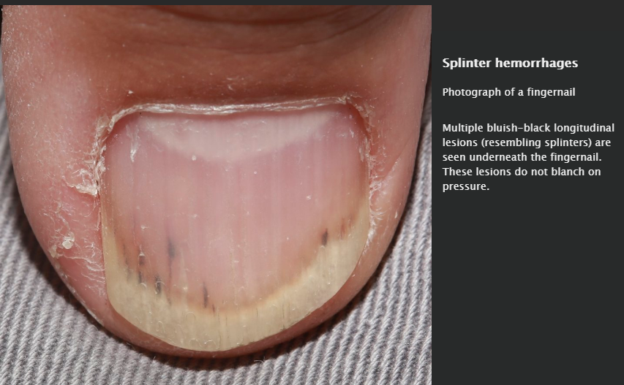

Slide 28
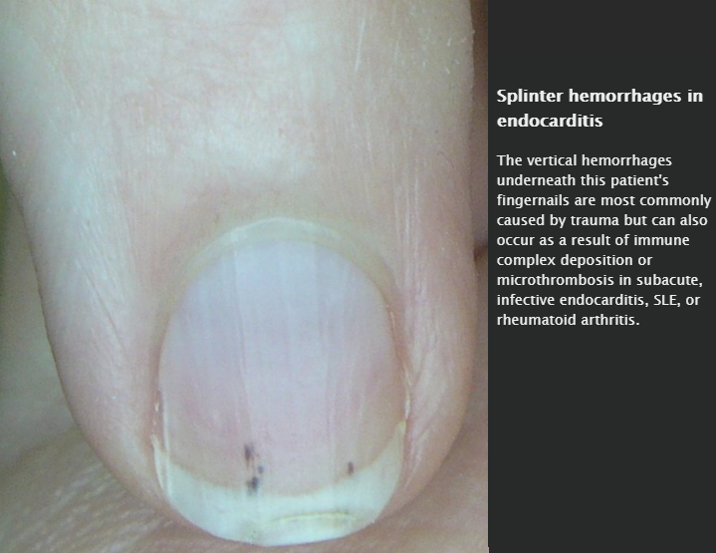

Slide 29
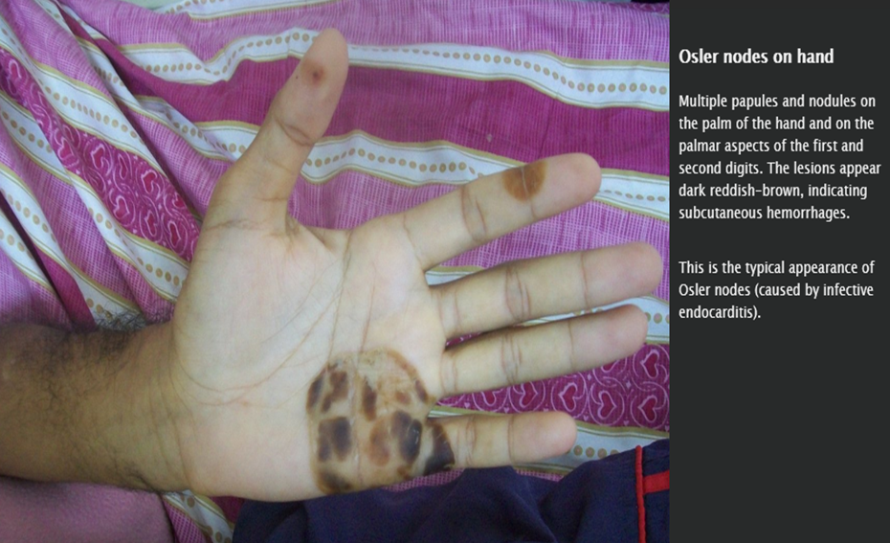

Slide 30
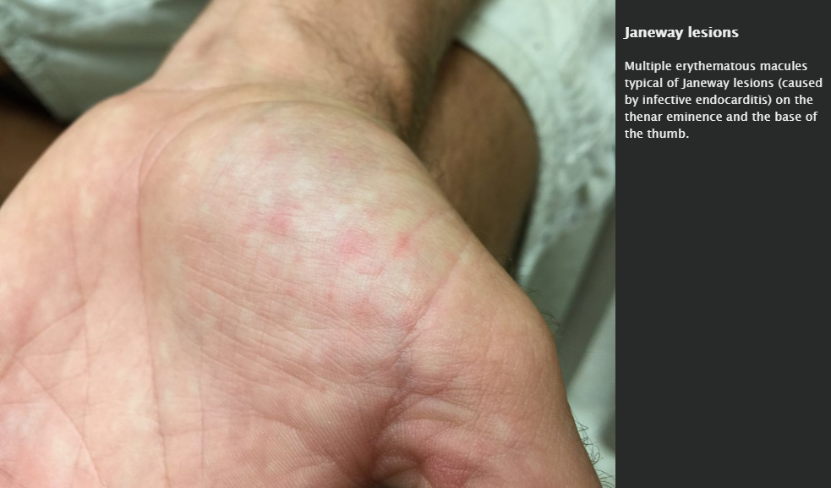

Slide 31
Diagnostics
Laboratory studies
Best initial test: blood cultures
Leukocytosis (with left shift), ↑ ESR, ↑ CRP

Slide 32
Echocardiography
Detects valve vegetations , new valvular regurgitation, abscess.
Transthoracic echocardiography (TTE) usually performed first (sensitivity: ∼ 75%)
Transesophageal echocardiography (TEE) higher sensitivity (> 90%) than TTE

Slide 33
(Modified) Duke criteria
The Duke criteria help to diagnose infective endocarditis. To confirm the diagnosis, one of the following requirements must be met:
  Two major criteria
  One major and three minor criteria
  Five minor criteria

Slide 34
Major diagnostic criteria
  Two separate blood cultures positive for typical pathogens (see “Etiology” above)
  Evidence of endocardial involvement in echocardiography
  A new valvular regurgitation (worsening of a pre-existing murmur is not sufficient)

Slide 35
Minor diagnostic criteria
  Predisposition: underlying heart disease or IV drug abuse
  Fever ≥ 38°C (100.4F)
  Vascular abnormalities
  Immunologic disorder
  Microbiology

Slide 36
Only negative findings on transesophageal echocardiography (TEE) can reliably rule out endocarditis, as transthoracic echocardiography (TTE) is not sensitive enough!

Slide 37
Pathology
Pathogenesis
Acute disease (leading to valve insufficiency, septic embolic infarcts, tendinous cord rupture)
  Erosion → fibrin deposits on valves
  Ulceration
  Perforation → adaptation of valve edges not possible

Slide 38
Chronic disease (leading to valve insufficiency and valve stenosis)
  Granulation tissue → valve scarring/fibrosis
  Calcification → thickened and/or shortened tendinous cords

Slide 39
Differential diagnoses
Nonbacterial thrombotic endocarditis
Rare, non-infectious form of endocarditis due to sterile platelet thrombus formation on the heart valves (usually aortic and mitral valves)
Most commonly associated with underlying malignancy, hypercoagulable states, or rheumatologic conditions (SLE, rheumatoid arthritis, etc.)

Slide 40
Compared to infectious endocarditis, vegetations are easily dislodged and embolization is common; most patients are asymptomatic until embolization occurs
Definitive diagnosis can only be made pathologically: shows vegetations on either surface of the valve that are composed of immune complexes.
Libman-Sacks endocarditis: describes especially large vegetations, also referred to as verrucous vegetations

Slide 41
Prosthetic valve thrombosis
Etiology
  Occurs if insufficient anticoagulatory therapy after valve replacement
  Usually affects mechanic valves
  Rare if anticoagulation is adequate

Slide 42
Clinical course of prosthetic valve thrombosis
  Signs of acute heart failure
    Left heart failure: dyspnea and cough
    Right heart failure: edema and jugular venous distention
  Deterioration of general condition, cardiac arrhythmias, cerebral emboli (stroke)

Slide 43
Diagnostics: transesophageal echocardiography
Treatment: anticoagulation and fibrinolysis, surgical valve replacement

Slide 44
Treatment
Empirical therapy
Condition/Patient group | Antibiotic therapy
Native valves | Initial intravenous empiric antibiotic treatment with vancomycin → adapt intravenous antibiotics according to resistogram results from blood cultures The duration of treatment depends on the patient's profile, and the patient's response to treatment. 4-week treatment Drug of choice: penicillin G Alternatives: ampicillin, IV ceftriaxone, IV vancomycin 2-week treatment regimens Drug of choice: gentamicin + penicillin G Alternative: gentamicin + ceftriaxone

Slide 45
Condition/ Patient group | Antibiotic therapy
Prosthetic valves | Generally the same antibiotic regimen as for native valves, but longer duration (at least 6 weeks) Exceptions for staphylococci Methicillin-susceptible: nafcillin (or oxacillin, cefazolin) + rifampin + gentamicin Methicillin-resistant: vancomycin + rifampin + gentamicin

Slide 46
Condition/ Patient group | Antibiotic therapy
IV drug users | Intravenous empiric antibiotic treatment with vancomycin After confirmation of a susceptible pathogen IV nafcillin (2 weeks) PO cloxacillin (2 weeks)
Indications for surgery: congestive heart failure, uncontrolled infection, systemic embolization, prosthetic valve, fungal endocarditis

Slide 47
If infective endocarditis is suspected:
1. Obtain blood cultures → 2. Start empiric antibiotic therapy immediately → 3. Adapt the therapy according to culture results

Slide 48
Targeted therapy
HACEK organisms
Drug of choice
  First-line: 3rd or 4th generation IV cephalosporin (e.g., ceftriaxone, cefotaxime)
  Second-line : IV fluoroquinolone

Slide 49
Duration of therapy
  Native valve infectious endocarditis: 4 weeks
  Prosthetic valve endocarditis: 6 weeks

Slide 50
Prevention
Endocarditis prophylaxis:
Indicated for high-risk patients undergoing procedures with risk of bacteremia
Regimens
  Usually PO 2g amoxicillin (administer 1 hour before procedure)
  Patients who are unable to take oral medication: IV ampicillin
  Patients with penicillin allergy: PO clarithromycin or azithromycin

