Slide 1
Peripheral arterial disease
(PAD)
Dr. Jamal Dabbas
Interventional cardiologist & internist

Slide 2
Summary
Peripheral arterial disease (PAD) is characterized by narrowing and, in final stages, occlusion of the peripheral arteries due to atherosclerotic plaques. Smoking is the most important risk factor for developing PAD.

Slide 3
PAD is often a silent disease, but patients may present with features of arterial insufficiency (intermittent claudication, reduced temperature and pulse rate in affected limb, skin discoloration, and trophic changes). On occasion, critical limb ischemia is the only presenting complaint. Segmental blood pressures and pulse volume recordings, particularly the ankle-brachial index (ABI), may support the diagnosis.

Slide 4
Further imaging may confirm and assess the location and severity of arterial stenosis or occlusion. Treatment focuses on smoking cessation, graduated exercise, avoiding extremely cold temperatures, and modifying other cardiovascular risk factors. If conservative treatment fails, interventional and surgical management is recommended for low-risk patients with potential long-term success.

Slide 5
Epidemiology
Prevalence:
  Prevalence increases with age, starting from the age of 40
Peak incidence: 60–80 years of age
Sex: ♂ = ♀

Slide 6
Etiology
Insufficient tissue perfusion due to atherosclerosis in the aorta and peripheral arteries
Often coexists with coronary artery disease (CAD), stroke, atrial fibrillation, and renal disease
See risk factors for atherosclerosis

Slide 7

PAD usually coexists with coronary artery disease. Smoking is the most important risk factor for PAD!

Slide 8
Classification
Fontaine Classification of PAD
Stage I | Asymptomatic PAD
Stage II | Pain on exertion IIa: claudication at a walking distance > 200 m IIb: claudication walking distance < 200 m
Stage III | Ischemic pain at rest
Stage IV | Necrosis/gangrene/ulcers IVa: dry necrosis, trophic disorders IVb: infection of necrotic tissue, humid gangrene

Slide 9
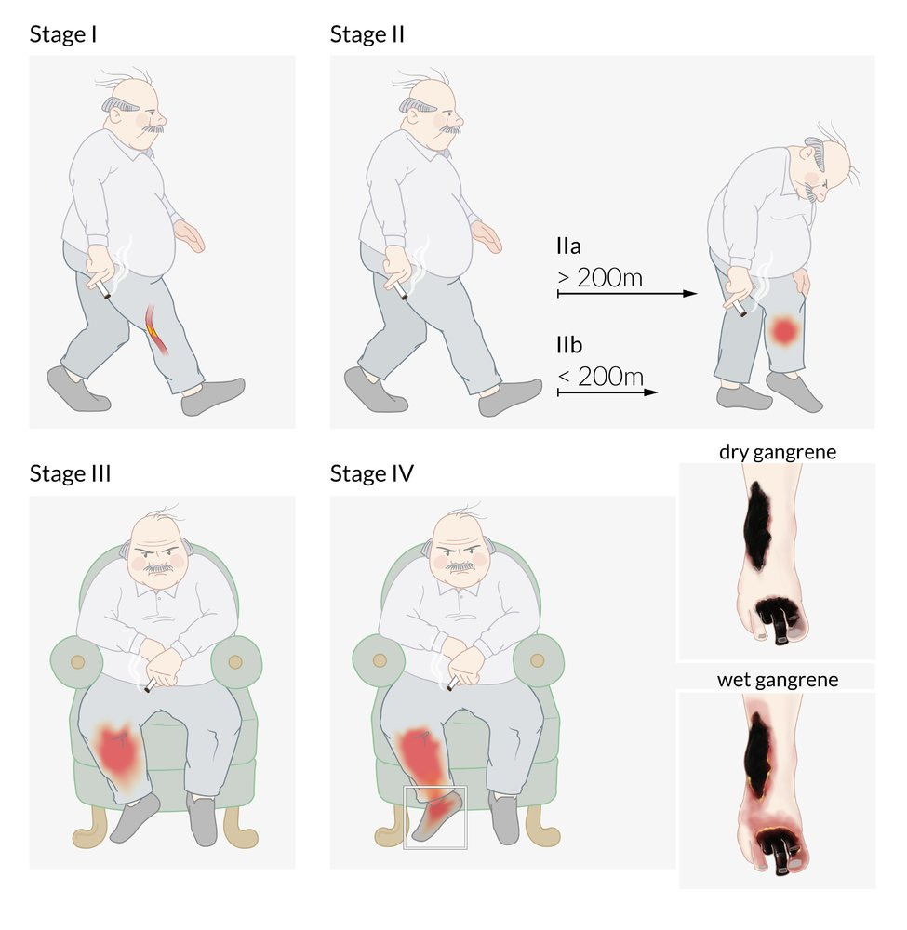

Slide 10
Clinical features
Characteristic features | Description
Silent disease | Up to 20–50% of patients with PAD are asymptomatic!
Intermittent claudication (10–35% of patients) | Pain, cramps, or paresthesia distal to arterial occlusion Femoropopliteal disease (most common) → calf claudication Aortoiliac disease (Leriche's syndrome) Level of the aortic bifurcation or bilateral occlusion of the iliac arteries Triad of bilateral buttock, hip, or thigh claudication; erectile dysfunction; and absent/diminished femoral pulses Tibiofibular disease→ foot claudication Worsens upon exertion , completely relieved by rest or lowering affected limbs Reproducible when the patient is asked to walk the same distance as when he/she was symptomatic

Slide 11
Characteristic features | Description
Absent or diminished pulses | Brachial artery Radial artery Femoral artery Popliteal artery Posterior tibial artery Dorsalis pedis artery

Slide 12
Characteristic features | Description
Trophic changes | ↓ Skin temperature ↓ Perspiration ↓ Hair on legs Brittle nails, ↓ nail growth Atrophied muscles Dry atrophic, shiny skin and/or bluish skin discoloration Skin pallor when limb is elevated and reactive hyperemia of dependency → Buerger test for examination Livedo reticularis (advanced disease) Gangrene, ulcers, necrosis (end-stage disease): also “Arterial ulcer”

Slide 13
Characteristic features | Description
Rest pain | Typically in distal metatarsals Worse at night Improved when hanging feet over bed or standing

Slide 14
Characteristic features | Description
Critical limb ischemia | The presence of any one of the following: Resting pain Ulcer Tissue loss (gangrene) Indicative of limb-threatening arterial occlusion

Slide 15
A bruit, suggestive of arterial stenosis, may be heard in > 60–70% of cases with PAD!

Slide 16
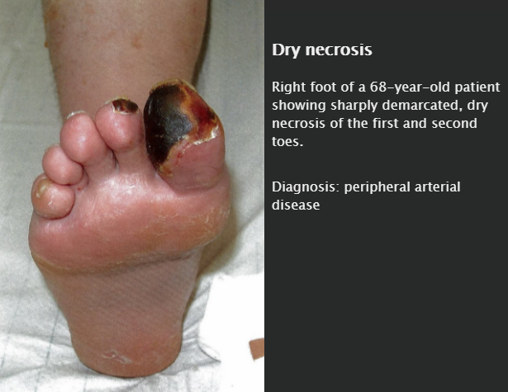

Slide 17
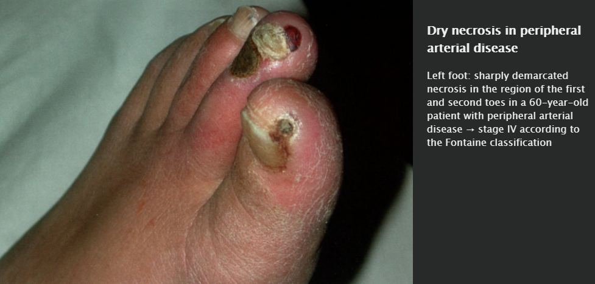

Slide 18
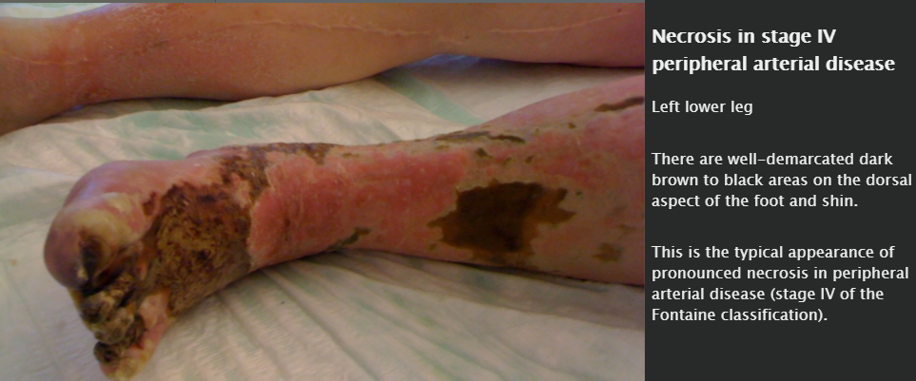

Slide 19
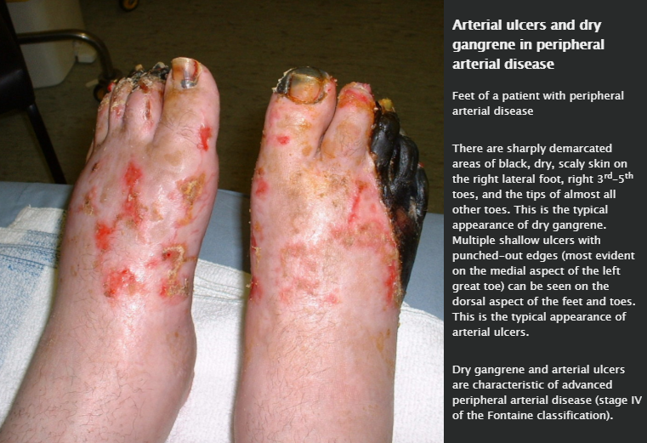

Slide 20
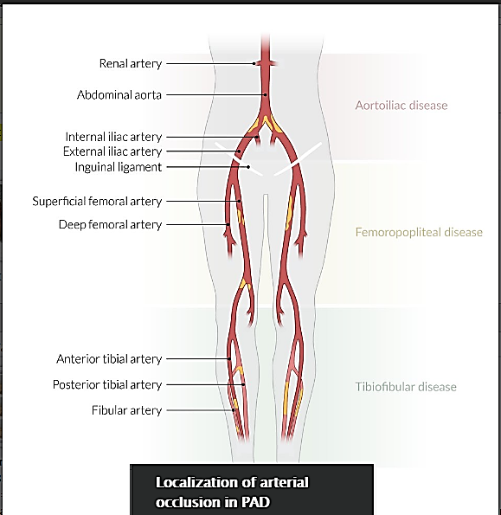

Slide 21
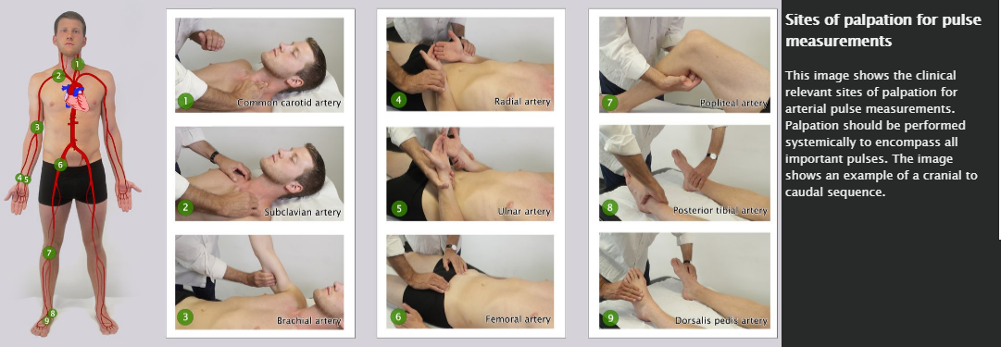
Ankle-brachial index (ABI)

Slide 22
ABI is the ratio of systolic ankle blood pressure (BP) to systolic brachial BP
Normally, ankle BP and brachial BP are equal (ABI = 1), or ankle BP is only slightly higher because of gravity (ABI ≥ 0.9)

Slide 23
Imaging
While vascular imaging is not necessarily required for diagnosis, it is useful to determine the site and severity of arterial stenosis or occlusion (especially preoperatively and postoperatively)
Color-coded duplex ultrasonography
Digital subtraction angiography (DSA): gold standard
CT angiography
MR angiography

Slide 24
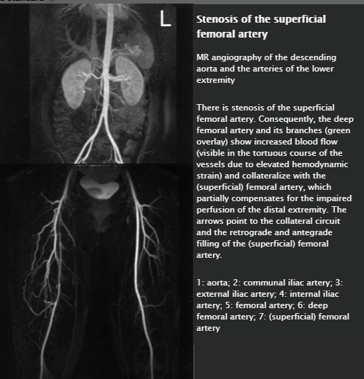

Slide 25
Differential diagnoses
Differential diagnosis of claudication
 |  |  | Patient characteristics | Clinical Features
Causes of arterial occlusion | Vasculitides | Takayasu's disease | Asian females 15–45 years | Fever, malaise, arthralgia Syncope, angina pectoris Impaired vision
 |  | Obliterating thromboangiitis | 20–40 years | Migratory thrombophlebitis Intermittent claudication, often limited to feet, calves and/or hands Raynaud's syndrome

Slide 26
Differential diagnosis of claudication
 |  | Patient characteristics | Clinical Features
Causes of arterial occlusion | (Lower-extremity) Fibromuscular dysplasia | Middle-aged women | Gradual onset of symptoms Rarely affects the extremities, leading to intermittent claudication, critical limb ischemia, and blue toe syndrome
 | Atherosclerosis | Similar risk factors as PAD | Chronic lower limb ischemia may manifest like PAD Acute limb ischemia → 6 Ps Blue toe syndrome: small vessel occlusion caused by embolus

Slide 27
Differential diagnosis of claudication
 |  | Patient characteristics | Clinical Features
Causes of arterial occlusion | Arterial embolism | Young patients without atherosclerotic risk factors | Sudden onset of symptoms 6 Ps

Slide 28
Differential diagnosis of claudication
 |  | Patient characteristics | Clinical Features
Mimics of arterial occlusion | Deep vein thrombosis | > 60 years old History of immobilization, obesity, hereditary thrombophilia or malignancy | Swelling Warmth Erythema Progressive tenderness Dull pain: worsened by walking, improved by resting
 | Spinal stenosis | Middle-aged to older patients | Bilateral neurogenic claudication
 | Diabetic neuropathy | Middle-aged to older patients High BMI | Progressive symmetrical loss of or abnormal sensation in the distal lower extremities (glove and stocking sensation) Normal ABI Neuopathic diabetic foot: warm, dry skin, palpable foot pulses

Slide 29
Treatment
Conservative
Smoking cessation!
Supervised graded exercise therapy
Foot care (especially in diabetic patients)
Avoid cold temperatures

Slide 30
Medical therapy
Modify cardiovascular risk factors: see therapy of atherosclerotic disease
  Antiplatelet therapy reduces morbidity and mortality
    Aspirin: irreversible cyclooxygenase inhibition → decreased thromboxane A2 synthesis → decreased platelet aggregation
    ADP receptor inhibitors
      Clopidogrel: inhibition of the P2Y₁₂ ADP receptor → decreased platelet activation and platelet-fibrin crosslinking
      Ticagrelor: reversible inhibition of the P2Y₁₂ ADP receptor (otherwise identical downstream effects as clopidogrel)
  Lipid-lowering agent (usually statins)
  Antihypertensive treatment
  Hyperglycemia control

Slide 31
PDE inhibitors
  Cilostazol: two beneficial mechanisms
    Phosphodiesterase 3 (PDE3) inhibition → increased cAMP → increased activity of protein kinase A → reduced platelet aggregation
    Myosin light chain kinase inhibiton → vascular smooth muscle relaxation → arterial vasodilation

Slide 32
Revascularization
Indications
  Critical limb ischemia
  Failure of conservative and pharmacologic treatment
  Inability to perform normal work or activities because of claudication

Slide 33
Minimally invasive interventional radiology: percutaneous transluminal angioplasty (PTA) with or without stenting
Surgical procedures
  Operative vascular reconstruction (bypass surgery): an autologous vein (e.g., great saphenous vein) is used to bypass the stenosis
  Endarterectomy

Slide 34
Amputation
Last resort in the event of gangrene

Slide 35
Complications
Arterial ulcer
  Definition: skin defect due to impaired blood flow to the lower extremities
  Etiology: most often seen in peripheral arterial disease
  Clinical features
    Punched-out ulcer with well-defined borders
    Usually involves the foot, particularly pressure points (e.g., lateral malleolus, tips of the toes)
    Often severe pain
  Differential diagnosis: venous ulcer

Slide 36
Infection of ulcers; sepsis
Acute limb ischemia

Slide 37
Prognosis
Intermittent claudication → good prognosis
Rest pain and/or ischemic ulcers → poor prognosis
Increased cardiovascular mortality → high risk for secondary MI or stroke

Slide 38
A low ABI in PAD is also predictive of an increased risk of all-cause and cardiovascular mortality!

Slide 39
Prevention
Primary and secondary prevention of atherosclerosis

