Slide 1
Valvular heart diseases
Dr. Jamal Dabbas
Interventional cardiologist & internist

Slide 2
Summary
Valvular heart diseases can take the form of stenosis, insufficiency (regurgitation), or a combination of the two. These defects are typically acquired as the result of infections, underlying heart disease, or degenerative processes. However, certain congenital conditions can also cause valvular heart diseases.

Slide 3
Acquired defects are found primarily in the left heart as a result of higher pressure and mechanical strain on the left ventricle.
Valvular stenosis leads to a greater pressure load and concentric hypertrophy, while insufficiencies are characterized by volume overload and an eccentric hypertrophy of the preceding heart cavities.

Slide 4
Diagnostic procedures typically include ECGs, chest x-ray, and echocardiograms. Management consists of interventional or surgical procedures to reconstruct or replace valves, as well as medical treatment of possible heart failure.

Slide 5
Epidemiology
Aortic stenosis
  Most common valve defect in industrialized countries
  Mostly degenerative
Aortic regurgitation
  Onset at 40–60 years
  Severity increases with age

Slide 6
Mitral stenosis: symptom onset at 20–30 years
Mitral regurgitation
  Second most common valve defect
  More common in women
Tricuspid valve defects occur in < 1% of the population
Pulmonary valve defects rare outside of congenital conditions

Slide 7
Etiology
Valvular heart defects may either be acquired or congenital. Acquired defects are more common and typically occur secondary to infections (postinflammatory), degenerative processes, or heart disease.

Slide 8
 |  | Valve stenosis | Valve regurgitation
Left heart | Mitral valve | Rheumatic fever Rheumatic diseases (e.g., SLE, RA) | Mitral valve prolapse Dilated cardiomyopathy Ischemic heart disease (e.g., following myocardial infarction) Degenerative calcification
 | Aortic valve | Degenerative calcification (most common) Rheumatic endocarditis Congenital (e.g., unicuspid, bicuspid, or hypoplastic valve) | Acute: infective endocarditis, aortic dissection type A, chest trauma Chronic Bicuspid aortic valve Connective tissue diseases (e.g., Marfan syndrome, Ehlers-Danlos syndrome) Rheumatic fever Rheumatic diseases (e.g., Behcet's disease, RA, SLE)

Slide 9
 |  | Valve stenosis | Valve regurgitation
Right heart | Tricuspid valve | Rheumatic fever Infective endocarditis (mostly IV drug abuse) | Right ventricular dilation (e.g., in right-sided heart failure) Infective endocarditis (IV drug use) Rheumatic fever Connective tissue diseases (e.g., Marfan syndrome)
 | Pulmonary valve | Congenital | Pulmonary hypertension ”PHTN “ (primary- e.g., tetralogy of Fallot, ventricular septal defects, or secondary PHTN)

Slide 10
Clinical features
All valvular defects can eventually lead to symptoms of heart failure as a result of excessive strain on the ventricles.
Aortic stenosis
Aortic regurgitation
Mitral stenosis
Mitral regurgitation

Slide 11
Auscultation in valvular defects
 | Maximum point | Murmur | Characteristics
Aortic stenosis | Aortic valve (parasternal 2nd right intercostal space) Erb's point | Harsh crescendo-decrescendo systolic ejection murmur | Radiation into the carotids Possibly ejection click
Aortic regurgitation | Aortic valve (parasternal 2nd right ICS) Erb's point | Diastolic murmur with a decrescendo Possible additional quiet systolic murmur | Immediately following the 2nd heart sound (“immediate diastolic murmur”) Austin Flint Murmur

Slide 12
Auscultation in valvular defects
 | Maximum point | Murmur | Characteristics
Mitral stenosis | Heart apex (midclavicular 5th left ICS) | Delayed diastolic murmur with a decrescendo with presystolic accentuation | “Tympanic” 1st heart sound Mitral opening murmur/opening snap (OS)
Mitral valve prolapse | Heart apex (midclavicular 5th left ICS) | Late-systolic crescendo | Mid-systolic high-frequency click

Slide 13
Auscultation in valvular defects
 | Maximum point | Murmur | Characteristics
Mitral regurgitation | Heart apex (midclavicular 5th left ICS) Left axilla | Holosystolic murmur 3rd heart sound audible Quiet 1st heart sound | Blowing Radiation into the axilla
Pulmonary stenosis | Pulmonary valve (parasternal 2nd left ICS) | Crescendo-decrescendo ejection systolic murmur | Possible radiation into the back Possible early systolic pulmonary ejection click and/or widely split 2nd heart sound

Slide 14
Auscultation in valvular defects
 | Maximum point | Murmur | Characteristics
Pulmonary regurgitation | Pulmonary valve (parasternal 2nd left ICS) | Diastolic murmur with a decrescendo | Graham Steel murmur: high-frequency decrescendo diastolic murmur
Tricuspid stenosis (extremely rare) | Tricuspid valve (parasternal 4th left ICS) | Delayed diastolic murmur with a decrescendo Possible pre-systolic crescendo

Slide 15
Auscultation in valvular defects
 | Maximum point | Murmur | Characteristics
Tricuspid regurgitation (extremely rare) | Tricuspid valve (parasternal 4th left ICS) | Holosystolic murmur | Augmentation of the murmur's intensity with inspiration (Carvallo's sign)

Slide 16
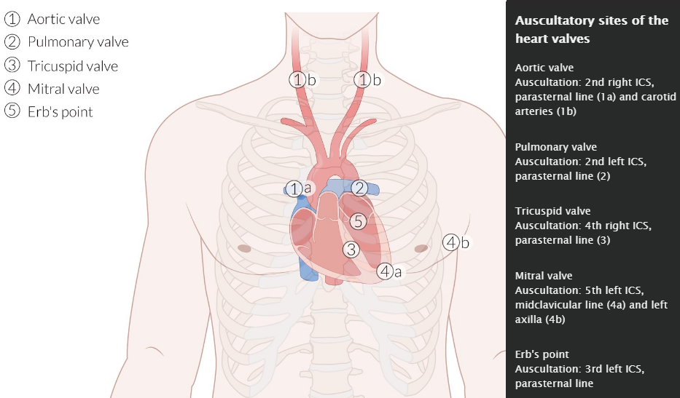

Slide 17
Treatment
Symptomatic
Treatment of heart failure
Endocarditis prophylaxis
Prevention of thromboembolism (if necessary)

Slide 18
Valve reconstruction (annuloplasty)
  Procedure: ring-shaped device attached to the outside of the valve opening to re-establish shape and function of valve
  Reduced thromboembolic risk compared to mechanical valve replacement; but high risk of recurring stenosis
  Lower mortality rate than valve replacements, though replacements are more durable

Slide 19
Prosthetic heart valve
 | Mechanical prosthetic valve | Biological prosthetic valve
Pros | Valve has a long lifespan | Anticoagulation only necessary for 3 months post operation

Slide 20
Prosthetic heart valve
 | Mechanical prosthetic valve | Biological prosthetic valve
Cons | Life-long anticoagulation necessary (warfarin, aspirin) | Short lifespan due to sclerotic degeneration May need to be replaced every ten years

Slide 21
Prosthetic heart valve
 | Mechanical prosthetic valve | Biological prosthetic valve
Indications | Younger patients Previously anticoagulated patients (e.g., with pre-existing atrial fibrillation) | Older patients Patients with a high risk of bleeding Women with a desire to have children

Slide 22
Interventional procedures via catheter
  Valve replacement, e.g., transcatheter aortic valve replacement (TAVR) or transcatheter mitral valve replacement (TMVR)
Percutaneous balloon valvuloplasty for stenoses

Slide 23
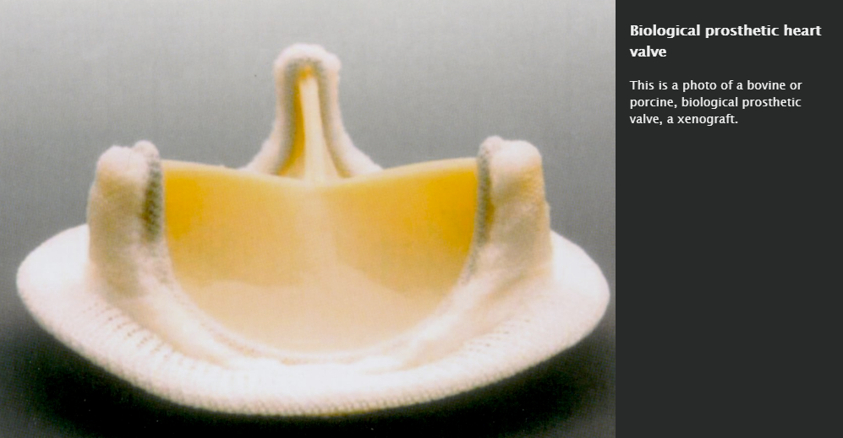

Slide 24
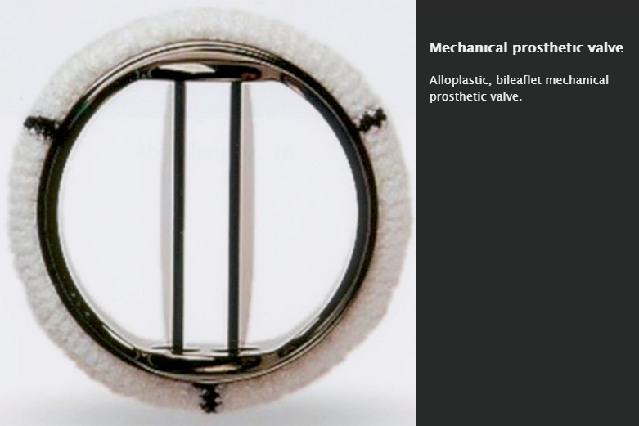

Slide 25
Aortic valve stenosis

Slide 26
Summary
Aortic stenosis (AS) is a valvular heart disease characterized by narrowing of the aortic valve. As a result, the outflow of blood from the left ventricle into the aorta is obstructed. This leads to chronic and progressive excess load on the left ventricle and potentially left ventricular failure.

Slide 27
The patient may remain asymptomatic for long periods of time; for this reason, AS is often detected late, i.e., when it first becomes symptomatic (dyspnea on exertion, angina pectoris, or syncope). Auscultation reveals a harsh, crescendo-decrescendo murmur in systole that radiates to the carotids, and pulses are delayed with diminished carotid upstrokes.

Slide 28
Echocardiography is the gold standard for diagnosis. Patients with asymptomatic aortic stenosis are treated conservatively. Symptomatic patients or those with severe aortic valve stenosis require valve replacement.

Slide 29
Epidemiology
Most common valvular heart disease in industrialized countries
Prevalence:
  Increases with age
  May reach up to 12.4% among individuals ≥ 75 years

Slide 30
By etiology
Congenital:
  Bicuspid aortic valve: Caused by a fusion of two of the three aortic-valve leaflets in utero
    Most common congenital heart defect, 3:1 ♂ predominance
    Predisposes the valve to dystrophic calcification and degeneration
    Patients present with symptoms of aortic stenosis earlier than in regular aortic valve calcification

Slide 31
Acquired
  Calcific aortic stenosis: most common cause of aortic stenosis
    Characterized by calcification and fibrosis of aortic valve leaflets that occur at an increasing rate as patients age (prevalence is 65% in those aged 75–84 years)
    Similar pathophysiology to atherosclerosis (see generic risk factors for development of arteriosclerosis)
  Rheumatic fever is a rare cause of AS in developed countries, but continues to remain a significant cause in developing countries.

Slide 32
Pathophysiology
Narrowed opening area of the aortic valve during systole → obstruction of blood flow from left ventricle (LV) → increased LV pressure → left ventricular concentric hypertrophy →
  Increased LV oxygen demand
  Impaired ventricular filling during diastole → left heart failure
  Reduced coronary flow reserve
Initially, cardiac output (CO) can be maintained. Later, the decreased distensibility of the left ventricle reduces cardiac output and may then cause backflow into the pulmonary veins and capillaries → higher afterload (pulmonic pressure) on the right heart → right heart failure ( congestive heart failure)

Slide 33
Clinical features
The disease may remain asymptomatic for years (particularly with mild or moderate stenosis).
Symptoms typically present on exertion, unless AS is severe
Dyspnea
Angina pectoris
Dizziness and syncope
Small blood pressure amplitude, decreased pulse pressure

Slide 34
Cardiac exam ( cardiovascular examination)
  Delayed and weak pulse (Pulsus parvus et tardus)
  Palpable systolic thrill over the bifurcation of the carotids and the aorta

Slide 35
Harsh crescendo-decrescendo (diamond-shaped), late systolic ejection murmur that radiates bilaterally to the carotids
  Best heard in the 2nd right intercostal space
  Hand grip decreases the intensity of the murmur.
  Valsalva and standing from squatting decreases or does not change the intensity of the murmur (in contrast to hypertrophic cardiomyopathy).

Slide 36
  Soft S2
  S4 is best heard at the apex.
  Early systolic ejection click
  Frequently associated with aortic regurgitation (see diagnosis of aortic regurgitation)
Additional signs specific to infants: wheezing and difficulty feeding

Slide 37

SAD (syncope, angina, dyspnea)

Slide 38

Without definite treatment (surgery), more than 50% of the symptomatic patients with severe aortic stenosis will die within the first 2 years of diagnosis!

Slide 39
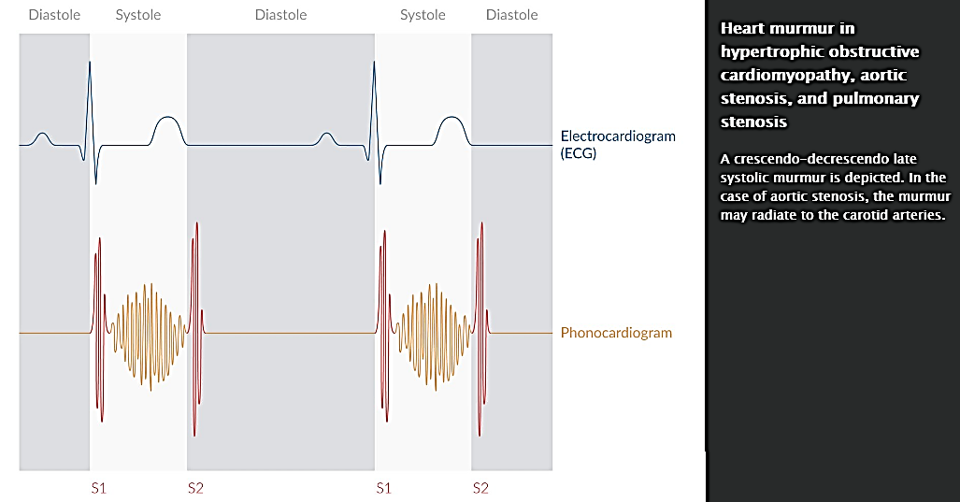

Slide 40
Diagnostics
ECG
  Nonspecific for AS
  Signs of left ventricular hypertrophy (e.g., left axis deviation, positive Sokolow-Lyon index)

Slide 41
Chest x-ray
  Findings of left ventricular hypertrophy, such as left ventricular enlargement and rounded heart apex, usually only in decompensated aortic stenosis, and possibly left atrial enlargement as well
  Narrowing of retrocardiac space (lateral view)
  Calcification of aortic valve: signs of more severe disease

Slide 42
Echocardiography
  Transthoracic (TTE) or transesophageal (TEE): preferred primary test and noninvasive gold standard
    Findings include concentric hypertrophy, narrowing of the opening of the aortic valve, and increased mean pressure gradient across the aortic valve.
    Also utilized to determine the severity of stenosis by parameters such as the mean gradient and cross-sectional area of the opening of the valve

Slide 43
Left-heart catheterization
  Definitive diagnostic test
  Indication: inconclusive echocardiogram
  Risk of cerebral embolization

Slide 44
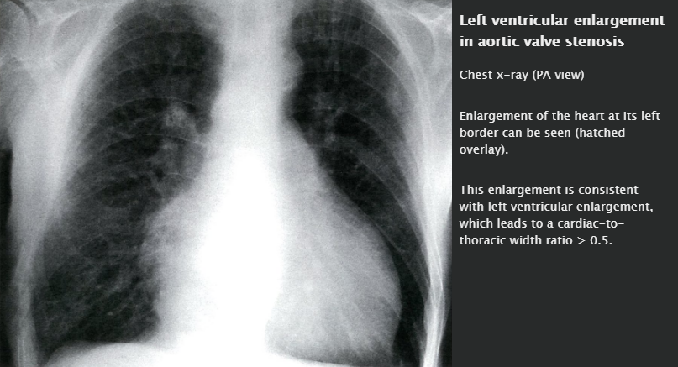

Slide 45
Treatment
Conservative management: regular follow-ups indicated for asymptomatic patients with mild aortic stenosis

Slide 46
Surgical ( heart valve prostheses)
  Indications
    Symptomatic patients
    Asymptomatic patients with severe AS and either significantly ↓ LV EF

Slide 47
  Aortic valve replacement (AVR): 3 possible approaches
    Surgical AVR: patients with low surgical risk.
    Transcatheter AVR (TAVR): patients with high surgical risk or contraindication
    Catheter balloon valvuloplasty: children without AV calcification

Slide 48

The presence of exertional symptoms (dyspnea on exertion, angina pectoris, syncope) is an indication for surgery!

Slide 49
Prognosis
Asymptomatic patients: The mortality rate is < 1% in a given year.
Symptomatic patients: The mortality rate in the first 2 years is > 50%.

Slide 50
Patients with severe AS have fixed cardiac output and fixed afterload, besides being preload dependent. So AF if develops in severe AS patients it will have deleterious effects in these patients .

Slide 51
ACE inhibitors and other afterload-reducing drugs (calcium channel blockers and ACE inhibitors / or ARBs ) are contraindicated because they cause dilation of peripheral blood vessels, which may lead to cardiovascular decompensation!
Besides diuretics and hydralazine slould be given cautiously in these patients .

Slide 52
Aortic regurgitation
(Aortic insufficiency)

Slide 53
Summary
Aortic regurgitation (AR) is a valvular heart disease characterized by incomplete closure of the aortic valve that leads to reflux of blood from the aorta into the left ventricle (LV) during diastole

Slide 54
Aortic regurgitation may be acute (occurring primarily after bacterial endocarditis or aortic dissection) or chronic (due to congenital bicuspid valve or rheumatic fever) and may be caused by valvular disease or an abnormality of the aorta. In most cases, acute AR leads to rapid deterioration of LV function with subsequent pulmonary edema and cardiac decompensation.

Slide 55
Frequently, chronic AR may remain compensated for a long period of time, becoming symptomatic only when left heart failure develops. Auscultation reveals an S3 and a high-pitched, decrescendo early diastolic murmur. Another characteristic diagnostic finding is widened pulse pressure.

Slide 56
Echocardiography is the most important diagnostic tool, both for confirming the diagnosis and determining the severity of disease. In asymptomatic patients, conservative treatment consists of symptom management and physical activity as tolerated. However, symptomatic patients or those with severely reduced LV function should undergo surgical aortic valve replacement.

Slide 57
Etiology
Acute AR
  Infective endocarditis
  Aortic dissection (ascending aorta)
  Chest trauma

Slide 58
Chronic AR
  Congenital bicuspid valve: most common cause of AR in young adults and in developed countries
  Rheumatic heart disease: most common cause of AR in developing countries
  Distortion or dilation of the ascending aorta and aortic root
    Connective tissue disorders (e.g., Marfan syndrome, Ehlers-Danlos syndrome)
    Tertiary syphilis

Slide 59
Pathophysiology
General
  Regurgitation of blood from the aorta into the left ventricle (LV)
    → Increased systolic blood pressure and decreased diastolic pressure
    → Widened pulse pressure → water hammer pulse ( “Diagnostics” below)

Slide 60
Acute AR
  Because LV cannot sufficiently dilate in response to regurgitant blood, LV end-diastolic pressure increases rapidly → pressure transmits backwards into pulmonary circulation → pulmonary edema and dyspnea
  Decreased cardiac output if severe → cardiogenic shock and myocardial ischemia

Slide 61
Chronic AR:
  Initially, a compensatory increase in stroke volume can maintain adequate cardiac output despite regurgitation (compensated heart failure)
  Over time, increased left ventricular end-diastolic volume → LV enlargement and eccentric hypertrophy of myocardium → left ventricular systolic dysfunction → decompensated heart failure

Slide 62
Clinical features
Acute AR
  Sudden, severe dyspnea
  Rapid cardiac decompensation secondary to heart failure
  Pulmonary edema
  Symptoms related to underlying disease (e.g., fever due to endocarditis, chest pain due to aortic dissection)

Slide 63
Chronic AR
  May be asymptomatic for up to decades despite progressive LV dilation
  Palpitations
  Symptoms of left heart failure
    Exertional dyspnea
    Angina
    Orthopnea
    Easy fatigability
    Syncope
  Symptoms of high pulse pressure (e.g., head pounding, rhythmic nodding, or bobbing of the head in synchrony with heartbeats- de Musset sign)

Slide 64
Diagnostics
Physical examination
For detailed information about the individual tests, (cardiovascular examination).
High pulse pressure
  Water hammer pulse of peripheral arteries characterized by rapid upstroke and downstroke
  Pulsing of carotid arteries with rapid upstroke and downstroke
  Visible capillary pulse
  Nodding of the head with each pulse
Point of maximal impulse (PMI): displaced inferolaterally, diffuse, and hyperdynamic

Slide 65
Auscultation
  S3
  High-pitched, blowing, decrescendo early diastolic murmur
    AR due to valvular disease: best heard in the left third and fourth intercostal spaces and along the left sternal border
    AR due to aortic root disease (e.g., aortic dissection): best heard along the right sternal border
    Worsens with squatting and handgrip
  Austin Flint murmur (Apical mid-diastolic or presystolic murmur ).
  In more severe stages, possibly a harsh, crescendo-decrescendo mid-systolic murmur that resembles the ejection murmur heard in aortic stenosis

Slide 66
Confirmatory tests
Transthoracic echocardiogram (TTE)
  Indicated for suspected AR as well as to monitor confirmed AR to determine optimal timing of surgery
  Findings
    Abnormal valve leaflets
    Regurgitant AR jet on Doppler
    Increased LV size and volume
    LV ejection fraction < 55%
Transesophageal echocardiogram (TEE): indicated if suboptimal or nondiagnostic TTE

Slide 67
Screening tests (optional)
ECG
  Signs of left ventricular hypertrophy
Chest x-ray
  Prominent aortic root/arch
  Enlarged cardiac silhouette

Slide 68
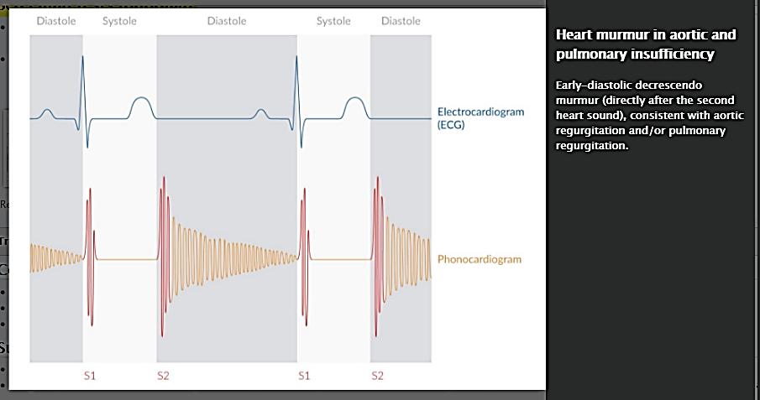

Slide 69
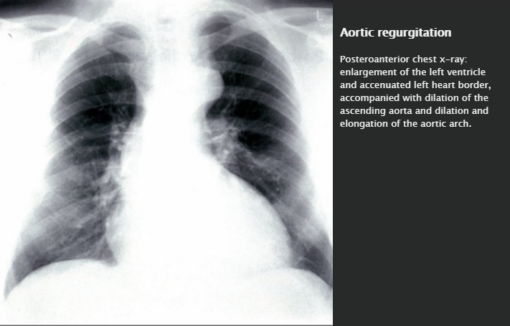

Slide 70
Treatment
Conservative
  Indication: asymptomatic patients and symptomatic patients who are not candidates for surgical treatment
  Treatment of heart failure
  Physical activity , but without excessive straining
  Remember that patients with severe AR are sensitive to bradycardia and drugs that cause bradycardia.

Slide 71
Surgical
  Indication: patients with acute severe AR and chronic AR with symptoms or with significantly reduced pump function
  Surgical procedure: aortic valve replacement (occasionally valve reconstruction is possible) and long-term anticoagulation therapy for mechanical valve

Slide 72
Prognosis
Asymptomatic patients with normal EF: progression to symptoms or LV dysfunction at a rate of < 6% per year
Asymptomatic patients with decreased EF: progression to symptoms at a rate of > 25% per year
Symptomatic patients: mortality rate is > 10% per year

Slide 73
Mitral valve stenosis

Slide 74
Summary
Mitral stenosis (MS) is a valvular anomaly of the mitral valve that leads to obstruction of blood flow into the left ventricle. The most common cause of MS is rheumatic fever. The clinical manifestations depend on the extent of stenosis: reduced mitral opening leads to progressive congestion behind the stenotic valve. Initial dilation of the left atrium (complications: atrial fibrillations, emboli) is followed by progressive congestion of the lungs and subsequent cardiac asthma (coughing, dyspnea).

Slide 75
Acute decompensation can cause pulmonary edema. Echocardiography is the main diagnostic tool for evaluating the mitral valve apparatus, left atrial size, and pulmonary pressure. In the event of high grade and/or symptomatic stenosis, percutaneous valvuloplasty or surgical valve replacement is often required.

Slide 76
Etiology
Most commonly due to rheumatic fever
Autoimmune diseases: systemic lupus erythematosus, rheumatoid arthritis
Congenital
Some conditions may mimic mitral stenosis: bacterial endocarditis of the mitral valve with large vegetation, left atrial myxoma

Slide 77
Pathophysiology
Mitral valve stenosis → obstruction of blood flow into the left ventricle (LV) → limited diastolic filling of the LV (↓ end-diastolic LV volume) → decreased stroke volume → decreased cardiac output (forward heart failure)
Mitral valve stenosis → increase in left atrial pressure → backup of blood into lungs → increased pulmonary capillary pressure → cardiogenic pulmonary edema → pulmonary hypertension → backward heart failure and right ventricular hypertrophy

Slide 78
Clinical features
Initially asymptomatic (onset ∼ 10 years after acute rheumatic carditis)
Dyspnea (paroxysmal nocturnal dyspnea) and orthopnea, especially when supine
Hemoptysis
Atrial fibrillation
Later stages: signs and symptoms of right-sided heart failure

Slide 79
Diagnostics
Auscultation ( auscultation in valvular defects)
  Diastolic murmur typically heard best at the 5th left intercostal space at the mid-clavicular line (the apex)
    Heard loudest when the patient is lying on his/her left side.
  Loud first heart sound (S₁)
  Opening snap of the mitral valve after S₂; shorter interval between opening snap and S₂ indicative of more severe disease, because left atrial pressure is greater than left ventricular end diastolic pressure (LVEDP)

Slide 80
Chest x-ray
  Posterior-anterior image
    LA enlargement with prominent left auricle (left atrial appendage) → straightening of the left cardiac border
    Signs of pulmonary congestion (see X-ray findings in pulmonary congestion)
  Lateral image
    Dorsal displacement of the esophagus (visible in barium swallow test)
    Signs of right ventricular hypertrophy

Slide 81
ECG
  P mitrale
  Atrial fibrillation
  Signs of right ventricular hypertrophy (Sokolow-Lyon index)

Slide 82
Echocardiography: most important diagnostic method for detecting and assessing valvular abnormalities
  Abnormal valve mobility
  Subvalvular thickening
  Leaflet thickening
  Calcification
Coronary angiography may be conducted prior to surgical interventions to assess the associated risk of coronary artery disease

Slide 83
Treatment
Conservative treatment
  Treatment of heart failure: only diuretics may be administered!
  Beta blockers or calcium channel blockers: ↓ heart rate and ↓ cardiac output
  Endocarditis prophylaxis ( “Infective endocarditis”)

Slide 84
  Remember that patients with severe MS are sensitive to tachycardias and drugs that cause it. So AF has deleterious effects in these patients.

Slide 85
Interventional
  Indication: high grade and/or symptomatic mitral stenosis
  First-line: percutaneous balloon commissurotomy of the mitral valve
  Alternatives: open commissurotomy and surgical valve replacement (mechanical prosthetic valve or biological prosthetic valve)

Slide 86
Complications
Atrial fibrillation → thromboembolic events
Progressive congestion of the lungs, pulmonary edema, pulmonary hypertension
Congestive heart failure
Enlarged left atrium (rare) → esophageal compression, recurrent laryngeal nerve palsy

Slide 87
Mitral regurgitation
(Mitral valve regurgitation)

Slide 88
Summary
Mitral regurgitation (MR) refers to the leakage of blood from the left ventricle to the left atrium due to incomplete closure of the mitral valve. The most common causes are primary diseases of the valve (e.g., mitral valve prolapse), although damage may also result secondary to other heart conditions such as left ventricular dilation and myocardial infarction.

Slide 89
Symptoms such as palpitations or dyspnea appear late in the course of chronic compensated MR in which cardiac output can still be maintained. In acute or chronic decompensated MR, pulmonary edema and pulmonary hypertension often cause dyspnea, coughing, jugular venous distention, and pitting edema.

Slide 90
Echocardiography is the most important diagnostic tool and allows for assessment of severity. It may also be used for preoperative evaluation. Treatment options include surgical mitral valve repair or replacement and percutaneous reconstruction. Early intervention is favored in most cases of MR with evidence of left ventricular dysfunction, regardless of symptoms.

Slide 91
Etiology
Primary MR
  Degenerative mitral valve disease (mitral valve prolapse, mitral annular calcification, ruptured chordae tendineae)
  Rheumatic fever
  Infective endocarditis

Slide 92
Secondary (functional) MR
  Coronary artery disease, prior myocardial infarction causing papillary muscle involvement
  Dilated cardiomyopathy and left-sided heart failure

Slide 93
Pathophysiology
Acute MR → ↑ LV end-diastolic volume → rapid ↑ LA and pulmonary pressure → pulmonary venous congestion → pulmonary edema
Chronic (compensated) MR: progressive dilation of the LV (via eccentric hypertrophy) → ↑ volume capacity of the LV (preload and afterload return to normal values) → ↑ end-diastolic volume → maintains ↑ stroke volume (normal EF)

Slide 94
Chronic (decompensated) MR: progressive LV enlargement and myocardial dysfunction → ↓ stroke volume → ↑ end-systolic and end-diastolic volume → ↑ LV and LA pressure → pulmonary congestion, possible acute pulmonary edema, pulmonary hypertension, and right heart strain

Slide 95
Clinical features
Acute mitral regurgitation
  Symptoms of left-sided heart failure
  Signs and symptoms of pulmonary edema
  Cardiogenic shock

Slide 96
Chronic mitral regurgitation: late onset of symptoms
  (Exertional) dyspnea, dry cough
  Palpitations
  Symptoms of left-sided heart failure

Slide 97
Diagnostics
Auscultation
  “Auscultation in valvular defects”
  Quiet first heart sound (S1)
  S3 gallop in advanced stages of disease
  Holosystolic murmur
    Radiates to the left axilla and heard loudest over the apex (5th ICS at the left mid-clavicular line)
    Intensity increases with increased systemic vascular resistance (hand grip, squatting)
  Cardiac impulse is often prominent

Slide 98
ECG
  Left cardiac hypertrophy and P mitrale
  Later, signs of right heart strain with P pulmonale
Chest X-ray
  Posterior-anterior image
    LV enlargement: laterally displaced left cardiac border
    LA enlargement: straightening of the left cardiac border
    Signs of pulmonary congestion in late stages of disease ( “X-ray findings in pulmonary congestion”)
  Lateral image: Narrowing of the retrocardiac space

Slide 99
Echocardiography: most important diagnostic method for detecting and assessing valvular abnormalities
  Valve apparatus (e.g., dimensions of valve opening area, calcification, rupture of the chordae tendineae) and mobility
  LV and LA size and function
Coronary angiography: prior to surgical intervention

Slide 100
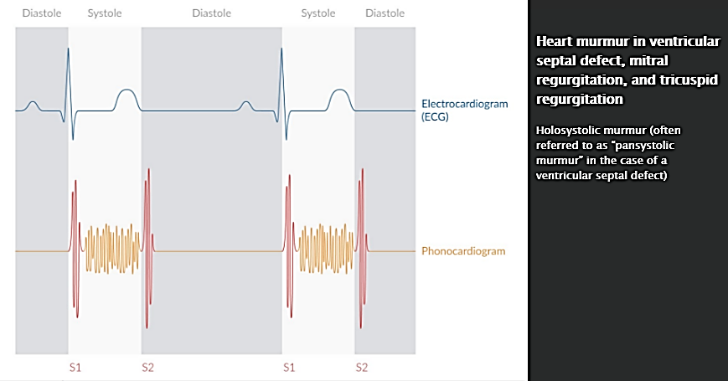

Slide 101
Myocardial infarction must be ruled out in patients presenting with acute MR!

Slide 102
Treatment
Acute mitral regurgitation
  Hemodynamic stabilization: diuretics, nitrates, antihypertensive drugs
  Intra-aortic balloon pump if pharmacologic management is insufficient
  Urgent surgical valve repair or replacement

Slide 103
Chronic mitral regurgitation
  Asymptomatic patients
    Without evidence of LV dysfunction (EF > 60%): conservative management (regular follow-ups, avoidance of physical exertion), management of underlying and/or secondary diseases
    With evidence of LV dysfunction (EF < 60%): early surgical valve repair or replacement

Slide 104
  Symptomatic patients
    Without evidence of severe LV dysfunction (EF > 30%): early valve repair or replacement (mechanical prosthetic valve or biological prosthetic valve)
    With severe LV dysfunction (EF < 30%): surgical valve repair or replacement only if the patient is hemodynamically stable ;
    Alternatives for severe LV dysfunction:
      Percutaneous reconstruction
      Medical management of heart failure

Slide 105
Complications
Heart failure, cardiac decompensation, and pulmonary edema
Atrial fibrillation and arterial emboli
Endocarditis

